Slide 1

CLHO Healthy Structure Committee Retreat
December 9th, 2014
Portland State Office Building
Room 1E

Slide 2
Conference of Local Health Officials Committee Structure & Roles

Slide 3
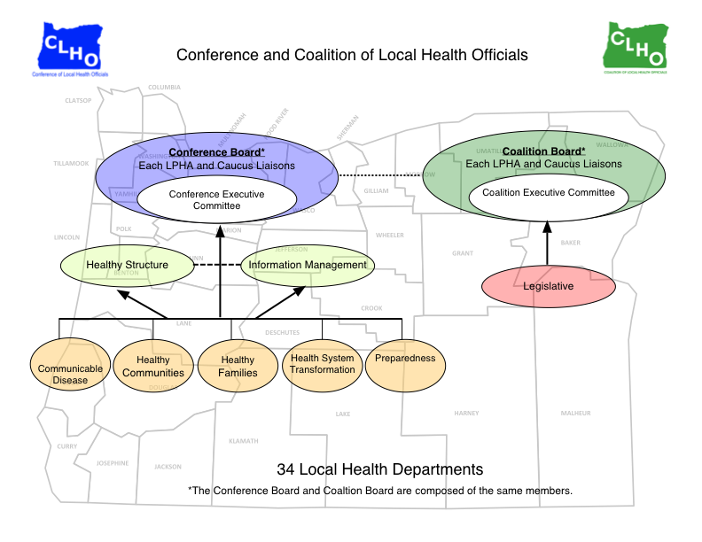

Slide 4
Conference of Local Health Officials
ORS 435.330 Conference of Local Health Officials- “shall consist of all local health officers and public health administrators and such other local health personnel as may be included by the rules of the conference
ORS 431.340 – 431.345 - The Conference may submit to the Oregon Health Authority such recommendations on the rules and standards for:
Minimum Standards for financial assistance
Notes:
The Conference bylaws have organized the Conference to include a vote for each Local Public Health Administrator, a representative of each caucus (Health Officers, Public Health Administrators, Environmental Health Specialists and Public Health Nursing Supervisors), and the CLHO Executive Committee (which can be elected from general membership, not just board members).
Minimum Standards:
To include education and organization, operation and extent of activities, which are required or expected of local health departments to carry out their responsibilities in implementing the public health laws of the state.

Slide 5
Committee Issues
Three major buckets of issues that should come from committees to the full Conference Board:
Recommendations on funding,
Changes to program elements,
Substantive changes

Slide 6
Changes in Funding
Funding changes:
Change in funding formula
Applying for new funding stream
A pilot of funding
Issue area committees discuss changes with PHD and make recommendations to Healthy Structure
CLHO Healthy Structure makes final recommendations to Conference Board

Slide 7
Program Element Changes
If not in agreement: The committee’s role is to review PE changes and make recommendations to PHD
If in agreement: The committee’s role is to the Conference Board to accept the changes

Slide 8
Substantive Changes
Issues that do not fall into PEs and Funding Changes that need approval by CLHO Board
Examples could include:
Data information
Data systems

Slide 9
Future of Public Health Recommendations & Next Steps

Slide 10
HB 2348 Background
Introduced in 2013; would have created eight public health regions
Amended to become a task force studying the future of public health services in Oregon and to make recommendations for legislation.
Report due to the Legislature Oct 1, 2014
Notes:
MC

Slide 11
Task Force Charge
Legislation requires the task force to focus
on recommendations that:
Create a public health system for the future
Explore the creation of regional structures
Enhance efficiency and effectiveness
Allow for appropriate partnerships with regional health care service providers and community organizations
Consider cultural and historical appropriateness
Are supported by best practices
Notes:
MC

Slide 13
Foundational Capabilities
Assessment & Epidemiology
Emergency Preparedness & Response
Communications
Policy & Planning
Leadership & Organizational Competencies
Health Equity & Cultural Responsiveness
Community Partnership Development

Slide 14
Foundational Programs
Communicable Disease Control
Environmental Health
Prevention and Health Promotion
Access to Clinical Preventive Services

Slide 15
Task Force Recommendations
The Foundational Capabilities and Programs should be adopted in order for Oregon’s public health system to function efficiently and effectively
Significant and sustained state funding be identified and allocated for proper operationalization of the Foundational Capabilities and Programs
Statewide implementation of the Foundational Capabilities and Programs will occur in waves over a timeline to be determined

Slide 16
Task Force Recommendations
Local public health will have the flexibility to operationalize the Foundational Capabilities and Programs through a single county structure; a single county with shared services; or a multi-county jurisdiction
Improvements and changes in the governmental public health system be structured around state and local metrics established and evaluated by the Public Health Advisory Board, which will report to the Oregon Health Policy Board

Slide 17
CLHO’s Recommendations
Endorse the Task Force on the Future of Public Health’s recommendations
Ensure a manageable timeline of 4 years for implementation of Foundational Capabilities and Programs
Retain shared governance between the state health division and local public health departments.

