Slide 1

Title V MCH Block Grant Needs Assessment Overview
CLHO Prevention & Health Promotion Sub-committee
Feb 7, 2019

Slide 2
MCH Title V Block Grant
MCH Title V Block Grant provides federal funds to improve the health of Oregon’s women, infants, children, adolescents, and children and youth with special health care needs.
States are required to:
Conduct a 5-year needs assessment
Choose among 15 national priority areas/performance measures; plus state-specific priorities
Develop strategies and measures to “move the needle” on the selected national priorities
Align use of funds with these priorities and strategies
2

Slide 3
MCH Title V Funding In Oregon
One third to Oregon Center for Children and Youth with Special Health Needs (OHSU) for children with special health care needs
One third stays at OHA PHD for state level Title V work
One third to Local Health Authorities and Tribes
  Funding allocated by formula
  Allocation determined in April for State Fiscal Year beginning July 1st
  Use of funds governed by Program Element 42 and Title V implementation Guideline
3

Slide 4
Oregon’s 2016-2020 Title V Priorities
Oregon’s selected national priority areas
  Well woman care
  Breastfeeding
  Children’s Physical activity
  Adolescent well visit
  Medical home (children and youth with special health care needs)
  Transition into Adult Health Care (children and youth with special health care needs)
  Oral health
  Smoking
State-specific priority areas:
  Toxic stress, trauma and ACEs
  Food insecurity
  Culturally and linguistically responsive MCH services
4

Slide 5
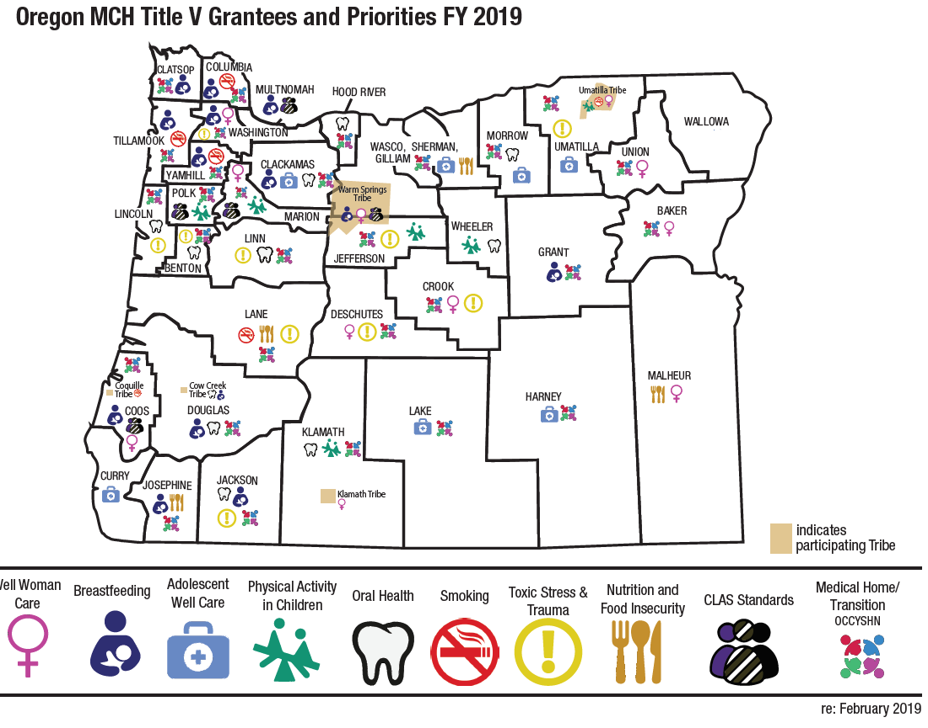

Slide 6
Upcoming MCAH Title V Block Grant Needs Assessment
Purpose:
Better understand the health status and needs of the MCAH population
Engage stakeholders, partners and communities in discussion about Title V’s work and how it aligns partner priorities and opportunities
Guide the selection of priorities for the state’s Title V MCAH program for 2021-2025
Nov 2018–Jan 2019: Initial planning
Sept-Nov 2019: Synthesize results, Prepare data tools & NA report
Mar-Aug 2019: Implement data collection & analysis
Feb 2019: Stakeholder input & workplan revisions
Dec 2019-Jan 2020: Conduct needs prioritization with stakeholders/partners
Feb-Apr 2020: Finalize 2020-2025 priorities & develop strategies and ESMs for new priorities
May-June 2020: Write up NA, priorities, strategies, ESMs for Block Grant application

Slide 7
Upcoming MCAH Title V Block Grant Needs Assessment
Research Questions:
What are the characteristics and needs of Oregon’s MCAH population in relation to
          National Title V priorities;
          State MCAH needs – both previously identified and emerging needs?
What are the disparities in the health status and needs of the MCAH population?
What are the cross-systems issues that influence Title V’s work in Oregon?
Where are there opportunities for alignment across systems and sectors that influence the health of Oregon’s women, children and families?

Slide 8
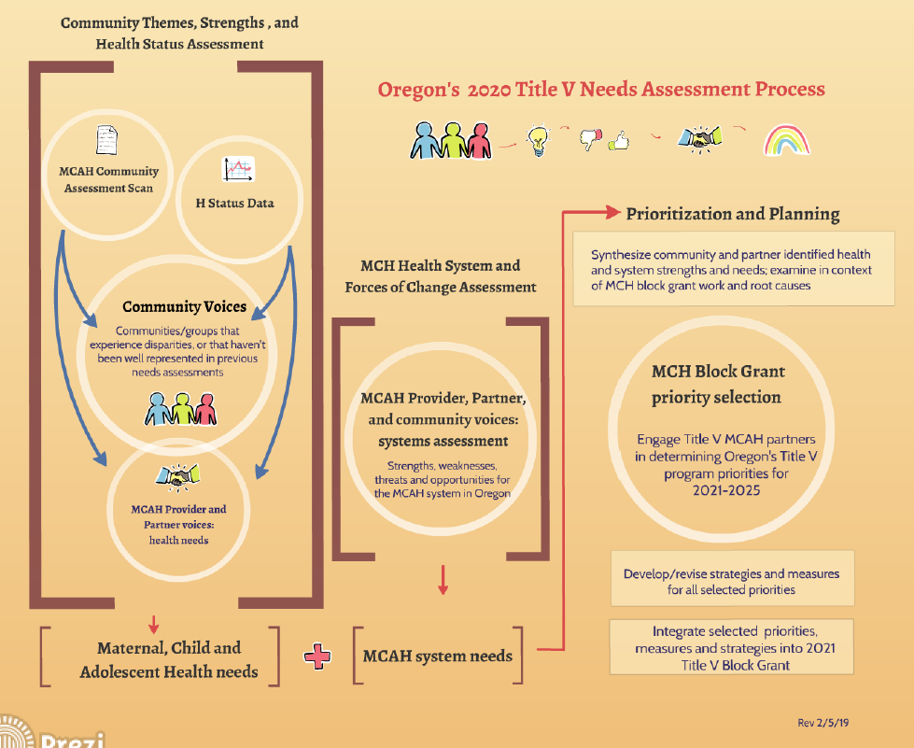

Slide 9
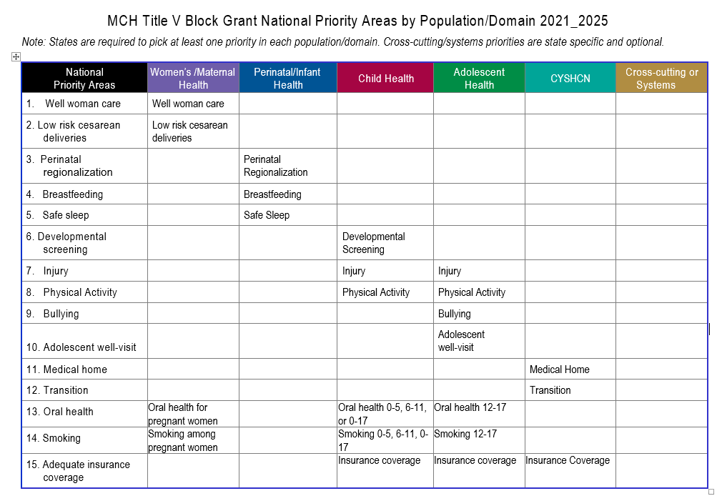

Slide 10
Get involved
Opportunities for involvement in the Title V NA
  Participate in planning (see webinar instructions)
  Take part in surveys, online discussions, listening sessions, etc.
  Engage your community – host focus groups,
  Let us know what we’re missing!
Why get involved?
Ensure that the needs of your community are heard and understood.
The Title V Needs Assessment will guide selection and funding of Oregon’s MCAH priorities the coming 5 years.

Slide 11
Upcoming MCH Title V Block Grant Needs Assessment Webinar
Wed February 13, 2019 from 1PM – 2:15PM
Give input on:
Draft needs assessment plans;
Proposed special populations of focus;
Proposed data sources;
Community partners and organizations that we should engage;
And anything else we haven’t thought of.
Please join us
Register now!

Slide 12
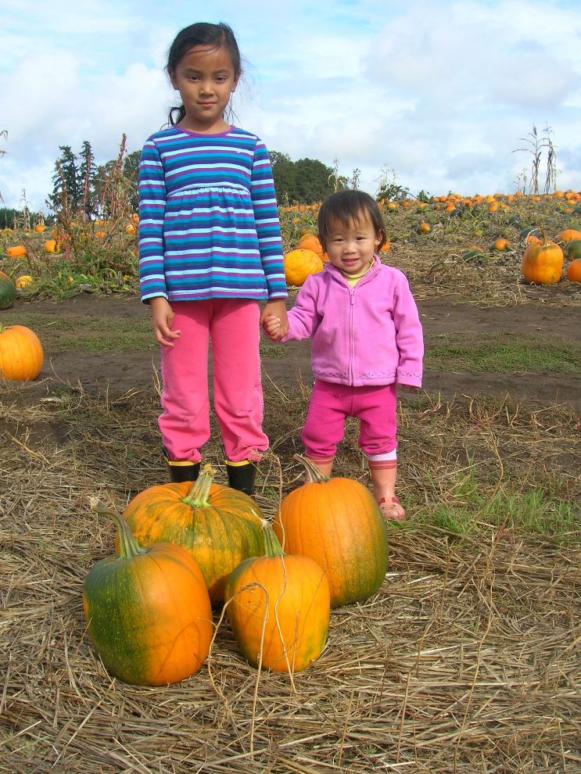
Additional questions and comments?
Webinar details and registration:
Stephanie Glickman stephanie.d.glickman@state.or.us
Needs Assessment:
Maternal and Child Health: Maria Ness maria.n.ness@state.or.us
Adolescent Health: Wes Rivers wesley.r.rivers@state.or.us
Children and Youth with Special Health Care Needs: Alison Martin martial@ohsu.edu
General MCAH Title V information:
Nurit Fischler nurit.r.fischler@state.or.us
Cate Wilcox cate.s.Wilcox@state.or.us

