Slide 1
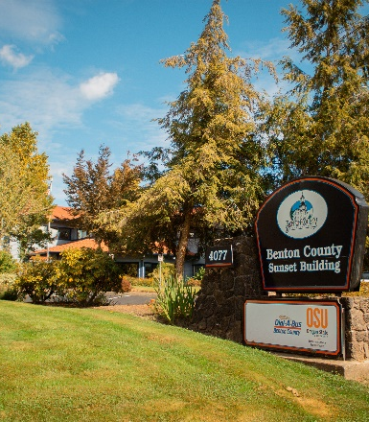
Benton County Covid-19 Fall/Winter 2022-2023 Planning Brief
An overview of Benton County Covid Outbreak Response sustainability in relation to staffing challenges during the winter 2022/2023 season
Gerald Dyer, Jr. (Benton County Communicable Disease Working Out of Class Manager and Communicable Disease Epidemiologist)
Friday, August 12, 2022

Slide 2
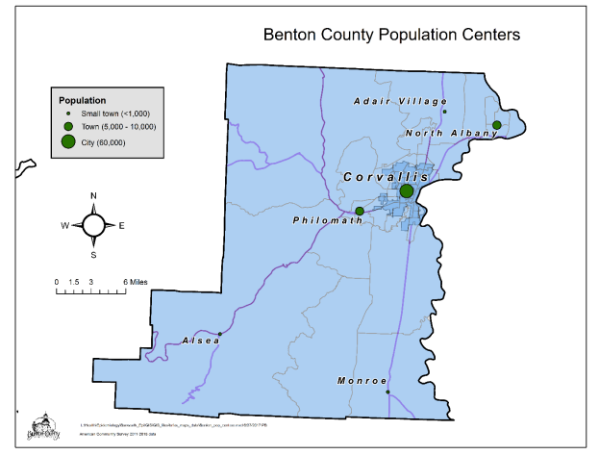
Benton County
Small Metro (According to CDC 2013 Urban-Rural Classification Scheme)
US Census Pop: 96,017
Current Staffing
3 CD Covid Response
1 Core CD (Non-Covid)
1 WOC Manager/Epi

Slide 3
Benton County Covid OBs vs Staffing

Slide 4
Benton County Covid OBs vs Staffing (Excluding K-12 OBs)

Slide 5



Federal CMS Covid LTCF Requirements
Serial Testing
Visitation & Active OBs
Perpetual Covid OB
As resources allow…weekly testing until 14 days of no positive cases
CMS allows visitation at all times, even during active OBs
Months long OBs affect holistic health

Slide 6
Team Questions (Sustainable? Realistic Response?)
How can we transition Covid within our core CD protocols?
How can we avoid every winter season focusing solely on Covid outbreaks in an environment of decreased Covid funding, staffing limitations, MPX emergency declaration, and other emerging pathogens?
What collective supports are available for counties who are unable to sustain ongoing Covid responses during the winter 2022/2023 season?
Please feel free to share your inquiries/concerns/insights.
Hope this brief can help us better plan our current and future Covid responses.
Thank you for listening and sharing our thoughts.
???

Slide 7

/BentonCoHealthDept
/BentonLinnCHCs

