Slide 1
Updates related to the PHE Ending
May 8, 2023

Slide 2
Agenda
COVID-19 epi briefing
COVID-19 Investigative Guidelines changes
  COVID-19 laboratory reporting
  Isolation in general population including K-12
  School exclusion
COVID-19 vaccination mandates in health care and K-12
End of the federal PHE coverage changes
Field Operations closure
Influenza surveillance during the off-season

Slide 3
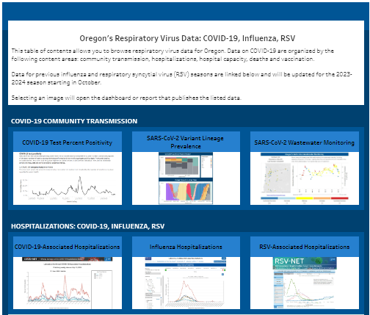
COVID-19 epi briefing
Notes:
Source: https://public.tableau.com/app/profile/oregon.public.health.division.acute.and.communicable.disease.pre/viz/OregonsRespiratoryVirusData/TableofContents

Slide 4
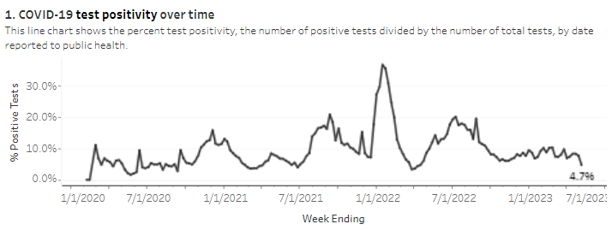
COVID-19 community transmission
Notes:
Source: https://public.tableau.com/app/profile/oregon.public.health.division.acute.and.communicable.disease.pre/viz/OregonsRespiratoryVirusData/TestPositivity. Accessed: 5/12/23.

Slide 5
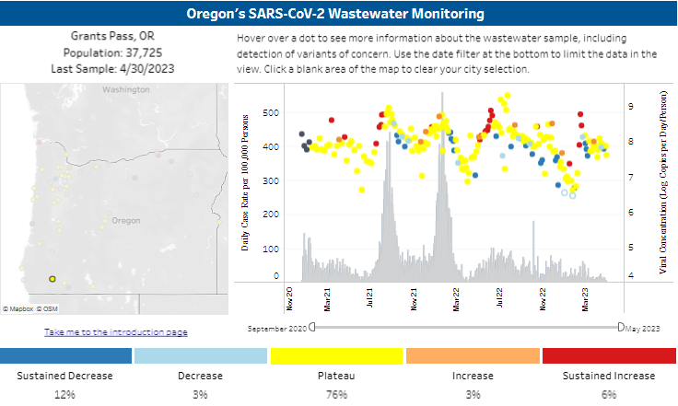
COVID-19 community transmission
Notes:
Source: https://public.tableau.com/app/profile/oregon.health.authority.covid.19/viz/OregonsSARS-CoV-2WastewaterMonitoring/Introduction. Accessed: 5/12/23.

Slide 6
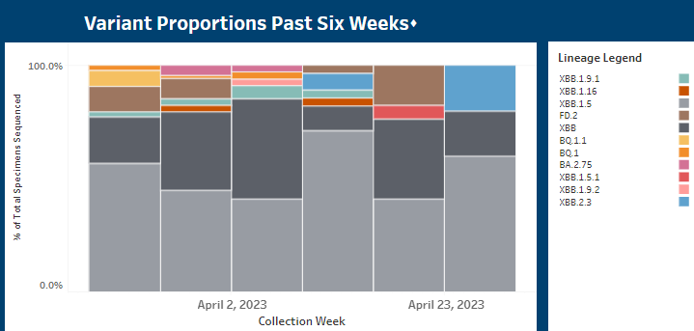
COVID-19 community transmission
Notes:
Source: https://public.tableau.com/app/profile/oregon.health.authority.covid.19/viz/GISAIDVariantDashboardUpdated/OregonVariantDashboard. Accessed: 5/12/23.

Slide 7
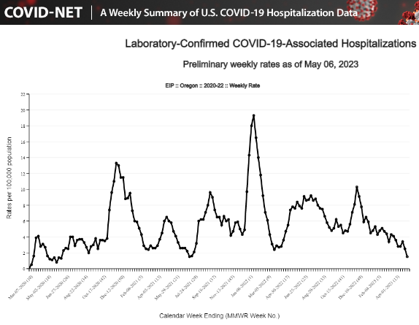
COVID-19 hospitalizations
Notes:
Source: https://gis.cdc.gov/grasp/COVIDNet/COVID19_3.html. Accessed: 5/12/23.

Slide 8
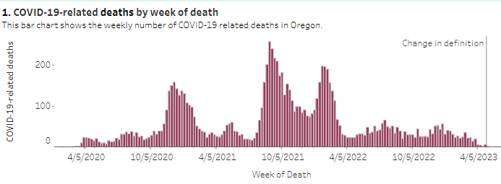
COVID-19 deaths
Notes:
Source: https://public.tableau.com/app/profile/oregon.public.health.division.acute.and.communicable.disease.pre/viz/OregonsRespiratoryVirusData/Deaths. Accessed: 5/12/23.

Slide 9
COVID-19 IG changes
COVID-19 laboratory reporting
  COVID-19 laboratory tests no longer reportable
  Permanent rulemaking initiated
  Will not be enforced effective May 11, 2023
Isolation in general population including K-12
  Stay home until 24 hours fever-free and symptoms improving
  Mask for 10 days
  Avoid at-risk individuals
School exclusion
  Removing COVID-19 from restrictable conditions list
  Permanent rulemaking initiated
  ODE documents will be updated once IG changes reviewed/finalized

Slide 10
COVID-19-related rule changes
Vaccination requirements for health care workers in healthcare settings (333-019-1010)
  Suspended by temporary rule May 11, 2023
  Permanent rule (repeal) proposed, effective June 30, 2023
Vaccination requirements for teachers & school staff (333-019-1030)
  Suspended by temporary rule effective June 17, 2023
  Permanent rule (repeal) proposed, effective June 30, 2023
COVID-19 reporting requirements
  Permanent rule proposed, effective June 30, 2023
  Reporting of cases, laboratory tests, hospitalizations, deaths in adults to be repealed
  Reporting of MIS-C and deaths in children will still be required

Slide 11
End of federal PHE changes
Testing
  Medicare: Part B will cover if ordered by provider; no free OTC tests
  Medicaid: will cover without cost sharing until September 30, 2024
  Private insurance: requirement to cover OTC & lab tests will end. Insurance companies may cover.
Vaccinations and therapeutics
  EUAs not affected
  Access to nirmatrelvir/ritonavir (Paxlovid) & molnupiravir (Lagevrio) not affected immediately; transition to traditional healthcare coverage later this year
  Vaccinations
    Transition to traditional healthcare coverage later this year; insurance will be required to cover
    Medicare: will still be covered under Part B
    Medicaid: no co-pay or cost sharing through September 30, 2024
Notes:
9/30/2024: “end of the first calendar quarter that begins at least 1 year after end of public health emergency on May 11, 2023.”
n.b., the waivers could be modified ore terminated at any time; but expire automatically on this time line.

Slide 12
End of federal PHE changes
1135 waivers (allow providers to establish alternative care sites, ease practice across state lines, expand Medicare telehealth coverage, suspend federal oversight and reporting requirements, etc.)
  Expire September 30, 2024
Required coverage with no cost sharing of COVID-19 vaccine for Medicaid and CHIP populations; 100% federal match for COVID-19 vaccines
  Expires 9/30/2024.
Notes:
9/30/2024: “end of the first calendar quarter that begins at least 1 year after end of public health emergency on May 11, 2023.”
n.b., the waivers could be modified ore terminated at any time; but expire automatically on this time line.

Slide 13
Field Operations closure
On June 30, 2023, the Field Operations team will close
Intent to transition COVID-19-related testing to the health care system
  Testing for COVID-19 widely available through traditional channels
OHA will no longer be able to support specimen collection
OSPHL will have very limited testing availability which will require epidemiologist approval and will be based on public health significance

Slide 14
Testing resources
Primary resource is the health care system
  Reimbursement mechanisms in place
  Partners serving those without health insurance are eligible for free OHA testing resources
OHA will continue to distribute COVID-19 rapid point-of-care tests to priority partners until July 31, 2024
  Includes LPHAs, tribal partners, residential congregate facilities
  Strongly encourage all residential congregate facilities to request these tests which must be used under a CLIA certificate of waiver
OHA will continue to distribute COVID-19 self-tests to priority partners until current supply is exhausted
  These tests must be used under a CLIA certificate of waiver when administered on others

Slide 15
Variant influenza surveillance outside of the influenza season
HAN to be released today
Expands several current recommendations
  All patients seeking care for ILI outside of the influenza season should be asked about fair attendance, pig exposure and contact with sick birds
  Individuals with these exposures should have NP collected for testing at OSPHL
Highlights current recommendation regarding antivirals
  Empiric antiviral treatment for all patients with possible infection with novel influenza A viruses
  Antiviral treatment should be based on exposure risk factors and not be withheld or delayed pending collection of specimens or laboratory testing
Expands current surveillance of hospitalized specimens
  Prioritize submission of ICU specimens

