Slide 1
Public Health Modernization in Oregon
History and Overview
CLHO May 2022

Slide 2

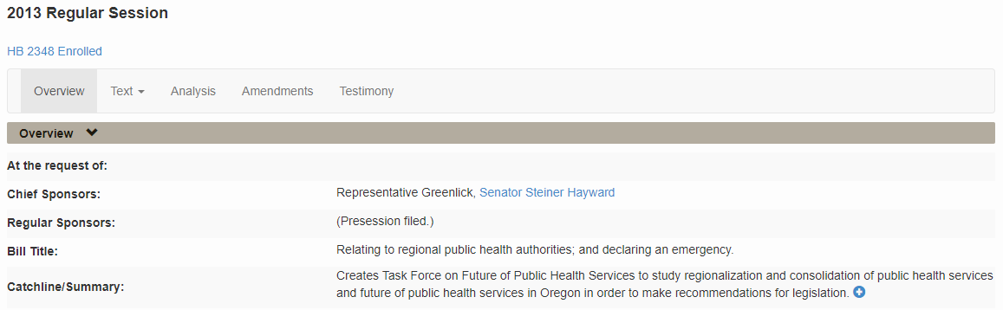
2013
HB 2348 Created Task Force on the Future of Public Health Services
https://olis.oregonlegislature.gov/liz/2013R1/Measures/Overview/HB2348

Slide 3
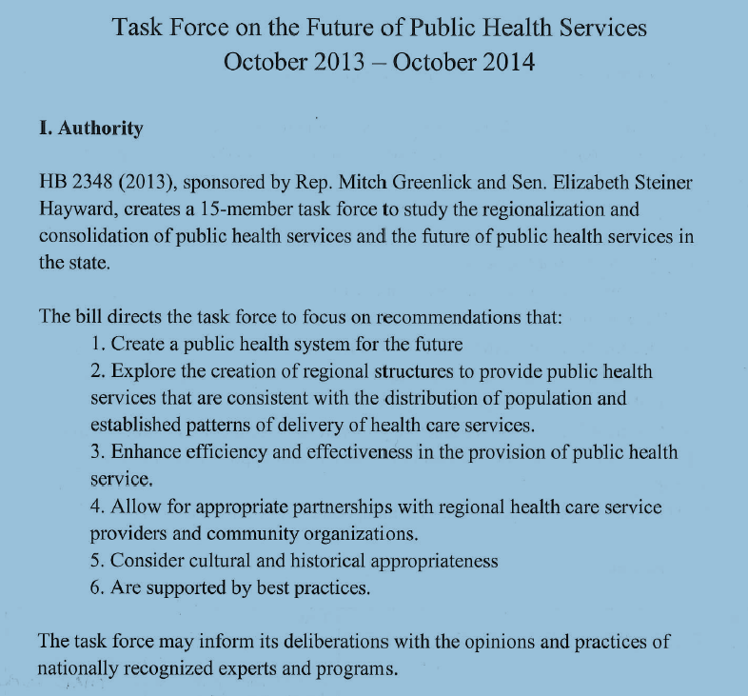
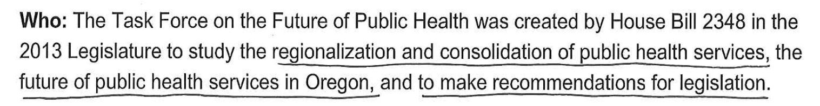
REGIONALIZATION!
REGIONAL STRUCTURES!
CONSOLIDATION!

Slide 4
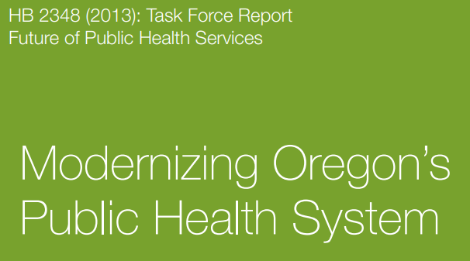
2014
Task Force on the Future of Public Health Services met and made legislative recommendations on an Oregon-specific version of the foundational public health services model and changes to the Public Health Advisory Board for a variety of perspectives into Oregon public health
Recommended a re-envisioned Public Health Advisory Board, which would oversee improvements and changes in the governmental public health system, in part structured around metrics.
https://www.oregon.gov/oha/PH/ABOUT/TASKFORCE/Documents/hb2348-task-force-report.pdf

Slide 5
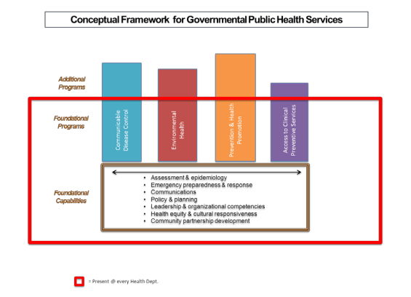

Slide 6
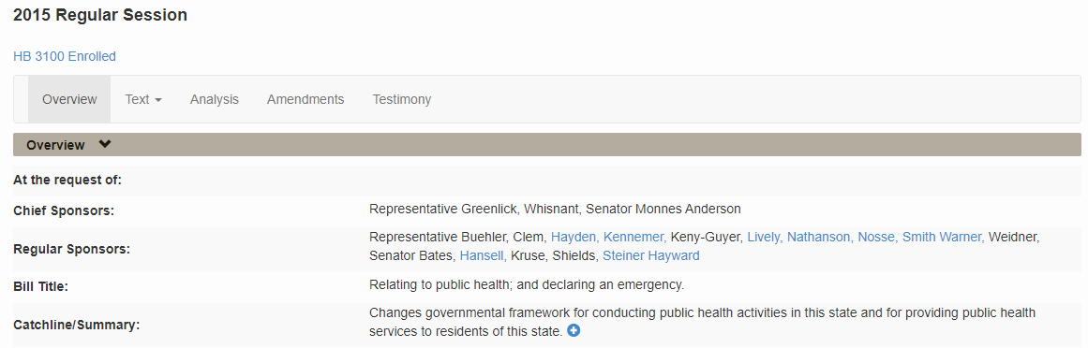
2015
HB 3100 adopted recommendations from the Task Force report
https://olis.oregonlegislature.gov/liz/2015R1/Measures/Overview/HB3100
LPHAs and OHA developed the Public Health Modernization Manual to be able to complete the Public Health Modernization cost assessment

Slide 7
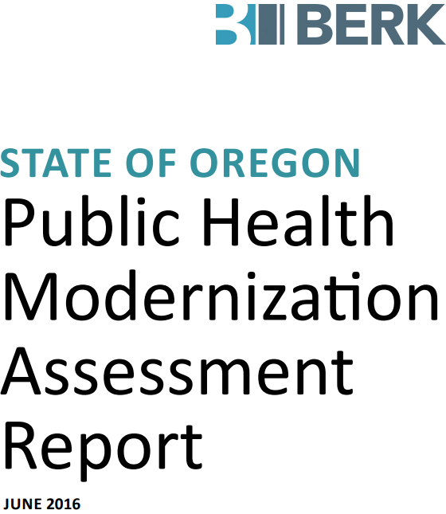
2016
New PHAB begins on January 1
Public Health Modernization Assessment Report completed
https://www.oregon.gov/oha/PH/ABOUT/TASKFORCE/Documents/PHModernizationFullDetailedReport.pdf
PHAB highlights
Oversaw public health modernization assessment and report, and recommendations for implementing public health modernization.
Met with Representative Greenlick, which was instrumental in shifting to an implementation framework intended to modernize across the whole system simultaneously instead of in waves.
2016-2019: Regularly met with staff from PHD sections to hear about progress and challenges in achieving State Health Improvement Plan goals.
Established two subcommittees that are still operating today (Incentives and Funding, and Accountability Metrics)

Slide 8
2017
HB 2310 makes additional statutory changes for public health modernization
https://olis.oregonlegislature.gov/liz/2017R1/Measures/Overview/HB2310
A $5M investment is made in public health modernization implementation
PHAB Highlights
Adopted public health modernization funding formula. Envisioned a new way to allocate funds that both provides each LPHA with base funding, and directs most funds to population-based health and demographic indicators. CLHO involved throughout this process. (Today, CLHO Systems and Innovation provides input on how to operationalize changes when PHAB is considering changes.)
Adopted first version of its health equity review policy and procedure, which requires a set of questions to be reviewed and considered whenever the Board adopts work products or deliverables.
Developed Guiding Principles for Public Health and Health Care Collaboration. The Guiding Principles largely aligned with foundational capabilities and were intended to bring attention to opportunities to expand partnerships and reduce barriers to collaboration.
Adopted first set of accountability metrics, among the first in the nation, and have produced annual reports since then.

Slide 9
2018
PHAB Accomplishments
Adopted Funding Principles, which are a set of seven principles intended to guide LPHA funding decisions, for both increases and decreases in funding. CLHO Systems and Innovation developed a corresponding check list that committees could use to operationalize each of the seven principles when working with OHA on LPHA funding.
Provided recommendations for CCO 2.0, specifically related to social determinants of health. Multiple recommendations were included in CCO 2.0 requirements.
Every even-numbered year, PHAB provides its recommendations/priorities for increased investments in public health modernization, as a kick-off to planning for the next legislative session. PHAB’s guidance becomes the basis for the planning work to develop a funding proposal and request.

Slide 10
2019
Additional $10M investment made in public health modernization
PHAB Highlights
Met with the Oregon Transportation Commission to discuss issues related to public health, transportation and equity.

Slide 11
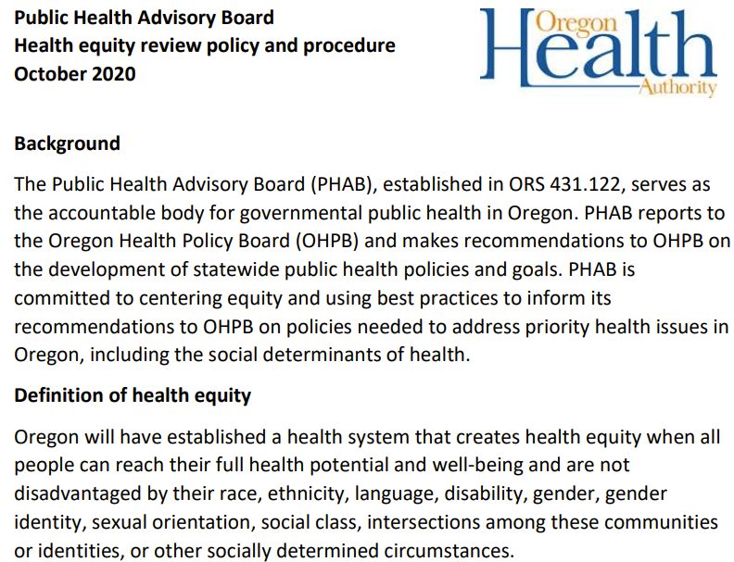
2020
PHAB Accomplishments
Revised Health Equity Review Policy and Procedure to lead with race.
https://www.oregon.gov/oha/PH/ABOUT/Documents/phab/PHAB-health-equity.pdf

Slide 12
2021
Additional $45M investment made in public health modernization to total of $60.6M
PHAB Accomplishments
Met twice with community partners working with OHA on survey modernization, and learned about recommendations for community-centered public health data systems.
Regularly heard about COVID-19 impacts and communities (from LPHAs, Tribes and CBOs)
Established Strategic Data Plan subcommittee.
Invited community partners to join two of three subcommittees.
Began significant overhaul to public health accountability metrics.
Participated in racial equity capacity building sessions through Health Resources in Action. Intended to support PHAB members and the Board as a whole identify ways that PHAB can take action toward racial equity.

