Slide 1


STATE OF OREGON ~ Executive Branch
COVID-19 After Action Review's
M.K. Harryman, MA
State Resilience Officer
Last update: 12 April 2021

Slide 2
Oregon COVID-19 AAR (Jan-May 2020)
Price Agreement between DAS and EM Partners (vendor)
  12-month retainer, started in June 2020
  To date we have established four Service Order Contracts (SOC)
EM Partners will use the following tools to collect data:
  Survey core groups:
    Agencies
    City, county and tribal EM’s and LHD’s
    Hospitals and healthcare organizations
    Long Term Care Facilities
    Incident Management Team key personnel
  Interviews of individuals and work groups (to include private sector)
  Review of all Incident Action Plans (IAPs) from: AOC, ECC and IMTs
  Review best practices

Slide 3
List of organizations getting surveyed
Governor’s Office
Coronavirus Response Team
DAS-ESF 7 Response Team
OEM
ODOC-Warehouse and PPE
Region X FEMA/HHS
Hospitals
Local PH and EM
Oregon Emergency Response Agencies
Tribes: Health and EM staff
CBO: Homelessness
CBO: Migrant Farmworkers / Food Producers
OR Emergency Management Association
Long Term Care Facilities

Slide 4
Oregon COVID-19 AAR
Three of SOC’s are running concurrently but have separate due dates
SOC #1 – Review of Personal Protective Equipment (PPE)
Establishing: survey groups/listing/questions
Completed Final Draft and Executive Summary – September 2020 and Final Report – 12 April 2021
SOC #2 – Oregon’s response to COVID-19
Phase 1 – Initial State Response
Phase 2 – Enterprise Mobilization
Completed Final Draft October 2020 and Final Report - April 2021
SOC #3 – State’s Joint Information Centers
Completed Final Draft – December and Final Report – April 2021
SOC #4 – Re-opening phase from 1 June to 30 Nov 2020
Currently is ongoing *Amended 10 Dec 2020, pending final draft April 2021
SOC#5 – Vaccination Campaign
Currently being put together with DAS and the vendor, 15 Dec – 30 June

Slide 5
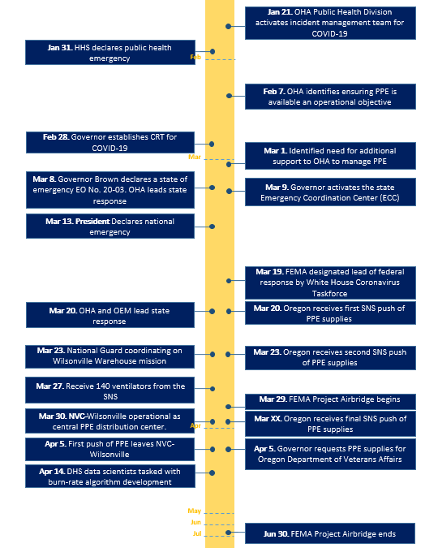
Oregon COVID-19 AAR
SOC #1 Key Decision Timeline

Slide 6
Oregon COVID-19 AAR SOC #1
Key Findings
Areas of Success
Preparedness | Training and Exercises—Executive leadership and agency-specific training and exercises increased competency in and engagement in response decision-making.
Situational Assessment | Initial Response—OHA acted in response to a health intelligence briefing in January recognizing the rising risk of a pandemic by standing up the incident management team, allowing Oregon to lean into preparations for response.
Operational Coordination | Executive Collaboration— The Governor quickly established the Coronavirus Response Team (CRT) to engage agency directors in the evaluation of situational information and response actions to determine priorities for the state. Incident Management Teams—Integration of IMT teams helped the CRT/Multi-Agency Coordination (MAC) group, OHA and OEM coordinate and transition from an agency focused response to an enterprise response. Relationship with Partners—Relationships with HHS partners assisted with the initial response to and the distribution of the warehoused PPE. As the sourcing and procuring effort grew, partnerships between FEMA and the private sector yielded good results. ESF 7 Problem-solving Mindset—Strong executive leadership and flexibility allowed DAS to embrace common day-to-day practices, adjust operations as the situation required, and engage team members to get the work done.

Slide 7
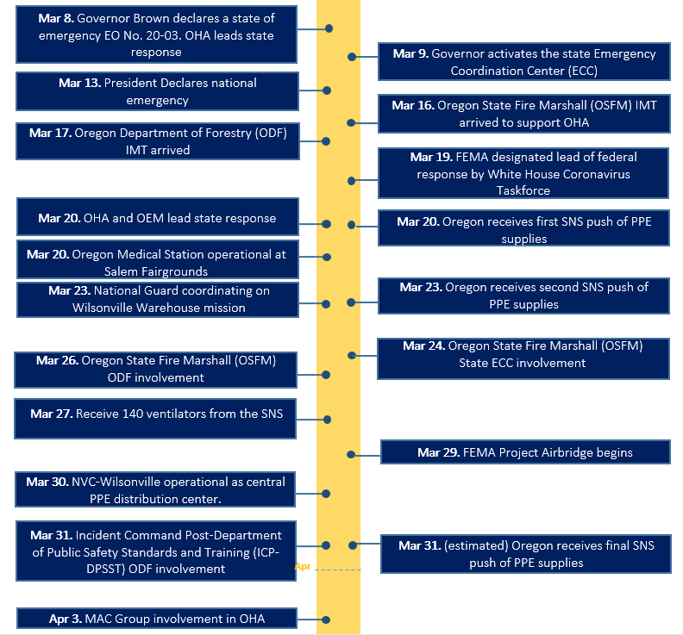
Oregon COVID-19 AAR
SOC #2 Key Decision Timeline

Slide 8
Oregon COVID-19 AAR SOC #2
Key Findings
Areas of Success
Planning | Comprehensive Emergency Management Program—The program includes a suite of plans, including a hazard mitigation plan, preparedness plan, emergency operations plan and a recovery plan. Training and Exercises —The Governor’s Disaster Cabinet (GDC) Exercises in 2018 and 2019 created a sense of buy-in for disaster work across state agencies.
Situational Assessment | Initial Public Health Response—OHA activated emergency operations on January 21 following a health intelligence briefing. Soon after the OHA IMT stood up and began augmenting public health personnel with staff from across OHA and other agencies as response operations grew. Executive Leadership—OHA worked very closely with the Governor and her team, providing the best information and guidance possible to assist with executive decision-making. Agency Engagement—The governor was well prepared to address this event. GDC and Economic Recovery EO 16-07 were established. The state agencies faced new challenges and were able to quickly adjust to overcome.
Environmental Response/Health & Safety | Public Health Guided Decisions—The Governor’s Executive Orders provided instructions to protect the health and safety of Oregonians.

Slide 9
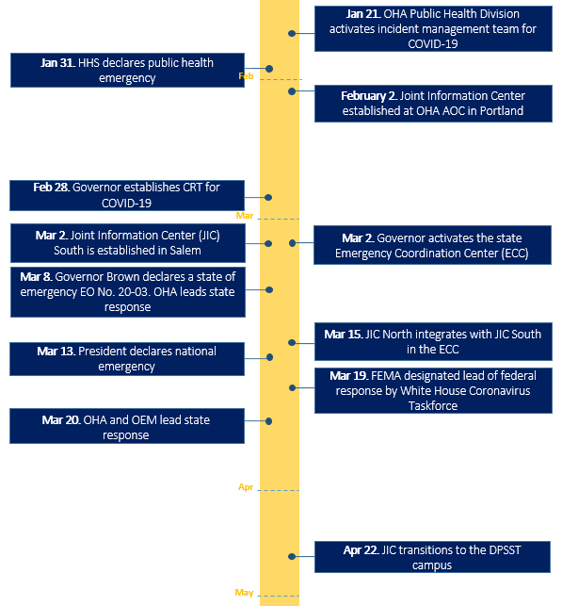
Oregon COVID-19 AAR
SOC #3 Key Decision Timeline

Slide 10
Oregon COVID-19 AAR SOC #3
Key Findings
Areas of Success
Preparedness | Communications Plans Exist—The High Impact Pathogen Plan of Operations (HIPPO), ESF 8 Base Plan External Affairs Annex and the state’s Emergency Operations Plan ESF 14 all outline public information and communication plans with Joint Information Center activation triggers, communication strategies, and roles and responsibilities.
Public Information and Warning | Translated and Interpreted Messaging—OHA has established mechanisms to facilitate translation of materials into multiple languages. This is a standard practice, so it was not a unique task to ensure materials were available in different languages. Consistently having a sign language interpreter at broadcast events supported communication to those who are deaf or hearing impaired.
Operational Coordination | Governor’s Office and OHA JIC Collaboration—The Governor’s Office and OHA collaborated closely on the COVID-19 response. This close relationship facilitated effective communication about the Governor’s decisions and public health protective measures.

Slide 11
Point of contact
Mike Harryman, MA
State Resilience Officer
Office of Governor Kate Brown
mike.k.harryman@oregon.gov | 503.975.1911 cell

