Slide 1
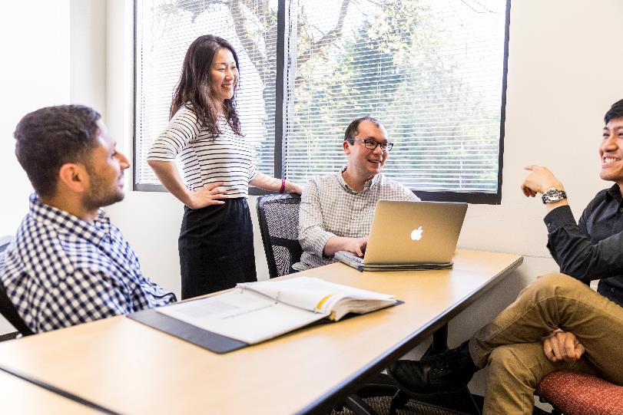
Training Needs Among Northwest Small Local Health Departments
Betty Bekemeier, Director
Oregon CLHO Meeting
December 17, 2020
This project is supported by the Health Resources and Services Administration (HRSA) of the U.S. Department of Health and Human Services (HHS) under grant number UB6HP31690. This information or content and conclusions are those of the author(s) and should not be construed as the official position or policy of, nor should any endorsements be inferred by HRSA, HHS, or the U.S. Government. For more information, please visit HRSA.gov.

Slide 2

Purpose
To fill the gap of PHWINS and better understand small LHD training priorities.
PH WINS
Large and medium jurisdictions
Sampling of jurisdictions
Individual, Staff Perspective
Quantitative
NWCPHP
Small jurisdictions
All small jurisdictions included
Leadership & Organizational Perspective
Qualitative
Lack of systematic knowledge
Notes:
Many of you are familiar w/ the de Beaumont Foundations regular PH Workforce Interests and Needs Survey (PH WINS).
PH WINS is a great addition to building our knowledge base about the PH workforce, but it has limitations w/ regard to small jurisdictions.
The needs assessment we’ll talk about today was conducted as part of our NW PH Training Center’s annual assessment of the training needs of the states in Region 10. When we did this in late 2019, we chose to focus on assessing the needs of small LHDs for a few reasons.
The most recent PH Wins included a sampling of large and medium jurisdictions in Region 10. It was a quantitative survey that assessed individual level-level training needs.
But PH WINS does not include small jurisdictions in their sample at all. (They’re hard to reach.)
NWCPHP was interested in adding to the individual-level data of PHWINS, by learning about organizational priorities and needs. Also, we wanted to expand our assessment to all of our LHDs since much of our NW Region (AK, ID, OR, WA) is made up of small LHDs. Also, we had never talked to our small LHD partners in a systematic way to learn what their training priorities and needs are. …so we lacked broad objective knowledge about these LHDs
Also, nationally we know that rural LHDs are different, than their urban counterparts in many ways (e.g. population needs, services, resources, staffing) and that not enough is known about how to support them most effectively.
We were eager to contribute to our understanding in our region & nationally of what is unique about small LHDs and how to meet their needs

Slide 3
Participants
Fall 2019
Small jurisdictions
FTE < 25
Serving populations < 25,000
27 LHDs classified as small jurisdiction
20 semi-structured interviews representing 21 of small jurisdictions in AK, OR, and WA.
78% response rate
Notes:
In Nov & Dec of 2019, staff from the NWCPHP conducted 30-minute interviews with the director/administrator of small LHDs throughout our 4-state region.
Small jurisdictions were defined, based on the PHWINS criteria as jurisdictions that have fewer than 25 FTE and serve pops. fewer than 25,000 people. In cases where only one criterion was met, small classification was based on the # of FTEs.
27 LHDs in Region 10 fell within this criteria based on the most recent pop & staff size data we had. All of the jurisdictions in ID were classified as medium due to their regional PH structure.
* So unfortunately we didn’t speak with our partners in ID, but they were represented in PHWins.
In the end, we, therefore, conducted 20 interviews among 21 LHDs in AK (2), OR (9), and WA (10). And, otherwise, had a very positive response to our interview request and our overall response rate was 78% of the 27 small LHDs.
Those Interviewed described themselves as being in the position of:
Administrator,
Director,
PH Nursing Manager/coordinator, and
other.
“Other” included 1 PHN clinical consultant and 1 PH educator
The vast majority, as shown here, self-identified as “administrators” or agency “directors”

Slide 4
Small Jurisdictions in Region 10
North Slope Borough
Health and Social Services Agency
Okanogan
Maniilaq Association
(North Arctic Borough)
Lincoln
Whitman
Mason
Garfield
Wahkiakum
Kittitas
Adams
Clatsop
Asotin
Klickitat
Columbia
Skamania
Morrow
Hood River
Wheeler
Polk
Baker
Jefferson
Grant
Crook
Lake
Harney
Malheur
Klamath
Interview Status:
Interviewed
Not Interviewed
N/A
Notes:
These maps of WA, OR, and AK (& an unnaturally small AK!), were the small agencies we interviewed (in blue.)
Orange/yellow depicts jurisdictions that qualified, but that weren’t interviewed.
No color counties here means they didn’t fit our ‘small LHD’ criteria.

Slide 5
Areas Assessed
Leadership background
Approach to workforce development
How are training decisions made
Organizational training priorities and training needs
How they find trainings
Challenges to workforce development
Best ways to train their staff
How NWCHP can support their workforce development
Notes:
The questions we developed and used for our interview were fashioned to assess these various attributes of workforce development in the small LHD:
Leadership background (of the respondent)
Approach to workforce development (in that agency and how agency- and individual-worker training decisions are made)
What are their agency’s Organizational training priorities and training needs
How they finding trainings when they need them
what are their Challenges to workforce development
what do they perceive is the best way to train their staff
…and for our own guidance, we asked:
How NWCHP could support their workforce development

Slide 6
Small LHD Leadership
Many hold more than 1 position or role
Many have expertise in other areas
Some leadership in position for less than 2 years
A few had been in their position for many years
“I'm the fifth director in seven years.”
“I've been in my position for a year and a half. I was the nursing supervisor for 20 years, and then our administrator retired and I'm still learning.”
Notes:
Many small LHD directors & leaders wear multiple hats & have multiple roles, such as
Director/Administrator of 2 neighboring jurisdictions (for efficiency and budget purposes)
Director and PH coordinator or RN
They do all of the management of the PH office and serve as back-up staff or fill in for vacant positions when needed
Among those we interviewed, some did all of the budgeting, programs management, HR activity, and hiring
Many of the directors, administrators, and coordinators have expertise in other areas. Such as being the director AND :
RN
Environmental health
In very small LHDs, (that is, jurisdictions with fewer than 13,000 population) some described themselves as also:
County judge
Behavioral health specialist
Nurse manager/supervisor
In AK, they were all PH nurses.
Further, high turnover was reported in many small LHDs, with some directors and administrators in their leadership position for less than 2 years, or in the position on an interim basis. In a few counties the entire leadership team (2-3 people) were new.
Among the even smaller jurisdictions, those with smaller pops (under 13,000), it seemed more likely to have leaders who wore more than 1 hat or had expertise/experience in areas other than PH.

Slide 7
Approach to Workforce Development
Few had standard approach
CEUs to maintain licensure (primarily nursing)
Programmatic requirements / state contracts
Individual staff interests and growth, tempered by time and budget
State modernization requirements (OR)
Doing training needs assessments
How to share resources and collaborate
Prescribed topics such as health equity
County training requirements
Accreditation not a primary driver for most LHDs
Only 4 LHDs mentioned accreditation
2 not seeking accreditation due to scale of work compared to workforce
Competency development not a primary driver for most LHDs
“…Without their license, they don’t have their livelihood.”
“We have a budget for them to spend…about thousand dollars a year on training of their own choice to maintain their CEs.”
Notes:
Few LHDs had a standard or consistent approach to Wkf development
The primary drivers for taking or encouraging training were for
maintaining staff licensure,
followed by all of the annual programmatic training requirements for programs such as WIC or EH.
Training topic areas that staff were interested in were the primary drivers of training choice.
Small LHDs have a difficult time attracting and maintaining staff, so they also described using training as a means of staff retention in helping them to pursue their own areas of professional growth.
The required training that is associated with OR’s PH Modernization process was mentioned frequently by LHDs in OR as a driver for training.
Health equity as an example
Finally, county HR training requirements were often cited as a training priority of the LHDs.
A theme throughout this list of motivators is the word “Required.”
There were so many annually required trainings, that respondents described there being little time left for organizational or individual desired training, ….although many LHDs said their staff still had some room for desired trainings.
Of note is also what was NOT an apparent driver:
Accreditation was one of those.
4 LHDs did mention accreditation (but not as a training driver). 2 of these respondents described accreditation unfavorably, describing accreditation requirements as not a fit for small LHDs.
These couple of quotes here really highlight the training focused on licensure.

Slide 8

Organizational Training Priorities
Public health operations and infrastructure:
Public health modernization (OR)
Collaboration with regional resources
Trauma-informed care
Programmatic:
Internal programmatic cross-training
Emergency preparedness (NIMS, ICS)
Substance abuse
Mental health
Competencies:
Leadership
Communication
Using and displaying data
Notes:
When asked about organizational training priorities, they fell into these 4 themes of:
PH Operations and Infrastructure
Programmatic priorities
Building Competencies
Health Equity and the Social Determinants of Health (but that’s on the next slide)
For PH Operations and Infrastructure, it was really these 3 areas that people described as priorities for which training was desired, required, or sought:
PH Modernization (and this was specific to OR)
Collaboration with regional resources
(Hood River: “learning about regional resources and intimately understanding what other agencies provide and how we work together with them”)
Trauma informed care was also a need as agencies described wanting to or needing to build this into their programs more effectively, and some have already gotten started with trainings in this area.
In terms of Programmatic priorities
Internal programmatic cross-training was being held up as a need. In small LHDs, practitioners have many roles and often see the same clients in several programs.
But agencies described wanting their practitioners to be able to serve the broader pop.
Emergency preparedness (And note that these interviews were conduct before this pandemic). This is usually in relation to annual trainings or required trainings.
National Indecent Management System (NIMS)
Incident Command System (ICS)
Substance abuse and MH were also big and, of course, this is relevant to the opioid crisis
In terms of Data, communication, Respondents described making a priority for training in their organizations around:
Media involvement and communication
Relevancy of data (to use data for communicating with the public to provide them with information and build their PH presence in the community)
Presenting data to leadership
Data-driven decision making (such as for budgetary purposes)

Slide 9
Organizational Training Priorities (Continued)
Health equity, social determinants of health:
Implicit bias
Using plain language
Adverse Child Experiences (ACEs)
Cultural competency
“Yeah, so actually we push back on some of those trainings. …]It seems to me like everything with this equity conversation it’s just on half the population, so we are just not going in that direction.”
“In Oregon, we're looking at public health modernization. And so that is a big training. We're looking at health equity, [which is a] huge training piece for our staff. And all the pieces that go with that—you know, implicit bias—and that's an ongoing training piece. And our staff is very into it. They absolutely love it.”
Notes:
Health Equity and the Social Determinants of Health was another big priority for Organizational Training
This can in the form of things like, what they referred to as training in:
Implicit biases
Using plain language
Adverse Child Experiences (ACEs)
Cultural competency
For some they really welcomed this focus on helping staff understand health equity (particularly in OR where such training is going on across the state). One respondent said (in the lower quote on this slide): “In OR, we're looking at PH Modernization. And so that is a big training. We're looking at health equity, [which is a] huge training piece for our staff. And all the pieces that go with that—you know, implicit bias—and that's an ongoing training piece. And our staff is very into it. They absolutely love it.”
But, not everyone has bought into the idea regarding training needed around health equity.
Where it is required in OR, as part of their PH Modernization work, one respondent said (upper quote): “Yeah, so actually we push back on some of those trainings. Because a number of things I have issues with... It seems to me like everything with this equity conversation it’s just on half the pop, so we are just not going that direction.”
Some LHDs don’t know what their staff need overall and are waiting on the results of assessments or strategic plans

Slide 10

Workforce Development Needs in Small LHDs
Hands-on experience in training
Training for succession planning
Training Topics needed:
General public health training
Budgets and billing
Data visualization and communication
Grant management and post award
Leadership skills
Policy
Behavioral and mental health
Notes:
In some small LHDs, there isn’t any standardized way of approaching wf development, but there are some clear needs.
Hands-on experience is a must. Practitioners in small LHDs don’t have a lot of time and they aren’t learning through,, “reading a thousand page books and thousand page documents.”
They want PRACTICAL applications and experience to make sure they know how to do things effectively.
As we mentioned earlier, LHDs have a mix of long-time practitioners who have a lot of knowledge and experience and newer staff from high turn-over.
When those more experienced staff leave, small LHDs are concerned about how to transfer that knowledge to new staff in on-the-job training.
Our small LHDs also specifically mentioned topics they’d like training on, including:
General PH training, especially since some leadership and staff come from backgrounds other than PH
Budgets and billing, since knowledge is passed on internally often without formal training, which sometimes results in errors.
Data visualization and communication--transforming the data they have (like surveys) into meaningful messages
Grant mgmt and post award.
Trainings on searching for and writing grants is generally available, but trainings for how to manage a grant once you get it are harder to come by.
Leadership skills,
because staff are sometimes promoted internally and have experience in PH but have to learn a lot of the leadership skills along the way.
Policy,
because some staff would be really interested in larger systems thinking and community engagement but haven’t had the training to get there.
Behavioral and mental health,
especially about how to talk about MH and how to help clients who have mental health challenges when they come in for other programs or services.

Slide 11
Challenges to Workforce Development
Still in “survival mode”
Not enough funding to do current public health work, training is a lower funding priority
Growth is hard when many rural LHDs have “change fatigue”
Cost of trainings – monetary cost and cost of lost time and staff
Lack of true skill development from online learning
Technical challenges from constantly changing online learning technology
Notes:
They also really talked about CHALLENGES to WFD
They spoke about still being in “Survival Mode”
Many interviewees said they had never really recovered from the 2007-2008 recession.
They focus on dealing with immediate needs:
getting the daily task completed, or
finishing what didn’t get done yesterday.
Not enough funding to do existing PH work, …so training is a lower funding priority
Growth is hard when many rural LHDs have change fatigue
Cost of trainings – monetary cost and cost of lost time and staff
Funding for training is limited and therefore all training requests must be carefully considered, especially trainings that aren’t required.
Sometimes grants to supplement the costs of attending a training end up costing the LHD more in other types of resources.
Participants talked about how their LHDs are so small that sending even 1 person out for a training would mean that a clinic or service would need to be temporarily shut down
Some solutions that LHDs have used to work around insufficient staff, include closing down for 2 hours each week for regular trainings, sending half of their staff to a training one day and the other half to a training the next day (if available), sending only 1 or 2 staff in-person and having them report back to the rest of the staff with what they learned.
Lack of Skill Development from online learning
Multi-tasking: Online trainings present a challenge for participants to stay focused when they have competing desires to be efficient and do a good job at their work but also attend the training. Sometimes PH practitioners cannot avoid interruptions when “you’re the only person in the office that can deal with [something that comes up].”
Interactivity: People may be less willing to interrupt to ask questions during online trainings or may be more shy when not in-person.
Technical challenges from constantly changing online learning technologies—learning different programs

Slide 12
Current Training Delivery
In-person training preferred for skill development
Mentoring and job shadowing
Distance-based training, for certain types of training
Limited time in the workday for online training
“We still do lots of mentoring around certain things and, you can't just throw everything at somebody all at once or they’ll be leaving…mentoring and opportunities for self learning”
“I think that we are becoming burned out on the online learning collaborative. I think that it's easy or to multitask and, or not participate as well.”
Notes:
There is a very clear preference for in-person training for multiple reasons:
higher engagement,
networking and
learning from peers,
reducing distractions, etc.
…..Remember that these interviews were done before the pandemic!
Small agencies try their best to facilitate in-person training, including mentoring and job shadowing.
Many LHDs still do a lot of mentoring and job shadowing from previous experienced staff.
However, if experienced staff were not doing something correctly, errors may continue in the new staff.
Sometimes in-person training is just not available or feasible for small LHDs, so they utilize distance-based learning instead.
However, they are getting burnt out on online training. “The pendulum is shifting the other way” from online to in-person. It’s too easy to multi-task or get pulled away when trying to do an online training because you want to do good work at your job.

Slide 13

LHD Suggestions for Distance-Based Training
Training improvements could include:
Increase skill development from online training
Increase distance-based engagement
Watching webinars in groups to increase group learning
Keep online trainings short to give opportunities to apply learning to work
Relevant, “catchy,” fast-moving subjects
Notes:
Small LHDs also know their limitations and that they can’t always attend as many in-person trainings as they’d like, and they recognize the value of gaining info through distance-based opportunities. They just want to make the best of what they have, and they had several recommendations for things they’ve tried for improving distance-based training experiences:
Host webinars in Skype or Zoom so that the instructor and learner can see each other and interact to increase learner focus.
Watching webinars in groups to increase group learning
Keep online trainings short to give opportunities to apply learning to work
Relevant, “catchy,” fast-moving subjects

Slide 14
Recommendations
Leadership in small LHDs are interested in the management-level training to help them balance their multiple, competing demands.
Small LHD staff need training in communication, trauma-informed care, and ACES.
NWCPHP should increase awareness of public health training resources among staff at small LHDs.
Incentives, such as CEUs, needed to encourage small LHD staff to make broad systems-level training desirable.
Small LHD public health staff need to see the value of systems-level training to their daily work.
Notes:
Part of our purpose here, again, was to understand how to support small LHDs most effectively and to understand how they may be different than medium- or large-LHDs.
These small LHDs in our region really are driven by, and to some degree limited to, what they are REQUIRED to learn and maintain capacity around
They use small incentives to help their staff get training—CEU’s, training as a small perk in hopes of retaining staff
State-wide training mandates, like those that have come w/ PH Modernization in OR, have tapped into this gap in training and the priorities of small LHDs to limit training to what is ‘required’….thus, allowing for (and sometimes having to force) more capacity building around things like health equity
So what does this mean for PH Training Centers like ours at the NWCPHP? Or for small LHDs nationally or those that support them?
Our Recommendations fall into the following:
For us at the NWCPHP….we need to be cognizant of the awareness of the limited training resources among staff in small LHDs
Training is an important issue for them and their organizations, but they struggle to get beyond that which is required and they look for small incentives, such as CEUs, for staff to build capacity.
CEUs, therefore, are likely important for encouraging small LHD practice staff to make broad systems level training desirable.
…but this, of course, pertains to those with licensure.
And if wanting to build Small LHD capacity, beyond technical or programmatic skills (such as for WIC or food safety inspections), PH staff will need to see the value of the training to their daily work.
So, this pertains to broader-level competencies related to PH 3.0 and systems- or pop-level thinking such as w/ regard to addressing health equity, persuasive communication, or systems-thinking
At the Leadership level, and like we have seen w/ PH WINS data for large and medium-sized LHDs, small LHDs are similarly interested in the mgmt-level training. And for them it would help them balance their many multiple, competing demands and the numerous ‘hats’ they wear.
We are working on ‘bite-sized’ mgmt. training…
Also, interestingly training in communication, trauma informed care, and ACES are training topic priority areas for small LHDs.
These could be training topics through which to capitalize on their interests and priorities, while also embedding systems- or pop-level concepts and competencies.

Slide 15
Recommendations (continued)
Training Topics for Leadership
Leadership development Succession planning Management skills Community engagement Policy development, using data
Delivery
Online training needs to increase engagement through a live component and/or application. Online training for skill development should be mini, bite-sized, and could focus on an internal cohort. In-person training should have multiple offerings so all staff can attend.
Notes:
In terms of specific topics and training modalities that emerged from our findings;
Specific topic needs that fell most directly into the wheelhouse of those in Leadership or who might be emerging leaders, mostly included Training in topics such as
General leadership development
succession planning,
management skills,
community engagement,
policy development,
using data for planning, decision-making, communication
In terms of training DELIVERY modalities, it became apparent that…
For Online training to engage these learners in small LHDs, it needs to have a live component or opportunities for application.
For general skill development, online learning should be in mini, bit-sized segments, and could potentially focus on a cohort internal to their agency
Any In-person training should have multiple offerings so all staff can attend, since small LHD staff have to close their doors if more that a few people are in a training.

Slide 16
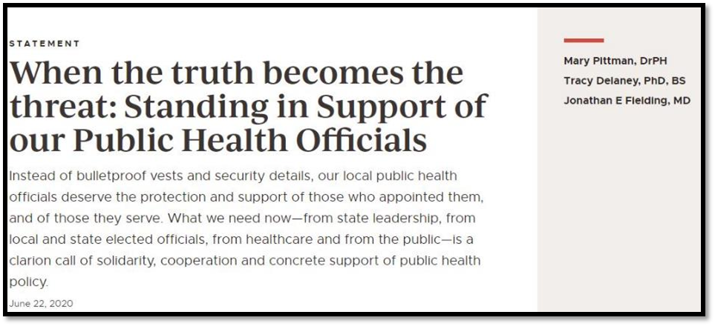
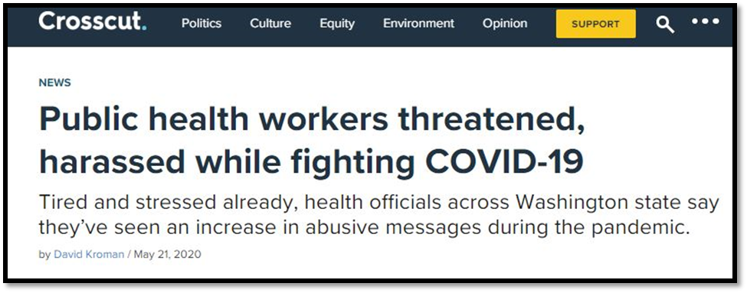
Reflection for CLHO Leaders
Questions
Do these results resonate with you? What was confusing or needs clarification? How can NWCPHP better meet your small LHDs where they are? What more can we do together? With greater interest in public health jobs, how might you seize the moment? How will you retain and continue to develop new talent?

Slide 17
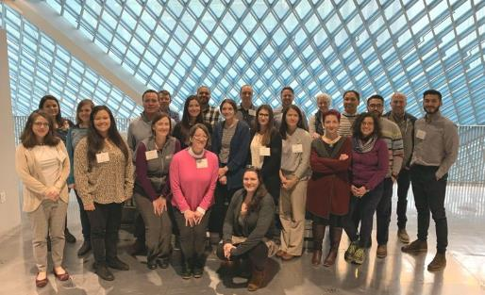

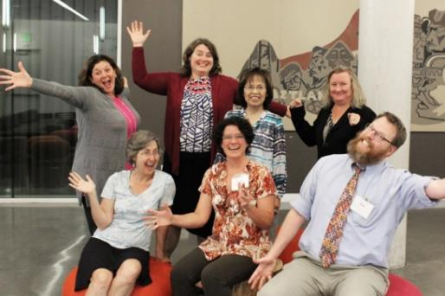
Training Teams and Individuals
New courses in 2021!
Northwest Public Health & Primary Care Leadership Institute
March–October 2021
Mentoring Matters Materials
Public Health Management
Visit nwcphp.org/training to explore hundreds of training and learning resources.

Slide 18




Thank You
Betty Bekemeier, PhD, MPH, RN
Director
Northwest Center for Public Health Practice
University of Washington
School of Public Health
bettybek@uw.edu www.nwcphp.org

