Slide 1

CLHO Leadership Program Webinar
Public Health Ethics
* Email sierra@oregonclho.org to receive a Moral Foundations Questionnaire
Notes:
Welcome, Everyone! Today’s webinar is brought to you by the CLHO Leadership Program. Our topic is Public Health Ethics. My name is Sierra Prior with CLHO, and thank you all for joining me.

Slide 2
Zoom Webinar Housekeeping
Everyone will be on mute until a discussion portion of the webinar.
For the discussion, I will unmute all participants, but you also need to make sure you are unmuted on your end. If you are using a phone, you may need to check if you are muted in Zoom.
If there is an echo, check if you are using computer and phone audio. Use one.
Please avoid background noise during the discussion.
If you are unable to talk, please feel free to type a question.
Please introduce yourself when speaking during the discussion.

Slide 3
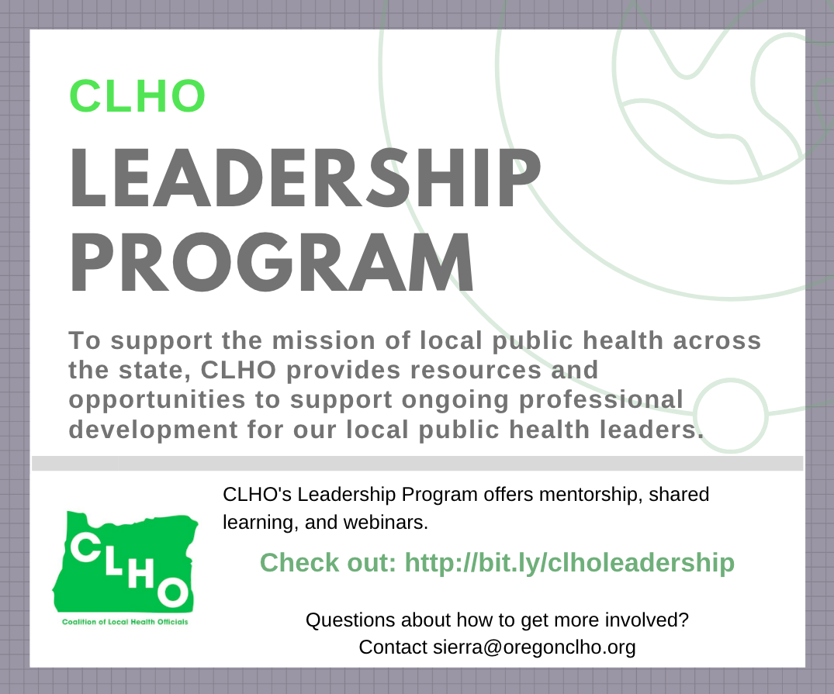
Seeking participants for Core Group discussions!
Bring your questions
and/or
expertise
Notes:
Today’s webinar is part of the CLHO Leadership Program. The program will alternate each month between webinars open to all CLHO members and every other month Core Group discussion calls for new and experienced administrators focused on shared learning. If you want to join the Core Group discussions, send me an email! If you already participate and have something you’d like to discuss in February, please let me know.

Slide 4
After the webinar, complete the
“Moral Foundations Questionnaire”!
Notes:
This is a quick an easy-to-use tool to help you understand your own morals in ethical deliberations.
Before we move on: I am not an expert in public health ethics. I believe that society has adapted a set of ethical principles for nearly every profession, but the actual application of those principles in a consistent and thoughtful way is a lifelong pursuit.
My primary sources of information are tools and trainings from NACCHO University online, and materials from a course in biomedical ethics at Oregon State University by Professor Campbell. I chose to combine these two sources of information because in my experience, people are more familiar with bioethics and applying it to health care. Personally, when I think of bioethics I start thinking about interpersonal relationships between physician and patient or between medical researcher and study participant. With public health ethics, it’s sometimes more difficult to know where to start because the public’s health includes more complicated relationships and entire populations.
For that reason, this presentation will start in the context of more tangible person-to-person ethical decision-making using some bioethics principles, and we will work to expand that to public health ethical decisions. With that said, let’s get started.

Slide 5
Why “Public Health Ethics?”
Why:
Reviewing ethical decision making as a leadership skill
Applicable to current events (vaping illness public health response)
Connections to health equity
Learning Objectives:
Understand similarities and differences between biomedical and public health ethics.
Review two ethical decision making processes.
Make connections between principles of public health ethics and Public Health Modernization.
Notes:
Why public health ethics?
This month the Leadership Program Webinar is focusing on public health ethics for three reasons.
1) Based on conversations I’ve had with some public health directors, having a consistent ethical decision making process is an important leadership skill that some folks would like to review.
2) The topic is relevant to the ongoing vaping public health issue.
3) The content of this presentation reaffirms the value of the upcoming work the coalition will be doing to develop a shared understanding of health equity because equity comes into ethical considerations.
Our learning objectives for this webinar are: (REVIEW SLIDE OBJECTIVES)

Slide 6
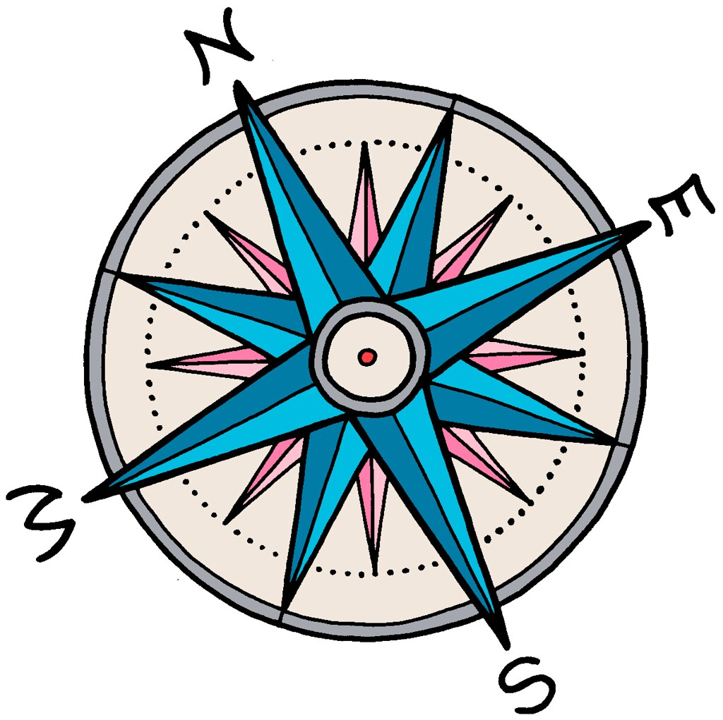
Moral Compass
1st ethical decision making tool
Established from:
Social experience
Upbringing
Cultural norms
Professional experience
Notes:
Let’s get started with our own moral compass.
Your moral compass is your first ethical decision making tool. Our foundational morals give direction as to what is right or wrong. We establish a moral compass over the course of our lives through social experience, how we are raised, cultural norms, and also our professional experiences. Our moral compass informs our ethical orientation.
Completing the Moral Foundations Questionnaire and reflecting on these moral development influencers will help you understand your personal moral compass.
At this point, we’ve taken some time to review our personal morals, but as public health professionals you are also guided by professional codes.

Slide 7
Professional Codes of Ethics
Biomedical example: Hippocratic Oath
Benefit the sick
Avoid harm and injustice
Refrain from exploitation
Patient privacy
Respect medical practice and pass on knowledge
Modern Physician Ethical Considerations
Beneficence, non-maleficence
Autonomy
Social justice
Professional competence
Honesty
Patient confidentiality
Professional relationships
Quality of care
Access to care
Conflicts of interest
Notes:
In bioethics, the most common example of a professional code– and the foundation to ethical decision making in physician-patient relationships – is the Hippocratic oath.
The main ethical parameters to the Hippocratic oath are to benefit the sick, avoid harm and injustice, refrain from exploiting others, patient privacy, and a duty to respect the practice of medicine and to pass on knowledge.
The Hippocratic oath has been around for a long time, and as the practice of medicine has advanced, and as society has learned more about treating illness and keeping people healthy, the professional code of ethics for physicians has evolved. A modern physician must consider these additional ethics:
1. beneficence and non-maleficence (which means help others and do no harm)
2. autonomy (which means respecting individuals and upholding the duty of achieving informed consent)
3. social justice (examples include: equitable distribution of resources, just scientific research)
4. professional competence (such as practicing within a physician’s trained scope)
5. honesty
6. patient confidentiality (and complying with HIPPA)
7. maintaining professional relationships
8. improving the quality of care
9. improving access to care
10. managing conflicts of interest
Comparing this list to the Hippocratic oath, we already are starting to see a shift from focusing on physician-patient relationship to considering how health care impacts larger groups of people.
At this point we have discussed personal moral foundations, and a professional code of ethics for medicine. Let’s run through a quick example of how to apply these ethics in a moral deliberation process:

Slide 8
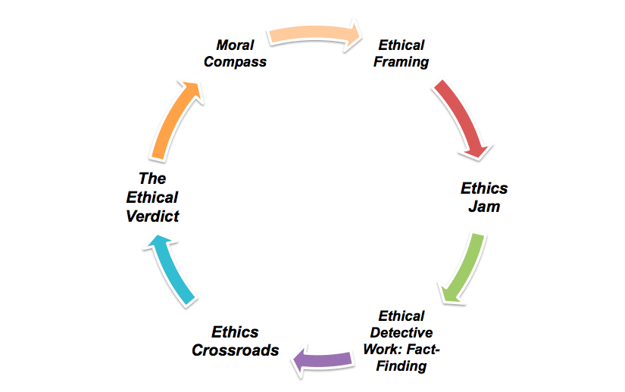
Moral/Ethical Deliberation Process
Notes:
We are going to use a six-step moral deliberation process:
First, we will frame the ethical question, which includes stating the problem, outlining the decision to be made, and considering stakeholders.
Second, we identify the ethics jam: this is where we identify what professional values and ethical principles are in conflict.
Third, we do some fact-finding to build a case for the possible ethical decisions that we could make.
Fourth, we face an ethical crossroads where with all the information that we have, we make an ethical decision supported by morals, values, or ethical codes.
Fifth, we arrive at our ethical verdict of what should happen.
And Sixth, we apply a moral compass test.

Slide 9
Moral/Ethical Deliberation Process
Quick Example:
A pregnant woman comes into an emergency room in active labor. As part of her intake process she informs the medical providers that she recently lost health insurance coverage?
What should the medical providers in the hospital do?
Notes:
Here’s a quick example: A pregnant woman comes into an emergency room in active labor. As part of her intake process she informs the medical providers that she recently lost health insurance coverage. What should the medical providers in the hospital do?
This is an easy example because the United States federal government has already deliberated on this moral issue. The ethical framing is that a pregnant woman needs urgent care but she’s unable to pay for the services. The values of beneficence and social justice for the physicians are in conflict with the hospital’s business values and interests of requiring payment for services. The facts are that the pregnant woman requires immediate care, whereas payment for services is a less pressing immediate issue. Not only is it the morally right decision to help the pregnant woman, but the medical providers and hospital are required by federal law (known as EMTALA) to provide emergency care regardless of ability to pay. The ethical verdict is that the medical providers should provide care.
Finally, let’s apply the moral compass test:

Slide 10
Moral Compass Test
Practicality: Can the ethical decision be implemented, and how?
Collegiality: Would professional peers support the decision?
Publicity: If the ethical decision were made public, could you explain and defend your decision?
Reversibility: If you reversed places, would you agree that an ethical decision was made?
Notes:
The test has four questions:
Practicality: can the ethical decision be implemented, and how?
Collegiality: Would professional peers support the decision?
Publicity: If the ethical decision were made public, could you explain and defend your decision?
Reversibility: If you reversed places, would you agree that an ethical decision was made.
In the case of the pregnant woman, it’s practical to help her, colleagues would support the decision, the public would approve of helping her, and in the reverse case I presume everyone on this webinar would want to receive medical care regardless of ability to pay. This was perhaps an overly simplistic ethical dilemma (for the sake of time), but it includes all aspects of the decision making process. Ethical decisions are often more complex and more difficult to arrive at a decision.
Now, at this point we have discussed how moral foundations and professional codes of ethics can be applied to an ethical decision making process in a medical context.

Slide 11
Ethical Theories
Virtue/Care Ethics: Why type of person am I? What acts are right/wrong based on my virtues?
Duty Ethics (Deontology): What acts treat others as ends-in-themselves, not as means? What acts treat people with dignity?
Utilitarian Ethics (Consequentialism): What acts have the best results for the greatest number of people?
Notes:
The final piece I will add to the equation is a quick explanation of three ethical theories:
Three common ethical theories are:
Virtue or care ethics: this theory focuses on questions like: What type of person ought I to be? And what acts are right or wrong based on my virtues?
Duty Ethics (or Deontology) asks: What acts treat others as ends-in-themselves, not means? What acts treat people with dignity?
Utilitarian ethics (or Consequentialism) asks: What acts have the best results for the greatest number of people?
These theories add another layer of considerations in an ethical dilemma.
At this point we should see some biomedical ethical principles and theories that align with public health, but what makes public health ethics different from bioethics?

Slide 12
Health Care vs. Public Health
Medicine/Health Care focuses on: | Public Health focuses on:
Treatment | Prevention
Individual patients | Populations and communities
Acute medical interventions | Variety of interventions
Fiduciary relation to private patients | Public stewardship
Authority from expertise | Authority based on police powers
Laws restrict practice | Laws expand practice
Individual benefit/ harm | Greatest net social good
Personal autonomy | Relational interdependence
Informed consent | Community engagement and aligning values
Social justice focuses on access to care | Social justice focuses on SDOH-HE
Notes:
The differences arise from the fundamental differences in the practice of medicine versus public health.

Slide 13
Public Health Ethical Principles
Core Values
Health, Community, Evidence-Based Interventions
Address root causes
Respond to emergencies
Enhance environment
Respect communities
Display cultural competence
Gain community consent
Establish collaboration to build trust
Achieve health equity
Evidence-based programs
Maintain data confidentiality
Competent workforce
Give stakeholders a voice
Notes:
Public Health’s core values are health, community, and evidence-based interventions. These values inform the core ethical principles of :
Addressing root causes to prevent disease and promote health
Responding to public health emergencies in a timely way
Enhancing the environment
Respecting communities
Displaying cultural competence
Gaining community consent and building consensus
Establishing collaborations to build trust
Achieving health equity
Basing programs on evidence
Maintaining data confidentiality
Ensuring competence in the public health workforce
And Giving stakeholders a voice

Slide 14
Public Health Ethical Principles
Core Values
Health, Community, Evidence-Based Interventions
Address root causes
Respond to emergencies
Enhance environment
Respect communities
Display cultural competence
Gain community consent
Establish collaboration to build trust
Achieve health equity
Evidence-based programs
Maintain data confidentiality
Competent workforce
Give stakeholders a voice
Discussion:
How do these values align with Public Health Modernization?
Notes:
DISCUSSION: This list comes from NACCHO’s public health ethics workbook. How do these values align with Public Health Modernization?
I found that this list of public health ethical principles strongly corresponds with Oregon’s Public Health Modernization Manual foundational capabilities.

Slide 15
Public Health Ethical Principles
Ethical Principles → Modernization Foundation Capabilities
Address root causes
Respond to emergencies
Enhance environment
Respect communities
Gain community consent
Establish collaboration to build trust
Achieve health equity
Display cultural competence
Evidence-based programs/policies
Maintain data confidentiality
Competent workforce
Give stakeholders a voice
Emergency Preparedness & Response
Community Partnership Development
Health Equity & Cultural Responsiveness
Policy & Planning
Assessment & Epidemiology
Leadership & Organizational Competencies
Communications
Notes:
Here are some connections. I think the connection to the foundational capabilities is powerful because it supports that public health work is fundamentally about “upstream, ethics-in-all-policies approaches to decision making,” and that ethics are integral to achieving improved health for society.
Before moving on from this list provided by NACCHO, I want to add beneficence and nonmaleficence to the list. These principles originate in bioethics, but they are appropriate to add here because it’s true of public health too that we shouldn’t harm others and our goal should always be to help improve health.
Let’s move on to applying these principles to ethical problems.

Slide 16



Ethical Problems in Public Health
Challenges in providing education through training and practice in skills and abilities.
Determinations based on established standards, rules, or guidance.
Deliberations that involve utilitarian weighing, and balancing stakeholder claims and values in relation to program goals.
Notes:
NACCHO provides three buckets of ethical problems in public health:
1. Challenges in providing education through training and practice in skills and abilities. (to me this sounds like building the moral compass of a public health professional)
2. Determinations based on established standards, rules, or guidance. (I would add laws to this list, and in Oregon, the Public Health Modernization Manual)
3. Deliberations that involve utilitarian weighing, and balancing stakeholder claims and values in relation to program goals. (I personally would swap out program goals for health outcomes here because improved health is the goal of all our programs).

Slide 17
Ethical Problems in Public Health
Discussion:
What are some real life examples that may fall in these buckets?
Challenges in providing education through training and practice in skills and abilities.
Determinations based on established standards, rules, or guidance.
Deliberations that involve utilitarian weighing, and balancing stakeholder claims and values in relation to program goals.
Notes:
DISCUSSION
What are some real life examples that may fall in these buckets?
Discussion Responses:
Examples -
Bucket 2: Environmental Health regulatory work
Bucket 3: HINI responses and choosing who should have priority to receive the limited number of available vaccines

Slide 18



Public Health Ethical Conflicts
Balancing individual liberty with protecting the public
Handling potential conflicts of interest
Community engagement
Allocating scarce resources
Navigating political contexts and constraints
Complying with ethical and legal regulations in a consistent way
Notes:
Here are some ethical conflicts that public health professionals frequently face:
- balancing individual liberty with protecting the public (enforcing environmental health regulations, reporting required diseases, requiring vaccinations to control an outbreak)
- handling potential conflicts of interest (perhaps in working with contractors or implementing organizational policies)
- community engagement (establishing what the adequate level of outreach is to support claims of a transparent and community informed process)
- allocating scarce resources
- navigating political contexts and constraints
- complying with ethical and legal regulations in a consistent way
Now that we have expanded the scope of our conversation from interpersonal to community responsive ethical principles, the next question is: how should public health professionals navigate ethical decisions?
We already covered one option for a framework to process ethical decisions that you could adapt for your own public health purposes, but now let’s look at something more tailored to public health authority:

Slide 19
3 Step Ethical Analysis Procedure
Gather and Analyze Relevant Facts | Design and Evaluate | Publicly Justify
Public health goals | Utility | Effectiveness
Stakeholder values, claims, interests | Respect | Proportionality
Risks and harms | Justice | Necessity
Legal authority and constraints on action | Contextual appropriateness | Least infringement
Relevant precedents, guidance, documents, and ethics resources |  | Reasonable trade-offs between stakeholder interests and values
Notes:
This is NACCHO’s framework for ethical analysis. The three steps to respond to a public health ethical dillema and choose your course of action are to 1) Gather and Analyze Relevant Facts for your ethical dilemma, 2) Design and Evaluate your options for responding to the ethical dilemma and choose a public health action, and 3) have a plan to publicly justify your ethical decision.
This chart provides a high level summary of things to take into consideration in your ethical analysis. Moving through this framework may not be a completely linear process, but it pulls together a lot of important questions to justify public health actions in an ethical way.
Some useful definitions:
Utility: does the public health action balance benefits and harms?
Justice: are benefits and burdens distributed fairly or equitably?
Respect: does the public health action respect individuals, communities, and shared values? Some values to consider may include honesty, trustworthiness, consensus-building, protection of vulnerable populations, and reducing undue stigmatization, to name a few.
Proportionality: refers to weighing whether the benefits of the decision outweigh other infringed moral considerations. Basically, do the costs and benefits balance each other.

Slide 20
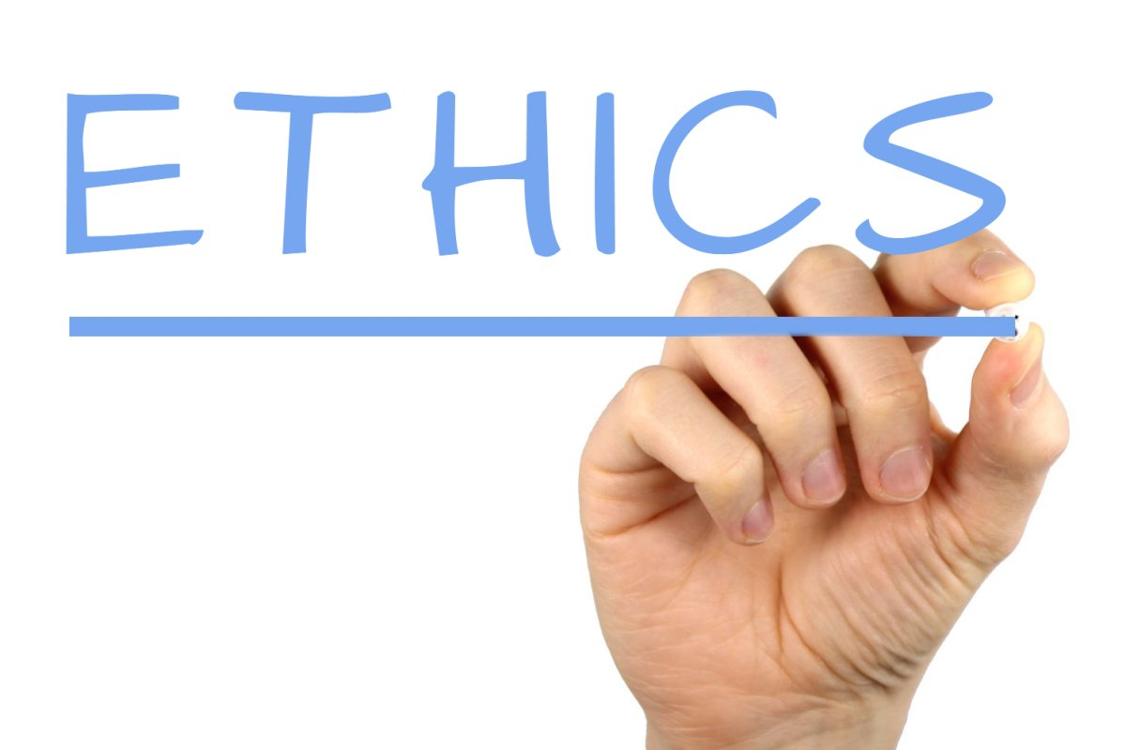
“Facts matter, but so do values:
minimize bias in acquiring evidence, but
values help in mediating evidence and local context.
Successful interventions translate from an evidence base to a local context in ways that resonate with stakeholder values.”
Notes:
Final piece of advice from NAACHO resources:
“Facts matter, but so do values:
- It’s important to minimize bias in acquiring evidence, but
- values help in mediating evidence and local context.
- Successful interventions translate from an evidence base to a local context in ways that resonate with stakeholder values.”
That concludes our review of bioethics and public health ethics principles and two frameworks for approaching ethical decision making. I will now open up the conversation to discussion.

Slide 21
Discussion (1/4)
Remember to say your name!
How does your public health department identify a public health ethical dilemma?
*If you are watching with other PH staff, feel free to discuss more as a group after the webinar!
Notes:
Discussion Feedback:
Participants said that they don’t have a formalized process for identifying or deciding ethical dilemmas. However, for local health departments working on Public Health Accreditation, this is important. Accreditation now has requirements related to ethical decision making. Resources in these slides may be useful for considering how to develop a formal process for ethical decision making. Participants said that often manager and administrators lead ethical decision making and will then expand the scope of stakeholders depending on the issue.

Slide 22
Discussion (2/4)
Remember to say your name!
In analyzing a public health ethical dilemma, you must analyze health goals, stakeholders, risks and harms, legal authority, and relevant precedent/guidance. Which of these areas would you personally start with in your analysis, and why?
What public health ethical principles would you use to support that decision?
*If you are watching with other PH staff, feel free to discuss more as a group after the webinar!
Notes:
Discussion Responses:
A couple participants with backgrounds in Environmental Health said that their professional experience has led them to start with considering legal authority to respond to an ethical issue. Others said that they start with assessing the risks and harms. One participant said that they first react with minimizing harm and do their best with what resources are available, and then as an administrator they will think more about legal authority.

Slide 23
Discussion (3/4)
Remember to say your name!
What are your takeaways from this webinar and how might you apply it to your work?
*If you are watching with other PH staff, feel free to discuss more as a group after the webinar!
Notes:
Discussion Responses:
Connection to accreditation requirements
Ethical decision making may be a useful topic for the Modernization Learning Collaborative
Importance of planning for ethical decision making processes to be more proactive, rather than reactive
Connecting ethics to preparedness and tobacco prevention. May be able to tie ethical decision making frameworks into presentations with decision-makers (e.g. commissioners) when talking about tobacco policy
Train new staff on public health ethics and revisit topic with experienced staff
This topic may be worth sharing with a bigger audience (e.g. OPHA Conference, Environmental health conference)

Slide 24
Discussion (4/4)
Remember to say your name!
How would you start an ethical analysis of Oregon’s public health intervention in the vaping illness epidemic?
*If you are watching with other PH staff, feel free to discuss more as a group after the webinar!
Notes:
Discussion Responses:
It’s important to start with the right people and have a thorough analysis
Sometimes you have to respond with cautionary principles to minimize harm when some information is unknown
Sometimes public health has to act with limited information (e.g. not knowing the precise cause of vaping illness)
Nuance in messaging individual rights vs. community safety
Example: OSU changed policy from “smoke free” to “tobacco free” campus and is doing in-depth work to appropriately message and communicate the change
Messaging ethical ethical decisions is challenging and important

Slide 25
References
Thank you!
Slides will be available at oregonclho.org
Biomedical Ethics Information. Professor Courtney Campbell, Hundere Chair for Religion & Culture and Philosophy Professor. Oregon State University. Materials from Course PHL 544: Biomedical Ethics. Spring 2017 https://liberalarts.oregonstate.edu/users/courtney-campbell
NACCHO University. Course: Introduction to Ethical Decision Making. https://www.pathlms.com/naccho

