Slide 1
Establishing High Burden Overdose Counties
The below are available from PDMP Oregon Data Dashboard for each county/region and are suggested by IVPP for the purpose of Overdose Prevention funding.
Overdose Deaths – All drugs (rates)
https://www.oregon.gov/oha/PH/PREVENTIONWELLNESS/SUBSTANCEUSE/OPIOIDS/Pages/data.aspx
Overdose Hospitalizations – All drug hospitalizations (rates)
https://www.oregon.gov/oha/PH/PREVENTIONWELLNESS/SUBSTANCEUSE/OPIOIDS/Pages/data.aspx
Risky Opioid Prescribing > 90 MED per fill
https://www.oregon.gov/oha/PH/PREVENTIONWELLNESS/SUBSTANCEUSE/OPIOIDS/Pages/data.aspxCo
The Oregon-Idaho HIDTA consists of 14 counties and the Warm Springs Indian Reservation. Counties in the HIDTA include Oregon’s Clackamas, Deschutes, Douglas, Jackson, Lane, Linn, Malheur, Marion, Multnomah, Umatilla and Washington counties. A key strategy of the programs goals is to promote the creation, and support of existing, community-based drug prevention and recovery initiatives whose missions are to significantly reduce the impacts of illegal drug use in the Oregon-Idaho HIDTA region.
HIDTA Regions – High Intensity Drug Trafficking Areas
http://oridhidta.org/

Slide 2
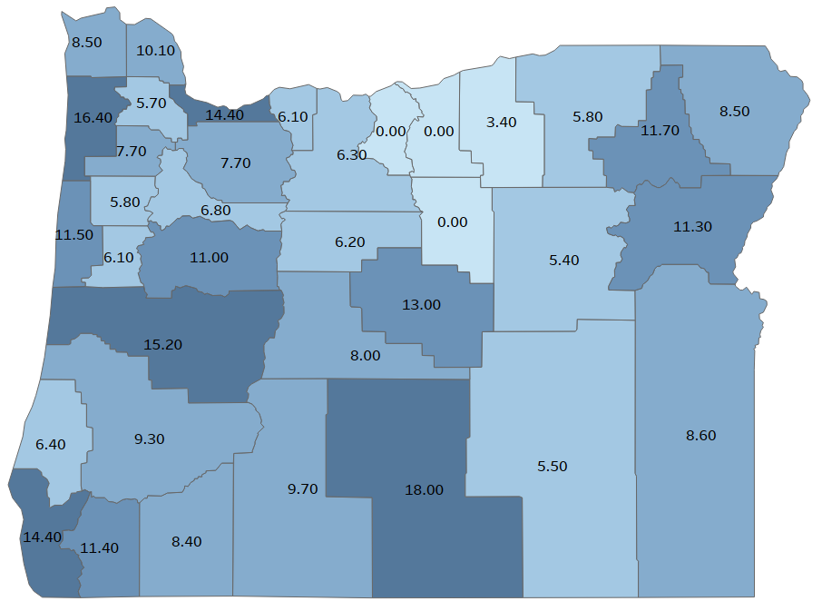
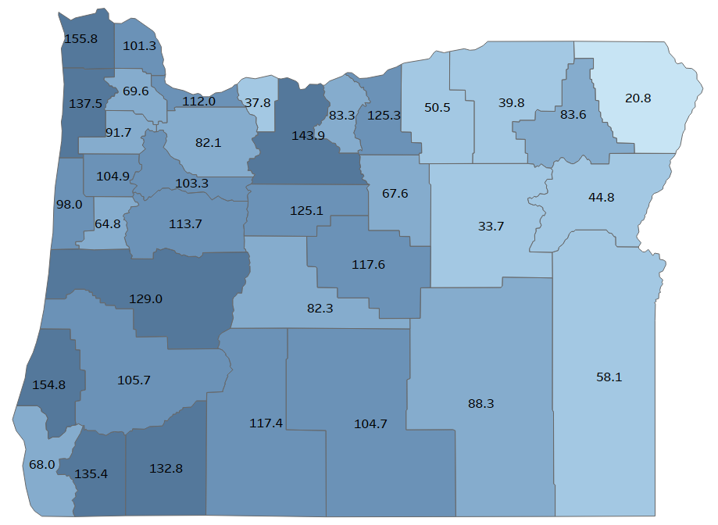


Overdose Deaths, All Drugs (2013-2017)
30% of score
Overdose Hospitalizations, All Drugs (2016-2017)
30% of score

Slide 3
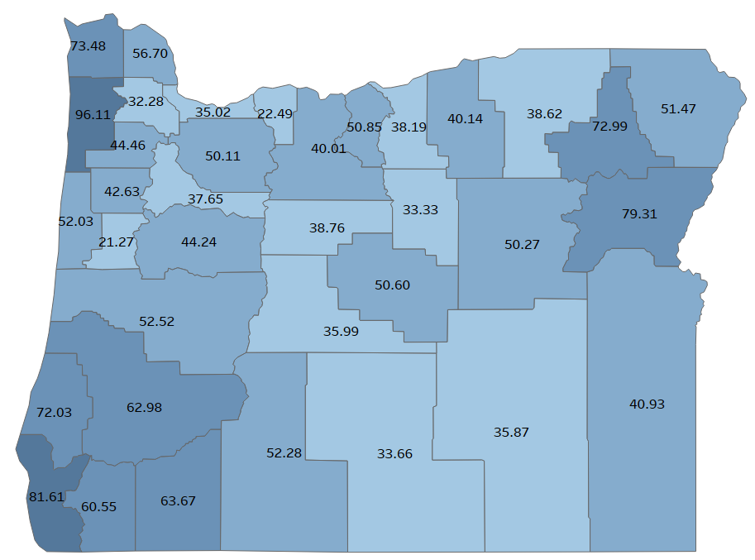
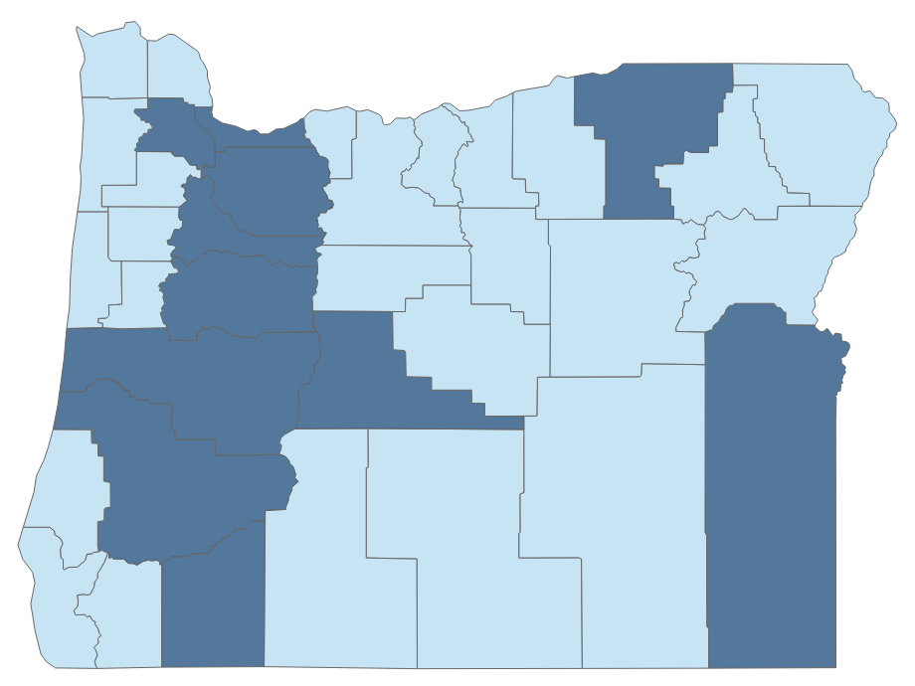

High Dose Opioid Prescribing (>90 MED), 2019
30% of score
High Intensity Drug Trafficking Area (HIDTA) Counties
10% of score

Slide 4
Composite High Burden Counties and Regions
Highest | Middle | Lower
Lane | Lake, Klamath | Polk
Douglas, Coos | Lincoln, Benton, Linn | Washington
Jackson | Clackamas | Umatilla
Multnomah | Crook, Deschutes, Jefferson | Harney
Clatsop, Tillamook, Columbia | Marion | Wallowa
Josephine | Baker | Grant
Curry | Gilliam, Sherman, Wasco | Morrow
Lake | Malheur | Hood River
Union | Yamhill | Wheeler

