Slide 1
Public Health Modernization Data Access and Visualization
Ali Hamade, PhD
Deputy State Epidemiologist
April 18, 2019

Slide 2
Items to ponder during the presentation
Are we missing any important data access & visualization strategies in terms of modernizing Oregon’s public health system?
What feedback do you have on this plan or strategy?
Do you see any underlying biases in our plan for data visualization?

Slide 3
Interactive data visualization enables data representations on a graph, table, or map with the ability to change variables and link multiple media.

Slide 4
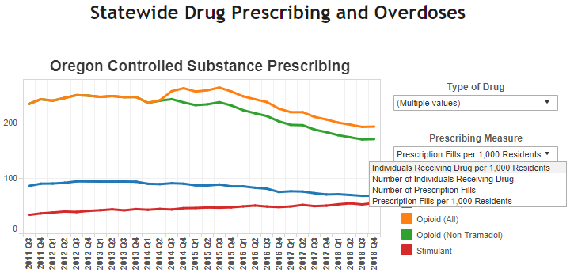

Slide 5
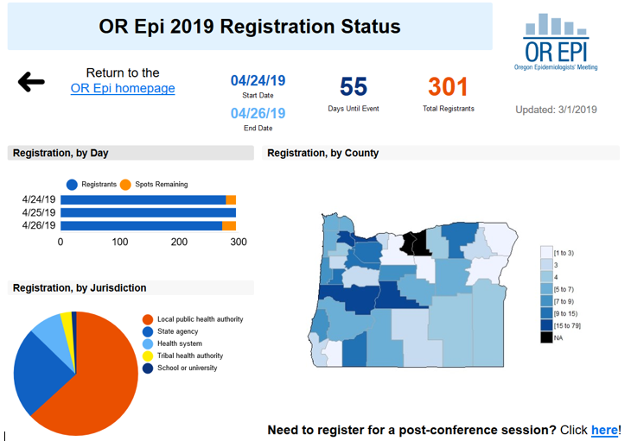

Slide 6
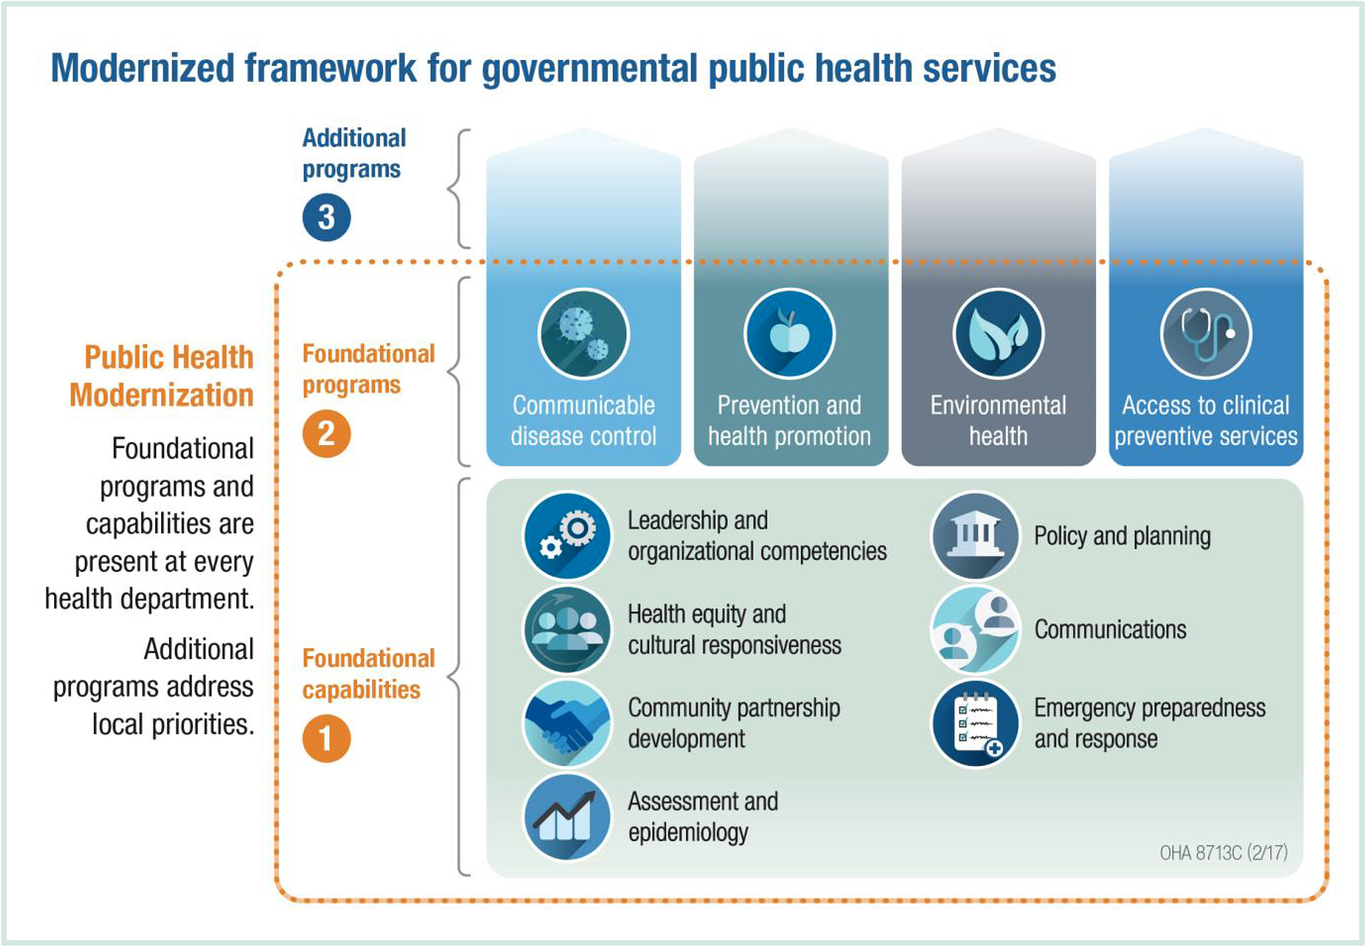

Slide 7
Data visualization initiative aims
Data access
Faster evidence-based planning
Staff time savings and capacity increase
Interoperability of systems
↓
Benefits to state agencies, LPHAs, tribes, policy-makers, community-based organizations, advocates, media

Slide 8
Assessment and Epidemiology Capability activities for State and LPHAs
Data collection and electronic information systems
Guide public health planning and decision making
Data access, analysis, and use
Accurate, timely, actionable, usable, meaningful to requester
Conduct and use community and statewide health assessments
Identify health priorities from assessments, including health disparities assessment
Infectious disease related assessment
Identification and response to disease outbreaks and epidemics

Slide 9
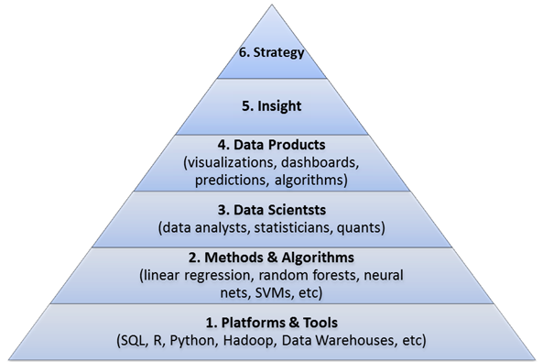
Science and purpose behind data visualization
Source: refactoredthinking.com

Slide 10
Data continuum
What?
How?
}
{
Reportable diseases
Vital statistics
Surveys
Service delivery
Collection
Electronic reporting
On-line / phone
Interoperability
Data exchange
}
{
Incidence/ prevalence
Time trends
Demographics
County distribution
SPSS
SAS
Stata
Analysis
}
{
Data Reports
Fact sheets
Interactive visualization, web-based
Reporting/
Communicating
Static PDFs
Tableau
Power BI
}
{
Population impact
Program evaluation
Policy development
Presentations to policy-makers
Presentations to funders
Interpretation
Credits: Katrina Hedberg, MD

Slide 11
Data access and visualization priorities
Vital Records
Birth and death data
Reportable conditions
ORPHEUS, OSCaR
Survey data
BRFSS; OHT; Student Health Survey; PRAMS I/II
Service delivery
Alert IIS (Immunizations); Oregon Trauma Registry, Prescription Drug Monitoring Program
Environmental and Regulatory
Safe drinking water information system
Emergency Preparedness and Response
Electronic Surveillance System for Early Notification of Community Based Epidemics (ESSENCE)

Slide 12
Measuring our performance on data visualization
Benchmark |  | Points
1 | Data visualization plan in place that includes maintenance | 1
2 | Data visualization and database software acquired and staff available who can use it | 1
3 | Back-end database created OR If project already complete, data updated per schedule in plan | 1
4 | Data visualization created and published | 1
Score for comprehensive projects |  | sum of 1 to 4
Score for partial projects |  | 50%

Slide 13
Performance measure plan
All data set owners will develop a plan that details how they will publish and share data interactively
Plan will include items on
Partner engagement
How to best share data with LPHAs, tribes, others
Ensure that data are useful for partners
Evaluation
Continuous Quality Improvement

Slide 14
Questions and discussion
Are we missing any important data access & visualization strategies in terms of modernizing Oregon’s public health system?
What feedback do you have on this plan or strategy?
Do you see any underlying biases in our plan for data visualization?

Slide 15
ali.k.hamade@state.or.us

