Slide 1
Oregon's Billable Vaccine Project
Revised Billing Standards 2019
Oregon Immunization Program
Erin Corrigan, MPH
November 21, 2019

Slide 2
Background: Vaccine Supply and Financing in OR
Private clinics
State supplied vaccine (VFC-qualifying patients)
Purchased by clinic/health system (commercially insured, adult Medicaid, Medicare)
Public clinics
State supplied* for most patients/vaccines (excludes flu and travel vaccines)
Billable Vaccines Project begins in 2003
LPHAs begin billing insurance companies for well-insured clients
*OIP manages $60,000,000 of vaccine for about 60% of Oregon’s children and all adults served at safety net sites

Slide 3
Billables Project, 2012-2015
Purpose
Assess LPHA billing capacity
Provide support to develop sustainable capacity
Outcomes
• Immunization Billing Standards
  Developed in 2012-14 with input from LPHAs, approval by CLHO
  Added to Program Element 43
• Improved consistency of CCO payments
• Commercial contracts – Moda, Providence, Regence, others

Slide 4
Original Billing Standards
“OIP will work with appropriate CLHO committees to add the standards to Program Element 43 and negotiate the Tier One implementation date.”
Needed to be revised to align with 2019 reality
Purpose: To standardize and assist in improving immunization billing practice
Included “Guiding Principles”
Three tiers to allow for different LPHA capacities

Slide 5
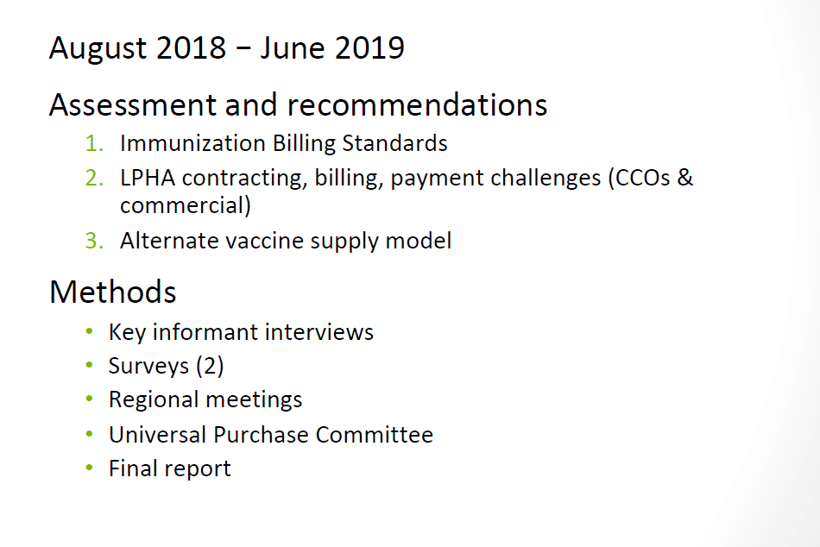
Billables 2.0

Slide 6
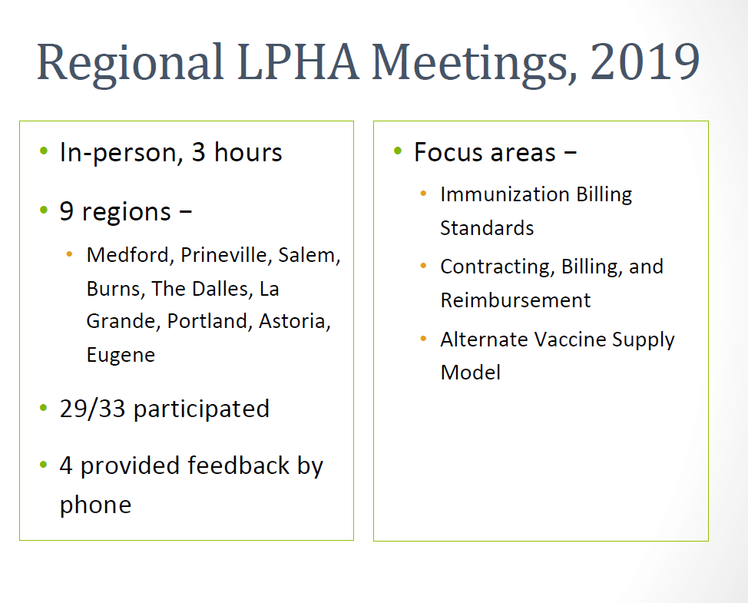
LPHA Regional Meetings 2019

Slide 7
Revised Billing Standards
Based on feedback from LPHAs in regional meetings, March-May 2019
  Retained guiding principles
  Simplified, single set of standards
  Acknowledges different business models among LPHAs
To CLHO CD for review November 2019 (draft)

