Slide 1
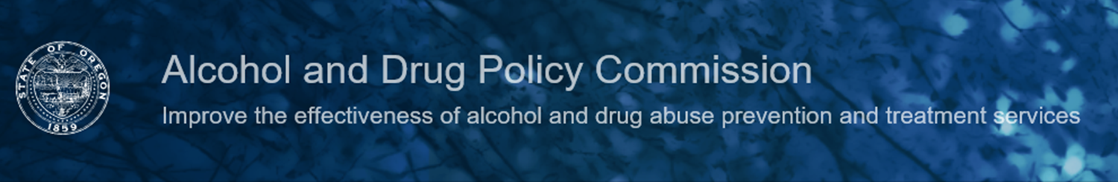
Strategic Prevention, Treatment, and Recovery Support Plan
Coalition of Local Health Officials
November 21, 2019
Dr. Reginald Richardson, Executive Director

Slide 2

Overview for Today
The Alcohol and Drug Policy Commission (ADPC) is an independent state government agency created by the Oregon Legislature to improve the effectiveness and efficiency of state and local substance misuse prevention, treatment and recovery services for all Oregonians. The ADPC is charged to develop a comprehensive Statewide Strategic Plan for Oregon that:
Identifies priorities for substance misuse/SUD prevention, intervention, treatment, and recovery support, and
Involves communities experiencing health inequities
Communities of color
Rural communities
Tribal nations
Purpose of the Alcohol and Drug Policy Commission
Overview of Substance Use Data Collected
Strategic Plan Goals & Objectives
Questions

Slide 3
Alcohol and Drug Policy Commission
The Alcohol and Drug Policy Commission (ADPC) is an independent state government agency created by the Oregon Legislature to improve the effectiveness and efficiency of state and local substance misuse prevention, treatment and recovery services for all Oregonians. The ADPC is charged to develop a comprehensive Statewide Strategic Plan for Oregon that:
Identifies priorities for substance misuse/SUD prevention, intervention, treatment, and recovery support, and
Involves communities experiencing health inequities
Communities of color
Rural communities
Tribal nations
The Alcohol and Drug Policy Commission (ADPC) is:
An independent state agency created by the Legislature to improve the effectiveness and efficiency of substance misuse prevention, treatment, and recovery services for all Oregonians
Charged with developing a comprehensive Statewide Strategic Plan that identifies priorities for prevention, treatment, and recovery support.

Slide 4
Substance Use Disorders
Nearly 1 in 10 Oregonians aged 12 and older were estimated to have a substance use disorder in 2015-2016
9.6%
7.1%
3.8%
0.8%
Any
Alcohol
Illicit drugs
Rx Pain Meds
Source: National Survey on Drug Use and Health, 2015-16.

Slide 5
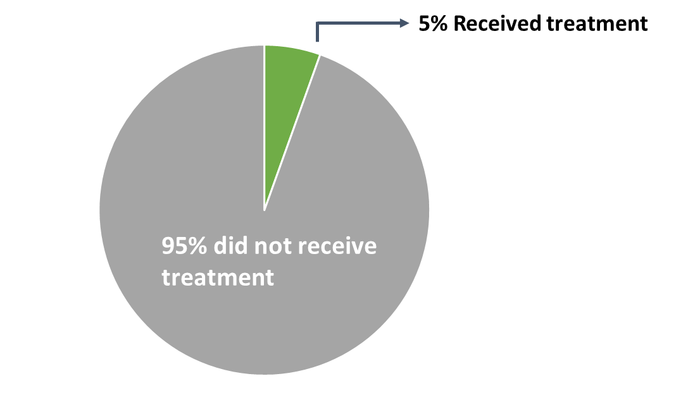
Treatment for Substance Use Disorders
Most Oregonians with a substance use disorder are estimated to not receive treatment
Source: National Survey on Drug Use and Health, 2016-17
Source: National Survey on Drug Use and Health, 2016-17
Substance Use Disorder is defined as meeting criteria for illicit drug or alcohol dependence or abuse.

Slide 6
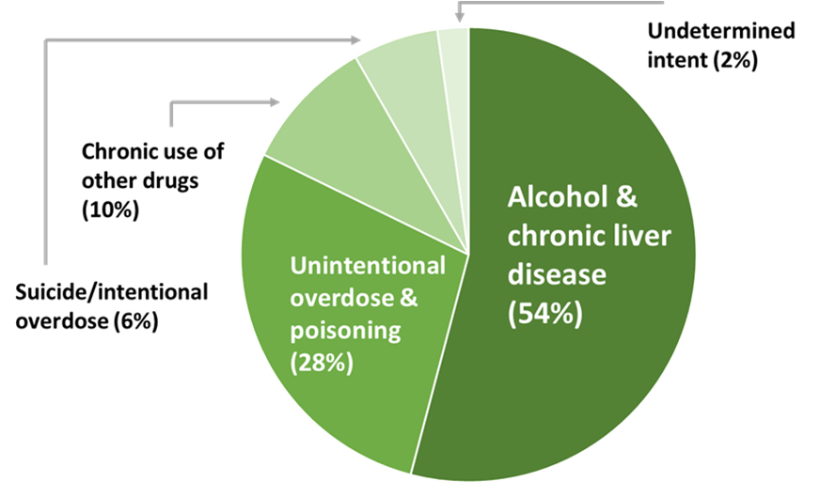
Personal Toll of Substance Use Disorders
1,549 deaths in Oregon in 2017 were due to alcohol or other drugs
Source: National Survey on Drug Use and Health, 2016-17
Substance Use Disorder is defined as meeting criteria for illicit drug or alcohol dependence or abuse.

Slide 7
Key Strategic Plan Tasks
Stakeholder Engagement
Data Assessment and Collection
Policy Assessment and Development
Program and Service Delivery Assessment, Alignment, and Coordination
Workforce Development and Staffing
Cost Estimates
Reporting and Communication

Slide 8
Strategic Goals
Goal 1: Decrease the percentage of Oregonians with a substance use disorder
Goal 2: Decrease the rate at which Oregonians die from alcohol, tobacco, and other drugs
Goal 3: Decrease alcohol, tobacco, and other drug-related health disparities
Goal 4: Decrease amount of state funds spent on the burden of substance use-related social and health problems to public programs

Slide 9
Overarching Objectives
Objective 1: Strengthen Oregon’s state substance misuse system
Objective 2: Increase the impact of substance misuse prevention across the lifespan
Objective 3: Increase rapid access to effective SUD treatment across the lifespan
Objective 4: Increase access to effective SUD recovery supports across the lifespan

Slide 10
Questions
Stay connected with ADPC:
www.oregon.gov/adpc

