Slide 1
Oregon’s Public Health and Wildfire James Markwiese
US Environmental Protection Agency Office of Research and Development
Oregon Coalition of Local Health Officials, August 15, 2019
Notes:
This research builds on existing collaborations between EPA ORD, Program Offices and the Regions, and contributes to …. to improve risk-based decision-making.

Slide 2
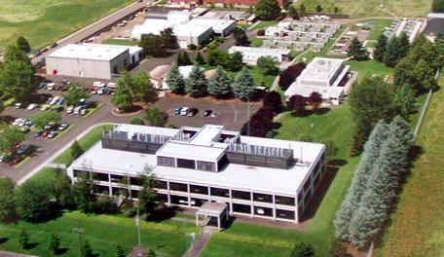
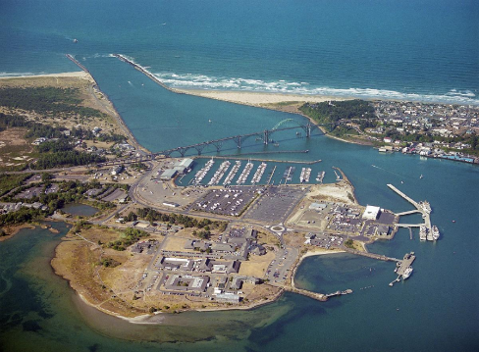
EPA ORD Research
Corvallis & Newport, Oregon
The Environmental Protection Agency’s Office of Research and Development conducts research to predict the condition of these systems and their contributions to human well being nationwide
61 EPA Staff, 67% with Ph.D.’s
51 Scientists
5 EPA Postdoctoral Fellows
5 Program Operations Staff
52 On-site Contractors
23 NRC/ORISE Postdoctoral Fellows + Students
16 SEE Employees
23 Cooperators/Collaborators
ORD supports the EPA Regions, state governments and local communities
Office of Research and Development

Slide 3
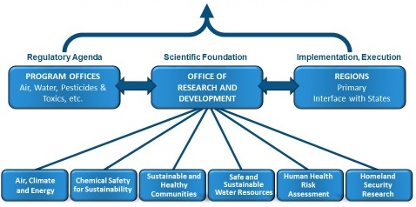
US Environmental Protection Agency Structure
Protect Human Health and the Environment
Office of Research and Development

Slide 4
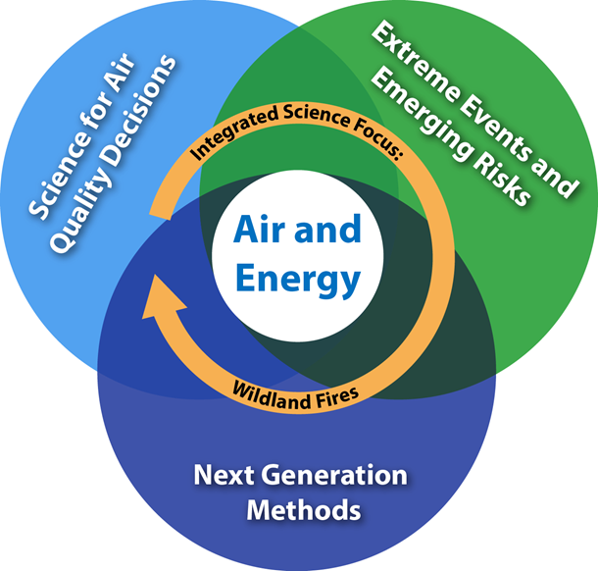
Air and Energy Research Program
Research topics/areas are interconnected and
rely on multiple scientific disciplines working collaboratively
Office of Research and Development

Slide 5
Wildfire Issues Facing Local Health Officials
Understand emissions from wildfires versus prescribed fire. Current dogma assumes prescribed burning significantly reduces emissions from wildfires. Is this true?
Does the smoke from vegetation (oak, pine) and the Wildland Urban Interface throughout Pacific Northwest produce different types and levels of pollution?
What is the estimated smoke exposure for those near fires, and how does it relate to observed health effects?
How do prescribed burns contribute to air pollution?
How do we characterize exposure?
Scale
Cost
Change in Annual Burned Acreage by State Between 1984–1999 and 2000–2014
Source:
MTBS (Monitoring Trends in Burn Severity). 2016. MTBS data summaries.
Office of Research and Development

Slide 6
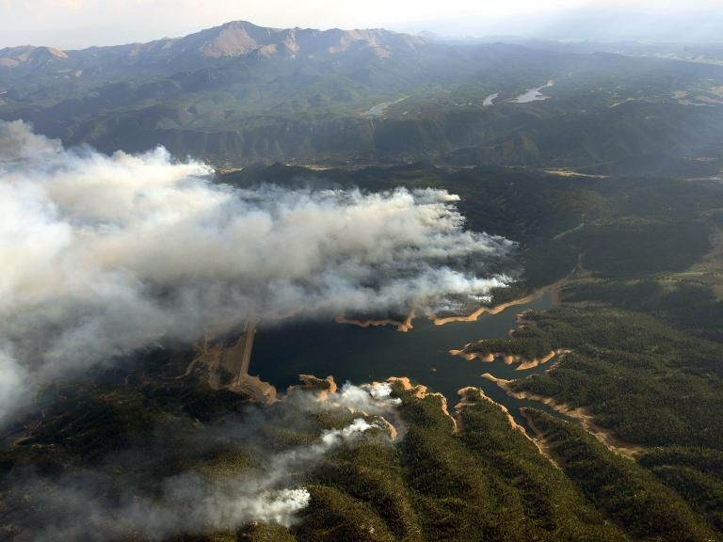
Wildfire-Water Research
About two-thirds of western US municipalities rely on water from forested watersheds
Wildfires can abruptly and adversely impact these watersheds and effects of wildfires are complex and long-lasting
Hazardous chemicals at the Wildland-Urban Interface
Fires like the one that razed Paradise [CA] in November burned thousands of pounds of wiring, plastic pipes and building materials, leaving dangerous chemicals in the air, soil and water.” - Sharon Bernstein, Washington Post April 9, 2019
Courtesy of Jeff Peterson (Retired-Office of Water, EPA)
Notes:
There are various water-wildfire research activities happening in ORD, including:
Understanding which watersheds are vulnerable to wildland fire,
Understanding the impacts they have on cold water refugia,
And also understanding how diseases and pests will behave with these fires and how that could effect tree health and water quality.

Slide 7
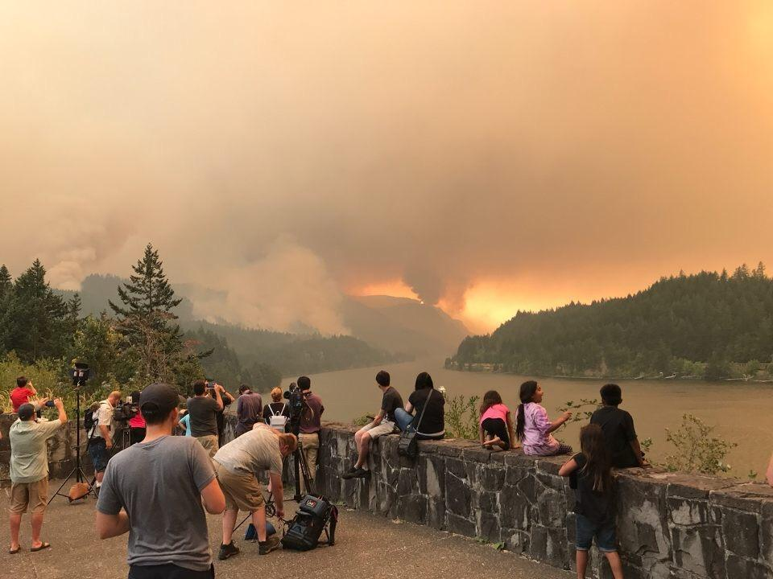
EPA, Wildfire and Smoke
Wildland fires are increasing in size and severity in the US
Air quality managers interested in reliable and accurate tools and to assess impacts of wildfires; e.g.,
Respiratory-related hospital admission rates surge during and after wildfire events
How and to whom do we communicate these approaches/guidance to reduce risks?
Smoke Sense: citizen-science study using a mobile-device app mapping current wildfire locations
20,000+ citizen scientists
Current and forecasted air-quality
Eagle Creek Fire, Sep 2017
Notes:
EPA’s Mission is to protect human health and the environment.
While there are some ecological benefits, Wildland fire, meaning uncontrolled wildfires and prescribed burning plus the smoke and ash from that fire can impact air quality, water quality, land management, ecosystem services, and public health.
Further, these fires are expected to get worse over time, so this area is an important topic that is right in line with our mission.

Slide 8
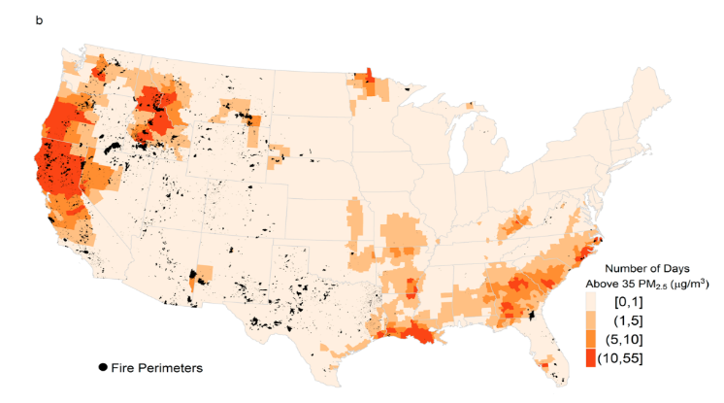
Days, fire-PM2.5 > daily health standard
Improved emissions data will inform wildfire contribution to air pollutants under Clean Air Act. National Emissions Inventory estimates >30% of PM_{2.5} associated with emissions from wildland fires
Source: Rappold AG, et al Environ Sci Technol 2017
Source: Rappold AG, et al Environ Sci Technol 2017

Slide 9
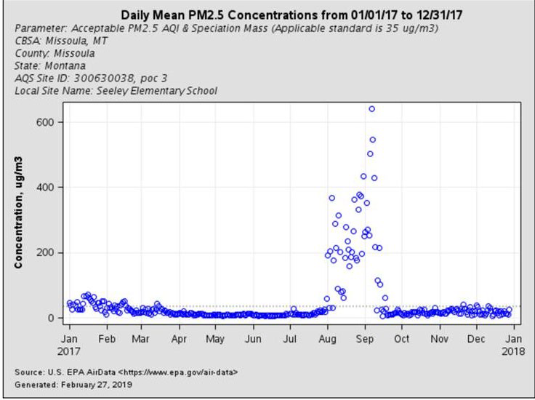
EPA ORD Fire Research: Pacific Northwest air quality
24 hour PM_{2.5} standard 35 μg/m³, during smoke events concentrations can be several hundred μg/m³ and higher
Health effects include: respiratory illness, cardiovascular events, depression and stress, and possibly adverse birth outcomes
People are not aware of the potential health impacts associated with wildland fire exposures…nor what actions they can take to protect themselves
Notes:
WED has capabilities that Researchers will collect air data, compare the performance of low-cost sensors and other small samplers at the labs to nearby regulatory monitors during wildfire smoke impact events.

Slide 10
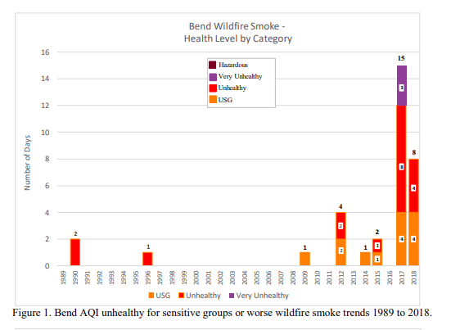
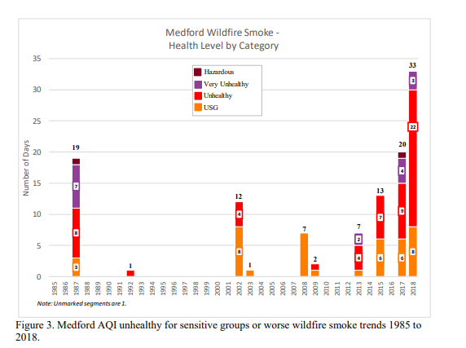
AQI unhealthy for sensitive groups/worse
Bend and Medford wildfire smoke trends
legend
Number of Days
Number of Days
Source: Oregon DEQ, Wildfire Smoke Trends and Associated Health Risks; Bend, Klamath Falls, Medford and Portland - 1985 to 2018 https://www.oregon.gov/deq/FilterDocs/smoketrends.pdf

Slide 11
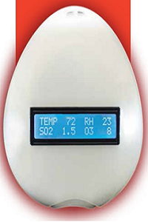
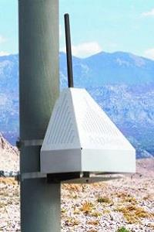
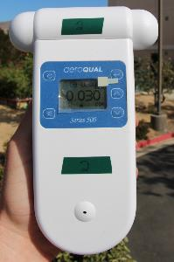
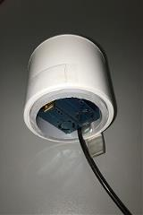
Wildland Smoke – EPA & Partners Require Tools to Evaluate AQM Sensors
EPA and Partners are relying more heavily on low-cost sensors for AQ monitoring and research
Sensors have numerous performance issues (durability, accuracy, precision, drift, bias, hysteresis, dynamic range) that require chamber & colocation field evaluations
Our partners are requesting a sensor/monitor testing platform that is outside regulatory network, BUT utilizes reference grade monitors | (FRM/FEM)
Office of Research and Development

Slide 12
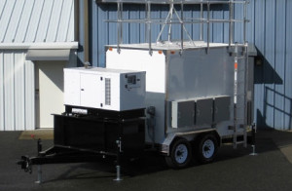
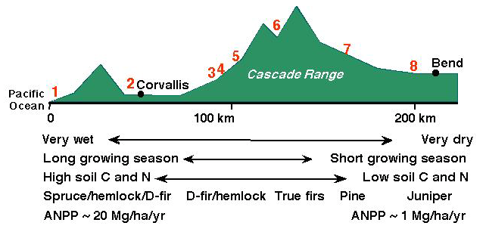

Enhanced Monitoring Network:
Tools To Address Wildfire Issues
Establishing reference grade Stationary & Mobile AQM platforms (under the Air and Energy Research Program) for collocated field evaluations of new monitors and sensors and to support ecological, human health, and community supported research activities. Location advantages:
Low background air quality levels (required to test dynamic range of sensors optimized for more polluted environments) and acute seasonal smoke events (high smoke levels impact performance of most all AQ sensors)
Proximity to western wildland fire action areas
Significant support from EPA Regions and States
Monitoring platforms facilitate integration across disciplines (especially health & ecology) and ORD Labs/Centers, Regions, States, Tribes, Local Air Quality Districts to fulfill 1970 CAA legal mandate to research and protect public health and environment

Slide 13
Wildland Smoke – EPA & Partners Require Tools to Evaluate AQM Sensors
Stationary AQM Platform
Resurrect AQM used in previous ORD Ozone studies (O₃)
NERL loaning ~ $50K AQ monitors (CO, NO_{x}, SO₂)
A-E Program & ORD contributed $75K for calibration equipment and PM2.5 sensor
Secure future funding to complete platform (~ $180K) and replace loaner equipment ( ~50K)
Mobile AQM Platform
Platform will contain data acquisition equipment, FRM/FEM monitors, will not require A/C power, will be fully self-sufficient for rapid, extended, and remote deployments
Joint NERL/NHEERL/NRMRL proposal that included Western mobile AQM platform
Secure future funding for “Western” mobile platform (~ $420K Core / ~$145K Optional Measurements)
Significant and Notable Region & State (R10, R9, R8 and CA, OR, WA, AK, ID) Interests
Collocate low-cost sensors of interest at ORD stationary site for evaluation compared to reference grade equipment across range of air quality conditions
Utilize mobile trailer for Air Resource Advisor deployments, short-term Regional/State/Tribal monitoring needs (e.g., seasonal wildland fire smoke, wintertime wood smoke [Yakima]), collocated low-cost sensor evaluations
Citizen scientists leverage deployed mobile trailer for calibration of low-cost sensors
Deployment to public events to assess health risks during high smoke periods
Office of Research and Development

Slide 14
Wildland Smoke – EPA & Partners Require Tools to Evaluate AQM Sensors
ORD will establish, maintain, and operate reference grade equipment (shown below) to monitor continuously and sample air pollution constituents that are of interest by State, Tribal, Regions, and ORD human and environmental health researchers.
Phase 1: Stationary Platform Needs and Cost Estimates
Core Items on Hand | Core Items Needed | Core Items Loaned by NERL | Optional Measurements
Climate controlled structure | O₃ (replace existing – age/no repairs) | CO | H₂S
Data acquisition system | PM_{2.5} (FRM) | NO/NO₂/NOx | Total reduced sulfur
Calibration equipment | PM size distribution (2.5 – 1000 nm) | SO₂ | Ceilometer
O₃ | Black and total carbon |  | PM_{2.5} (filter based)
Optical PM_{2.5} Sensor | NH₃
CO₂
Meteorological Sensors | Core Items Cost | Replace Loaner Cost | Optional Items Cost
 | $180K | $50K | $145K
Phase 2: Mobile Platform Needs and Cost Estimates
Establishment (Core items + trailer/generator) = $420K
Optional items = $145K
Office of Research and Development

Slide 15
Current ORD Fire Research: Phoenix AZ
Low-cost sensors, not suitable for regulatory monitoring, can provide valuable information about local air quality to state and local stakeholders, help identify areas in need of more robust and accurate monitoring and/or efforts to reduce air pollution exposures
Accuracy of low-cost sensors can be uncertain
Need confidence providing giving correct information
Office of Research and Development

Slide 16
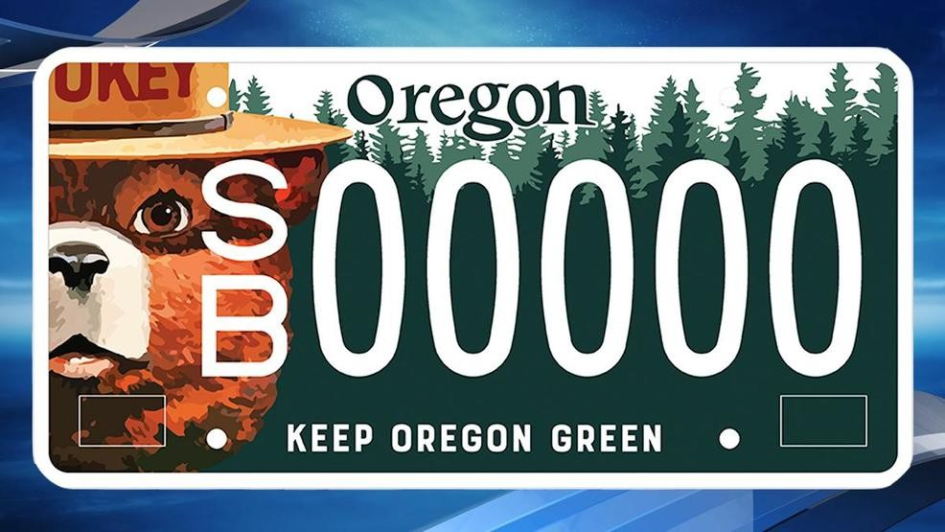
Mobile Ambient Smoke Investigation Capability (MASIC) : Western US, 2019
Collect air measurements from both regulatory-grade and low-cost air sensors, determine their performance capabilities during large and intense wildfires
Two mobile laboratories filled with monitoring equipment driven to wildfires
state- of- the-art research-grade instruments and regulatory air quality monitors
mobile laboratory contains low-cost air quality sensors and other instruments
Three stationary labs in wildfire-prone areas with additional regulatory and research grade instrumentation and low-cost sensors
Reno, Nevada
Boise, Idaho
USFS, Missoula, Montana
Office of Research and Development

Slide 17
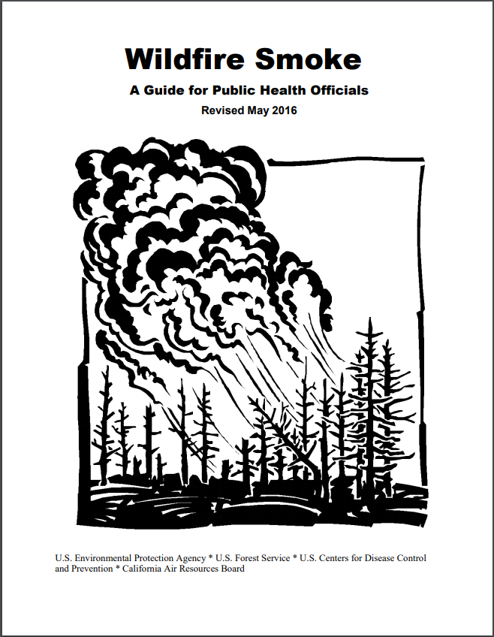
Wildfire Smoke: A Guide for Public Health Officials 2019 Updated look/format
Multi-agency document
CA ARB, DPH, OEHHA; US CDC, EPA, FS
Expanded sections
Preseason planning
Indoor air quality
Outdoor workers
Partnerships
New monitoring and air quality estimation technologies
After the fire clean-up
Health effects section
Prolonged exposures
Heat and smoke
Ozone
Office of Research and Development

Slide 18
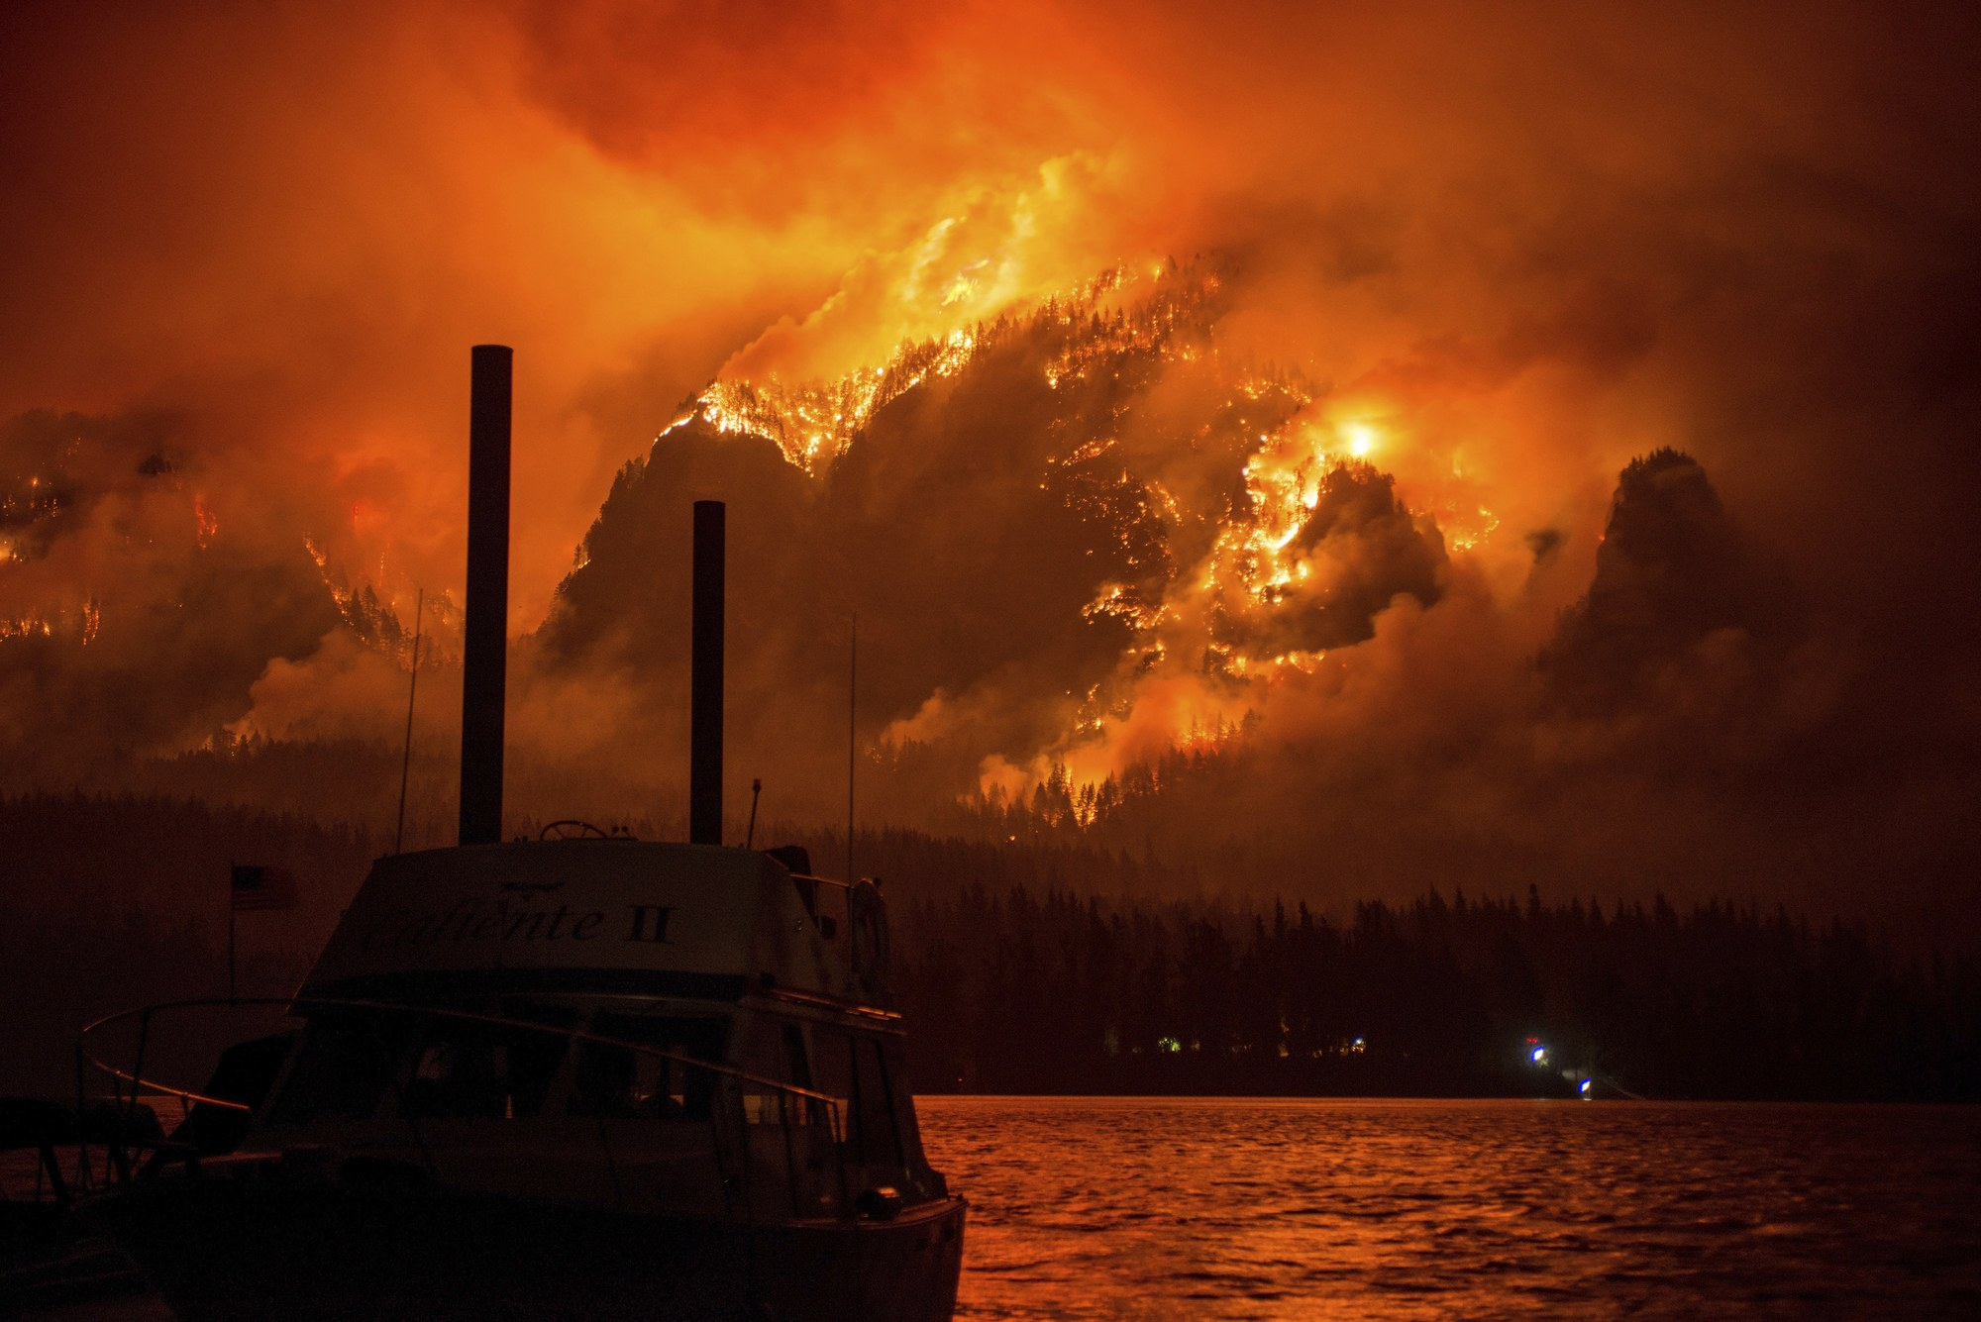

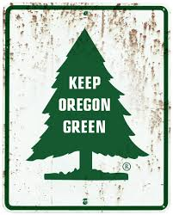
Contact Information
For more information on how to protect public health and reduce exposure please visit EPA’s Smoke Ready Toolbox for Wildfires
James Markwiese, PhD 541.754.4670 markwiese.james@epa.gov
Office of Research and Development

