Slide 1
Public Health Practice & Academia Strengthening Connections
Mentorship Program Webinar
September 27, 2018

Slide 2



Our Speakers
Benton County’s Public Health Department
Charlie Fautin, Public Health Administrator
Clackamas County’s Public Health Division
Philip Mason-Joyner, Operations Manager
Oregon State’s College of Public Health & Human Sciences
Ann Custer, Manager of Workforce Development

Slide 3

Our Purpose
To share and discuss possibilities for collaboration between public health practice and academia

Slide 4
Our Agenda
10 min 20 min 10 min 10 min 10 min | What are Academic Health Departments? Benefits of Collaboration Workforce Development Data, Research & Practice Policy Our Experiences Local Health Department Perspective Academia Perspective Ways to Meaningfully Engage with Academia Q&A

Slide 5
What are Academic Health Departments?
Public Health Foundation
Council on Linkages
AHD
The Council on Linkages Between Academia and Public Health Practice’s Objectives:
Foster collaborations between academia and practice within the field of public health.
Enhance public health practice-oriented education and training.
Support the development of a diverse, highly skilled, and motivated public health workforce.
Promote and strengthen the evidence base for public health practice.
Notes:
The AHD is one vehicle for achieving the Council’s Objectives NOTE: use EITHER slide 5 + 6 OR this one

Slide 6
What are Academic Health Departments?
A formal relationship between an academic institution and a public health practice organization for the purpose of strengthening linkages and facilitating collaboration for both mutual and community benefit.
Area | Goal
Education Research Practice | Enhance Development of Current and Future PH Workforce Further Build the Evidence Base for PH Better Deliver Essential PH Services
Notes:
Quoting from the Council on Linkages’ AHD: Core Concepts document
In the US, 22 states (including OR) have AHDs…in OR we have two: CCPH + PHHS; BLLL + PHHS
Have another speaker(s) comment on established relationships and experiences allowing for quicker/more efficient/more effective joint responses to timely opportunities, timely needs – especially in the current PH environment (PH 3.0, PH Modernization, political climate, financial trends)…stronger together! yada yada
What’s a formal affiliation?
Is it limited? Is it open?
What level of engagement and resources are available in Oregon?
This does not mean that counties can’t have a step-wise or more informal relationship with academic partners.

Slide 7
Benefits of Collaboration: Developing the Future Public Health Workforce
Internship opportunities
Practicum opportunities
Support for project evaluation or research activities
Curriculum consultation
Guest speaking
Experiential learning activities
Informational interviews
Site visits & field trips
Notes:
Ann’s Note: Focus on internships, but include other options as well (curriculum consultation, guest speaking, experiential learning activity)
Caitlin’s note: tips for successfully recruiting, training, and engaging interns
Charlie’s note: OSU CPHHS has VERY well developed undergraduate and graduate internship programs with written criteria & processes for developing intern project/job descriptions & working with LHDs to identify the best student to fit needs & guide LHDs through supervising/evaluating students. I don’t think this presentation needs much of that detail, but I do think it’s important that the “tips” that are provided guide LHDs toward working closely with the OSU internship coordinators & not making things up on their own.

Slide 8
Benefits of Collaboration: Developing Current Public Health Practice
For the Public Health Workforce
Gain access to academic expertise and exchange fresh ideas / perspectives to strengthen public health programs & services
Lifelong learning opportunities
Formal: Continuing education and certificate programs
Informal: Professional development opportunities
Opportunities to connect faculty member’s students to public health practice opportunities
For Local Public Health Agencies
Enhanced opportunities for grant funding
Expand capacity to advance priorities
Co-publishing in journal articles to gain

Slide 9
Benefits of Collaboration: Connecting Research Faculty and Practice Professionals
Increased opportunities for applied research addressing local public health issues
Access to communities and community-based data for research purposes
Increased awareness of and appreciation for public health practice and respect for public health professionals

Slide 10
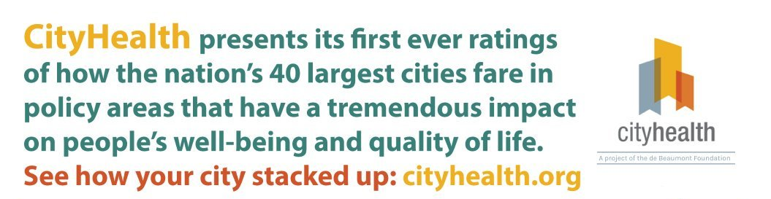
Benefits of Collaboration: Building Capacity to Advance Public Health Policy
Earned Sick Leave
Complete Streets
Smoke Free Indoor Air
High-quality, Universal Pre-Kindergarten
Alcohol Sales Control
Food Safety & Restaurant Inspection Rating
Affordable Housing / Inclusionary Zoning
Tobacco 21
Healthy Food Procurement

Slide 11
Our Experiences: Benefits & Challenges
Perspectives from Local Health Departments
Formalized internship programs
Research & grant proposal agendas
Increased opportunity for practice-informed research, translational research, and grant funding
Creation of local data profiles & publications
Participation in Community Health Improvement Plans, Strategic Planning, Advisory Boards & Community Engagement Initiatives
Focus on Public Health 3.0 & achieving Public Health Modernization

Slide 12
Our Experiences: Benefits & Challenges
Perspectives from Academia
Benefits for all = formalized internship programs
Benefits for all = research & grant proposal agendas
Benefits for research faculty = increased opportunity for practice-informed research, translational research, and grant funding
Benefits for students = improved readiness to enter the workforce
Benefits for teaching faculty = increased relevance of educational materials and activities
Challenges = limited resources
Notes:
Ann’s Note: Include challenge of limited RESOURCES on both sides (time, money, personnel, and related to that competing priorities)

Slide 13
Ways to Meaningfully Engage with Academic Partners
There are lots of ways to engage with academic partners in your community that do not require a formal academic health department relationship.
Additional opportunities:
Two currently accredited colleges of Public Health in Oregon:
Oregon Health & Science University / Portland State University
Oregon State University
Courtesy Faculty Appointments for CLHO Board Members to access academic journal articles / evidence-based literature
Local partnerships with OSU Extension Offices to help implement community-based health improvement projects
Local partnerships with Community Colleges

Slide 14

Questions

