Slide 1
CLHO Leadership Development Webinar
July 26, 2018

Slide 2


BARHII Assessment for LHDs
CLHO Leadership Development Webinar
July 26th, 2018
Drew Docter
Deschutes County AmeriCorps VISTA
Channa Lindsay
Deschutes County Quality Improvement Analyst

Slide 3
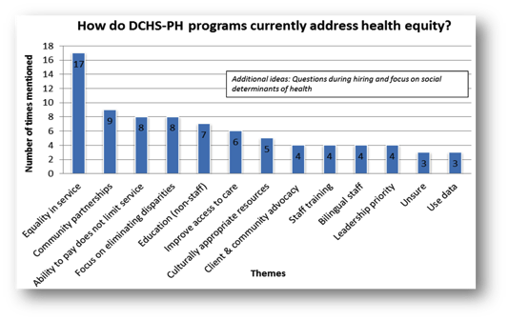

Deschutes County Health Services
Status of Equity Work
Equity & Inclusion Staff Training
Preliminary Health Equity Assessment in Spring 2017
-Limited 4 question survey highlighting current work
-No community component

Slide 4
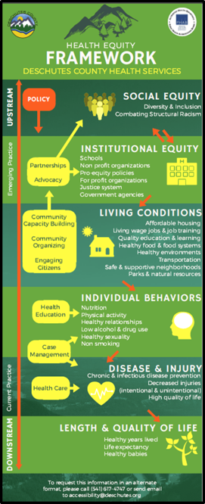
Status of Equity Work
Developed Health Equity Workgroups
-Internal Policy Review with Equity Focus
-Framework & Definition
-InsideDC
-Webpage

Slide 5
Deschutes County Health Services
Status of Equity Work
Public Health Equity Workgroup
-Recognized need for more robust, baseline tool
-PH Modernization Grant & Re-Accreditation
sd

Slide 6

Bay Area Regional Health Inequities Initiative (BARHII)
11 LHDs in California
Mission: “To transform public health practice for the purpose of eliminating health inequities using a broad spectrum of approaches that create healthy communities.”
Developed tools to help state health departments and local health departments apply social justice across all programs.

Slide 7


BAR HII Organizational Self-Assessment
Aims to build capacity to address the major causes of health inequities.
Leverage our Re-Accreditation Standards
Leverage Public Health Modernization Standards

Slide 8
BAR HII Organizational Self-Assessment
Comprehensive 5-part Assessment
Staff Survey
Collaborating Partner Survey
Staff Focus Groups
Management Staff Interviews Changed to Leadership Focus Group
Internal Document & Materials Review

Slide 9
BAR HII Organizational Self-Assessment
Comprehensive 5-part Assessment
Staff Survey February 2018
Collaborating Partner Survey May 2018
Staff Focus Groups In Progress
Leadership Focus Group In Progress
Internal Document & Materials Review In Progress

Slide 10

BAR HII Organizational Self-Assessment
Comprehensive 5-part Assessment
Staff Survey February 2018
Collaborating Partner Survey May 2018
Staff Focus Groups In Progress
Leadership Focus Group In Progress
Internal Document & Materials Review In Progress
Language specific to Public Health
Thorough Guidance & Support
Assessment Toolkit

Slide 11
Considerations Prior to Selecting BAR HII Assessment:
Where are we at as an organization?
Discomfort & history of pushback.
How much staff time can we dedicate?
How do we prioritize & incentivize completion?

Slide 12
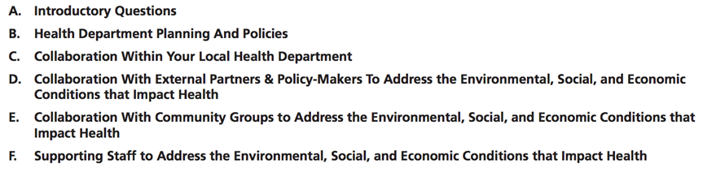
Phase 1: Staff Survey
Most labor-intensive step.
Backbone of the assessment process.
Crucial step in understanding individual perspectives, organizational themes, and key potential for action within the community.

Slide 13
Phase 1: Staff Survey
Review Questions
Oct – Dec 2017
Prep.
Jan 2018
Launch
Feb 2018
Analysis
Mar 2018
Review: Modify toolkit questions as an Equity Workgroup
Added glossary of Equity/SDoH terminology
Preparation
Trial run with equity workgroup
Informed All-Staff and Leadership
Launch
Analysis
Excel exporting and cleaning
Creating summaries for individual program and entire organization

Slide 14
Phase 1: Staff Survey
Takeaways & Recommendations
Don’t rush into it, make sure your organization is ready.
Allow time for reflection and data analysis.
Use General Survey Link.
Begin preparing for Collaborating Partner Survey while internal portion is open.

Slide 15
Phase 1: Staff Survey
-Propels conversation around equity and a need for action
-66 out of 75 staff participated (86%)
-Aids in Re-Accreditation process
-Utilized for PH CD Modernization Grant
-Technical Difficulties with Distribution
-Conflicting Job Responsibilities
-Staff time

Slide 16
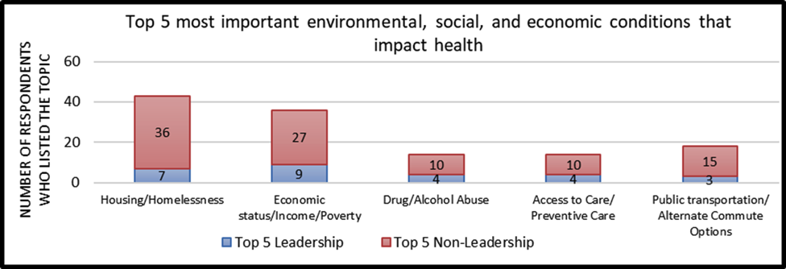
Phase 1: Staff Survey
Results – Top Determinants of Health Priorities

Slide 17
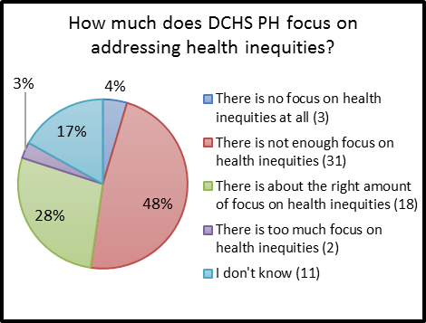
Phase 1: Staff Survey
Results – Organizational Focus & Policy
Focus on addressing health inequities.
Mission, Vision, Values & Equity

Slide 18
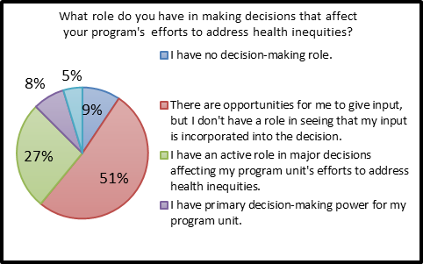
Phase 1: Staff Survey
Results – Staff Input in Program Planning
Role in making program level decisions regarding health inequities.
Current emphasis of ours.

Slide 19
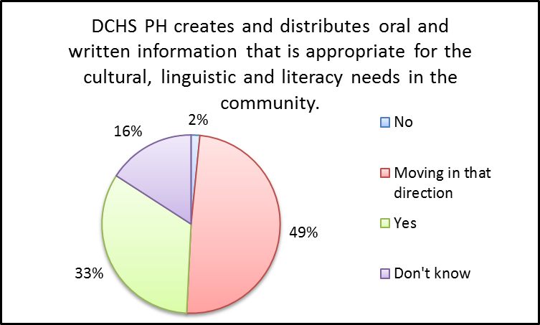
Phase 1: Staff Survey
Results – Collaboration with Community & Partners
The department is working to create culturally appropriate and accessible material distributed amongst the community.

Slide 20
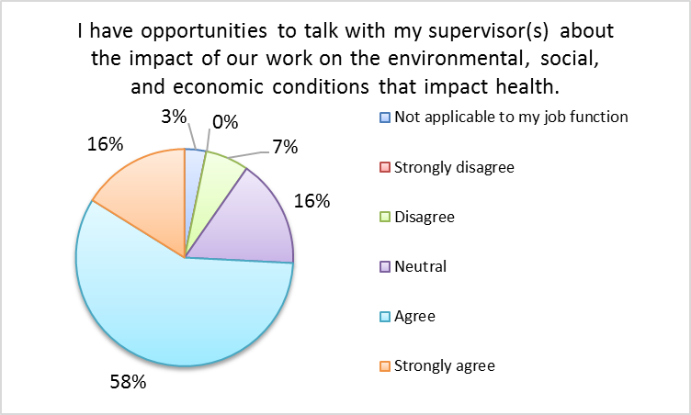
Phase 1: Staff Survey
Results – Supporting Staff to Address Health Inequities
Ability to engage in conversations with their supervisor(s) regarding their work’s intersection with the social determinants of health.

Slide 21
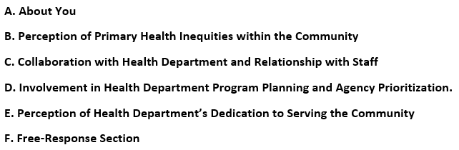
Phase 2: Collaborating Partner Survey
Considerations and Modifications
Opportunity to expand on the toolkit – what all would we like to know?
Free-response.
How can we reach the most partners?

Slide 22
Phase 2: Collaborating Partner Survey
Review: Modified questions as an Equity Workgroup
Preparation
Trial run with Equity Workgroup
Incorporate Advice from Crook & Jefferson staff
Launch
Analysis
Excel exporting and cleaning
Creating summaries for Crook, Jefferson, Deschutes & Tri-County
Review Questions
Feb – Mar 2018
Prep.
Apr 2018
Launch
May 2018
Analysis
Jun 2018

Slide 23
Phase 2: Collaborating Partner Survey
-108 Regional Partner Respondents
-Utilized for Regional PH CD Modernization Grant
-Partners having to respond multiple times.
-Lack of specificity between Behavioral Health and Public Health.
Takeaways & Recommendations
Use Open-Answer: Tailor to your department and community.
Use community network and staff to distribute.
Offer response options both for county and region (depending on Modernization funding).

Slide 24
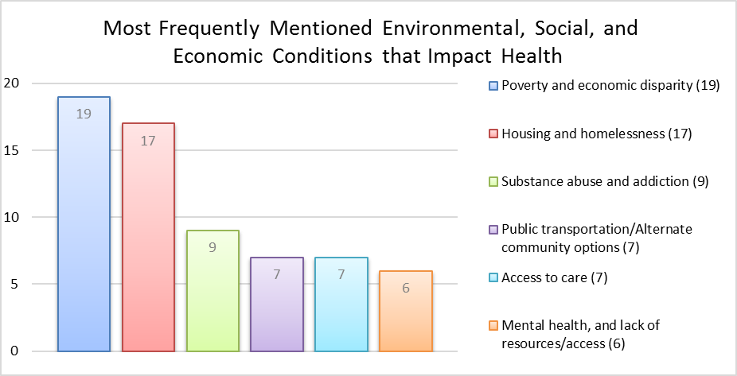
Phase 2: Collaborating Partner Survey
Deschutes Results – Top Determinant of Health Priorities within the Community

Slide 25
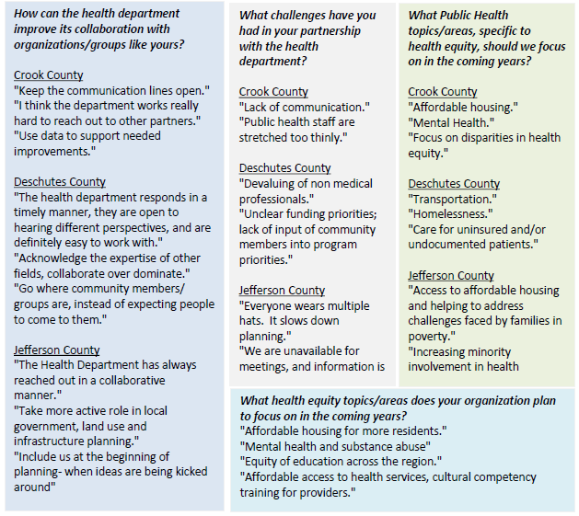
Phase 2: Collaborating Partner Survey
Tri-County Results
Qualitative Data

Slide 26
Phase 2: Collaborating Partner Survey
Tri-County Results
Qualitative Data
Questions Posed:
How can we improve our collaboration with organizations like yours?
What challenges have you had in your partnership with us?
What health equity topics/areas should we focus on in coming years?
What health equity topics/areas does your organization plan to focus on in coming years?

Slide 27
Phase 3: Staff Focus Groups (In Progress)
Considerations and Modifications
Input from Staff Survey & Partner Survey.
Staff-led vs. contracting facilitator.
Promoting honesty & comfort: Separate Leadership from Non-Leadership.
Ensuring total confidentiality.
Develop Questions
May – Jun 2018
Schedule & Prepare
June 2018
Launch
July – Sep 2018
Analyze & Theme Code
Sep 2018?

Slide 28
Phase 3: Staff Focus Groups (In Progress)
-Appreciation from Participating Staff
-Candid, open discussion and similar themes
-Need for increased time: Need at least 2 hours in order to work through full list of questions.
Takeaways & Recommendations Thus Far
Provide adequate time for discussion
Schedule far in advance.
Tailoring based on prior themes gathered: can “shape” discussion

Slide 29
Next Steps
Staff & Leadership Focus Groups
Documentation Review with Equity Lens
Draft Equity Report
Workgroup Prioritization
Re-Assess

Slide 30


Thank you for your time! Questions?
Please contact with any questions:
Drew Docter
541-322-7401
Andrew.Docter@Deschutes.org
Assessment Toolkit

Slide 31
Upcoming Webinars
September 27, 2018: Academic-Public Health Partnerships
November 29, 2018: Oregon Public Health Policy All leadership development webinars are posted here:
https://oregonclho.org/resources/leadership-development-webinars/

