Slide 1
Suicide Prevention
Tricia Mortell, MPH, RD
Washington County Public Health Division Manager
Association of Oregon Counties – November 2018

Slide 2



Not Just the Tip of the Iceberg
National Rates 2016
National Rate 13.4 per 100,000
Reported suicides: 44,965 in 2016
Thoughts of suicide: 4% Past Year
Plan (1 in 4 will make a plan)
Attempt (1/2 of those who make a plan will make an attempt)
3% will end in death
10th leading cause of death in US
LivingWorks Education Inc. www.livingworks.net
Notes:
Suicide Prevention needs to focus on more than just the tip of the ice berg. One of the most startling statistics here is that for people who have thoughts of suicide 25% (1out of 4) will make a plan and 50% of those with a plan will attempt

Slide 3
Oregon Suicide Rates 2016
Oregon rate 17.8 vs US Rate 13.4
Oregon ranked 16th
Reported suicides in Oregon: 771
One person dies of suicide every 12 hours
8th leading cause of death
2nd leading cause of death ages 15-34
3rd leading cause of death ages 10-14

Slide 4
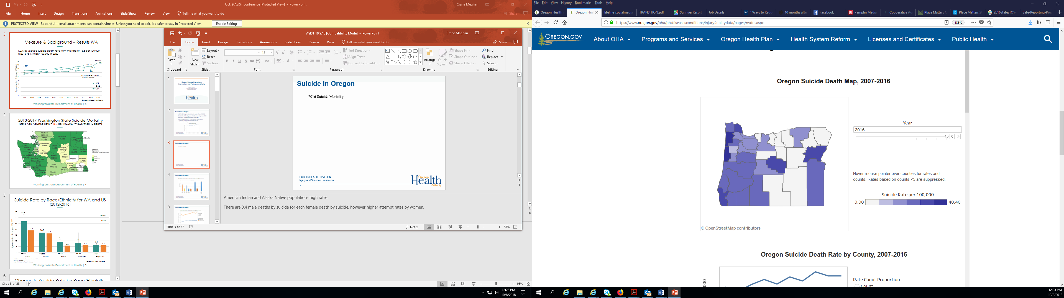
Suicide in Oregon
Notes:
2016 Suicide Mortality. Higher rates in more rural parts of the state but might not be as visible because numbers are low. Areas without shading might not be zero but the numbers are so low we don’t report

Slide 5
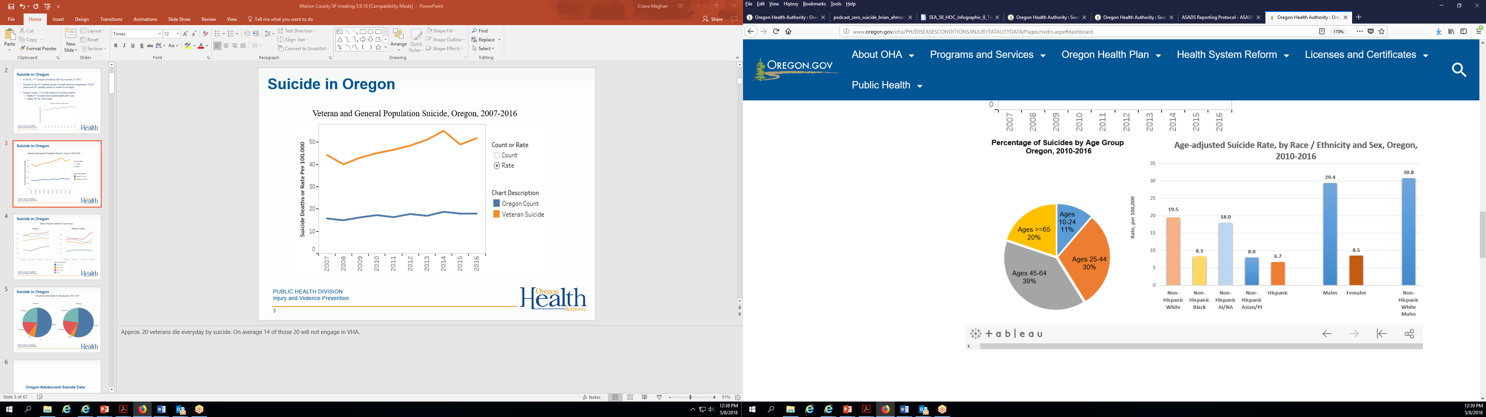
Age-Adjusted Suicide Rate by Race/Ethnicity and Sex
Oregon 2010-2016
Notes:
3.4 male deaths by suicide for each female, but higher attempts by women White males have highest suicide death rates

Slide 6
At Risk Groups
Military members, veterans and their families
Native Americans
People who suffer from mental illnesses
People with chronic medical conditions
People bereaved by the loss of a loved one
People who previously attempted or seriously thought about suicide
LGBTQ Youth
2017 YSIPP

Slide 7
Youth Suicides in Oregon
Oregon ranks 15th in the nation for youth suicides
From 2006 - 2016 there has been a 31% increase in youth suicides
In 2016 there were 98 youth suicides
Youth = ages 10-24
Notes:
From YSIPP annual report - Middle stat alarming

Slide 8
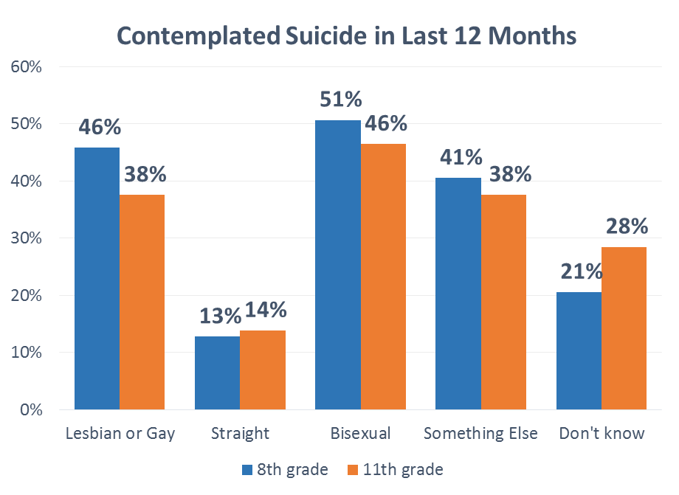
Gender Identity for Youth is a Risk
Notes:
Oregon - LGBTQ much higher percentage of suicidal thoughts. Consistent with national trends
Gender identity – Transgender and non-binary again much higher percentage of suicidal thoughts

Slide 9
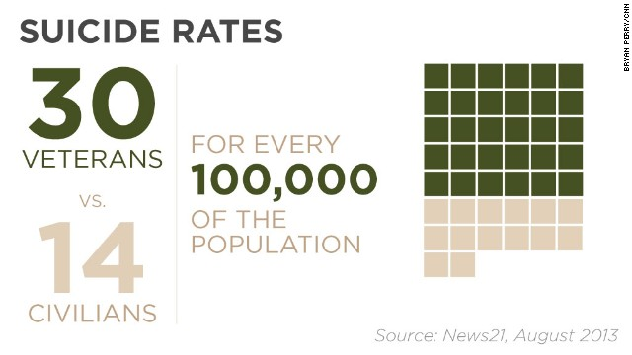
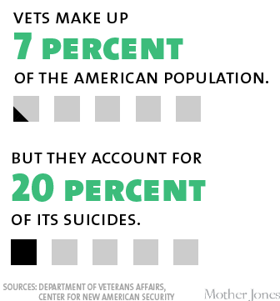
US and Veteran Suicides
Notes:
Veterans Over twice the rate of civilians - Was 22/day – this has been reducing

Slide 10
Actions Counties Can Take
Trainings
Provide Community Wide
QPR (1-3 hours)
ASIST (15 hours)
Adult Mental Health First Aid (8 hours)
Youth Mental Health First Aid

Slide 11
Washington County Successes
Get Trained to Help – Free Community Trainings
“One stop shopping” to sign up for trainings offered by all three counties
http://www.gettrainedtohelp.com
Tri-County (Multnomah, Clackamas, Washington)
Notes:
All trainings are free of charge. Some small costs for training of the trainers, but most trainers either volunteer or do on paid time from their organizations

Slide 12
Actions Counties Can Take
Bring People Together
Review and understand your data
Discuss prevention strategy options
Agree on common priorities
Share expertise and resources

Slide 13
Washington County Successes
Suicide Prevention Council
Began in 2013
One of our CHIP Committees
Co-chaired by WC Suicide Prevention Coordinator and a community partner
County/Community collaborative
Meets every other month
25-30 show up regularly but over 100 on the Listserv

Slide 14
Actions Counties Can Take
Know Your Community’s Risks
Gather and review national, state and local data
Participate in suicide fatality reviews and other
post-vention activities
Gather local data from community stakeholders

Slide 15
Washington County Successes
Medical Examiner Data Collection & Suicide Fatality Review Committee
Led by Epidemiologist, Medical Examiner and Suicide Prevention Coordinator
With next of kin permission multiple agencies (mental health clinics, hospitals, law enforcement, VA) review cases together
Collects information from family not normally collected (financial, relationship, mental health, housing etc.)
Looks for systemic failures
Purpose is to target prevention efforts (Post-vention become prevention)
Notes:
Subcommittee of our Suicide Prevention Council, Began in 2014, Through this Work we identified people who were contemplating suicide were likely to give up their pets to our local shelter – trained our staff in QPR and prevented 7 people from completing. Also trained staff at low budget motels, as we found a risk for those locations

Slide 16
Actions Counties Can Take
Means Reduction
Research shows it works
Focus on two most fatal methods
Heights
Fences over bridges and high places such as parking structures
Gun Safety
Provide gun locks, train gun owners, set up community safe storage options
Notes:
Suicide fatalities are higher in men because of the choice of means. So a focus on means reductions can prevent suicide completion. We know it works and we must focus our attention in two areas; places that those with suicide ideation may jump from and gun safety – this isn’t about reducting gun rights but letting gun owners know about the risks of suicide - WC is just starting down these paths. Our parking garage has been the site of several suicides so we are working to restrict access to the top floors to the general public

Slide 17
Actions Counties Can Take
Hire a Suicide Prevention Coordinator
Federal and state grants often available
Provides facilitator and staff support to community wide coalition
Support for data collection and analysis
Notes:
This is one reason for our successes

Slide 18
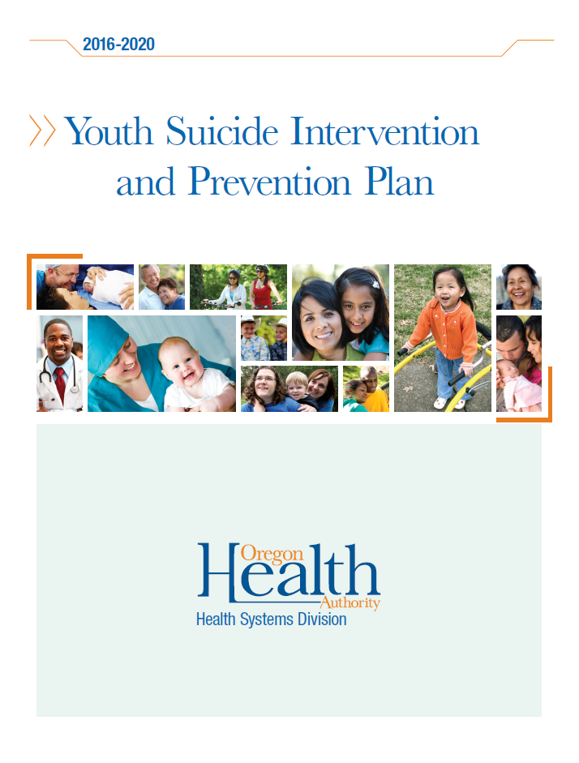
Resources
Notes:
YSIPP annual report, engaged over 100 subject matter experts including those with lived expertise, modeled after the national strategy for suicide prevention

Slide 19
Make a Difference in Your Communities By Focusing on Four Strategic Priorities
Healthy and empowered individuals, families and communities
Clinical and community preventive services
Treatment and support services
Surveillance, research and evaluation

