Slide 1

Advancing the Adoption and Use of a Uniform Chart of Accounts in Public Health
Public Health Activities & Services Tracking (PHAST)
University of Washington
phastdata.org
Notes:
GREG

Slide 2
PROJECT TEAM
Betty Bekemeier
Alex Shoemann
Accounting & finance
Accounting & finance
Project director
Simone Singh
Project director
Accounting & finance
Greg Whitman
Project manager
Melinda Schultz
Data management
Fred Abrahamson
Public health systems
Administration
Notes:
GREG

Slide 3
NATIONAL ADVISORY COMMITTEE
Liza Corso
PHNCI, PHAB
JP Leider
CB Mamaril
Kent State University
Independent consultant, SHED
University of Kentucky
CDC
Ashley Edmiston
ASTHO
Jessica Fisher
Karl Ensign
NACCHO
Pamela Russo
RWJF
Matt Stefanak
Public Health Practice-Based Research Networks
Notes:
GREG

Slide 4
THE CHALLENGE
Individual LHDs’ charts of accounts
Uniform Chart of Accounts
No standard process for reporting financial information in public health
Challenge to compare financial performance and budgets across public health agencies
Notes:
GREG
Public health agencies want to show how the money they spend improves health outcomes.
They can’t because no national uniform financial reporting standards or systems exist
That means a lack of comparable financial data collection and reporting.
That means they can’t:
compare the sources and uses of funding across agencies
monitor resource accountability
document how public health activities improve population health

Slide 5
ALIGN
The Uniform Chart of Accounts (COA) complements—but does not replace—participating public health agencies’ COA
Participating public health agencies will crosswalk—or map—financial information from their agency-specific COA to the Uniform COA
Financial information reported includes expenditures and revenues, broken down into key categories
Notes:
GREG
We piloted the uniform COA in 2015-2017 with 16 LHDs and 4 states
19/20 could complete the crosswalking process and align their PH agency’s COA to the uniform COA
Key categories based on FPHS, but are more detailed – in the uniform COA these are major programs and capabilities

Slide 6
Capabilities |  | Program Areas
 |  | Communicable Disease Control | Chronic Disease Prevention | Injury Prevention | Environmental Public Health | Maternal, Child, and Family Health | Access to and Linkage with Clinical Care | Other Major Programs
All Hazards Preparedness And Response | Major Programs | Communicable Disease Epidemiology | Asthma | Firearms | Air | Coordination of Services | Eligibility Determination | Other Health Services
Assessment |  | Hepatitis | Cancer | Motor Vehicle | Fish and Shellfish | Direct Service | Health Care Licensing | Other Social Services
Communications |  | HIV/AIDS | Cardiovascular | Occupational Injuries | Food Safety | Family Planning | Other Access to and Linkage with Clinical Care
Community Partnerships Development |  | Immunization | Diabetes | Senior Falls Prevention | Hazardous Substances and Sites | Newborn Screening
Organizational Competencies |  | Sexually Transmitted Diseases | Obesity | Substance Abuse | Lead | Population-based Maternal, Child, and Family Health
Policy Development And Support |  | Tuberculosis | Tobacco | Other Intentional Injuries | On-Site Wastewater | Supplemental Nutrition
Other Capabilities |  | Other Communicable Disease Control | Other Chronic Disease Activities | Other Unintentional Injuries | Solid and Hazardous Waste | Other Maternal, Child, and Family Health
 |  |  |  |  | Water
 |  |  |  |  | Zoonotic
 |  |  |  |  | Other Environmental Public Health
Notes:
GREG
The COA includes expenditures and revenue data for 7 public health program areas and cross-cutting capabilities
Specified 50 major programs & capabilities with the help of our 20 pilot PH agencies
We tried to be as detailed as possible to avoid putting many activities into the “other” category.

Slide 7
VALUE
Help your public health agency
  Understand the costs of programs and services
  Analyze revenue sources
  Improve the budgeting process
  Improve performance management
  Improve external reporting
Compare
  Benchmark financial performance
  Evaluate cross-jurisdictional sharing arrangements
Communicate
  Communicate financial accountability and the value of public health to the community
  Help legislators and boards of health understand the need for added investments in public health
Notes:
GREG
Our G20 pilot participants identified many ways that the uniform COA could be useful to them

Slide 8
JOIN
What LHDs do
Validate data with visualizations
Match data to COA format
What LHDs get
Online training
Technical assistance
Interactive data visualizations
View online training
Peer learning community support
Expected time commitment for completing the Uniform COA crosswalk process:
25-30 hours
Notes:
GREG
Initial time investment was an average of 30 hours for our pilot LHDs, and many said they would expect it to take less time in the future
Depends on the PH agency’s current accounting system
So far 3 of our LHDs have signed up to do the COA again and one who wants to submit an extra year of data.

Slide 9
TIMELINE
Cohort 1
Ongoing:
Recruitment of participating LHDs
July 2018:
Launch of online training
Nov/Dec 2018:
PHAST team evaluates data & provides visualizations
July 24, 2018: Kick-off webinar
Jan/Feb 2019: Cohort 1 reviews data & visualizations
Sept 2018: Cohort 1 crosswalks & reports data to PHAST
Notes:
GREG
ongoing: we will give contact info so you can sign up
We will start with pilot group to test online training in July (you could be part of this!)
After bugs worked out, official launch is September 2018

Slide 10
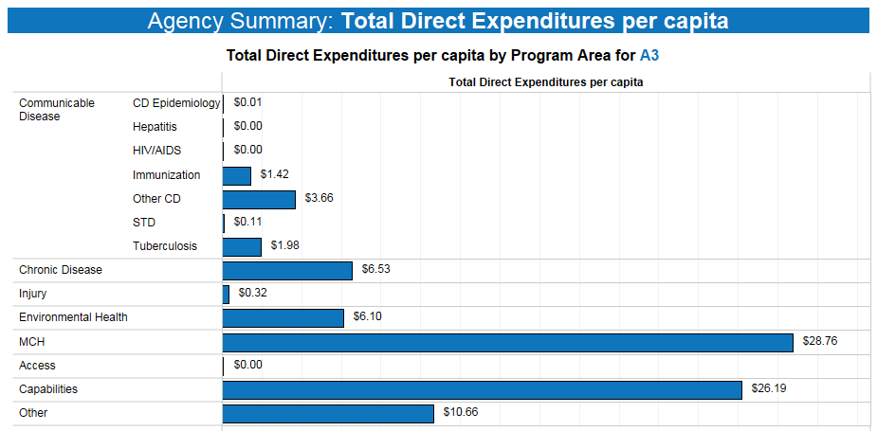
PILOT DATA
Notes:
SIMONE
This shows data for a single LHD.
Each bar is a program area’s total expenditures per capita.
CD is broken down into the major programs’ expenditures per capita
We also have the ability to look at total expenditures, revenue, and revenue per capita.

Slide 11
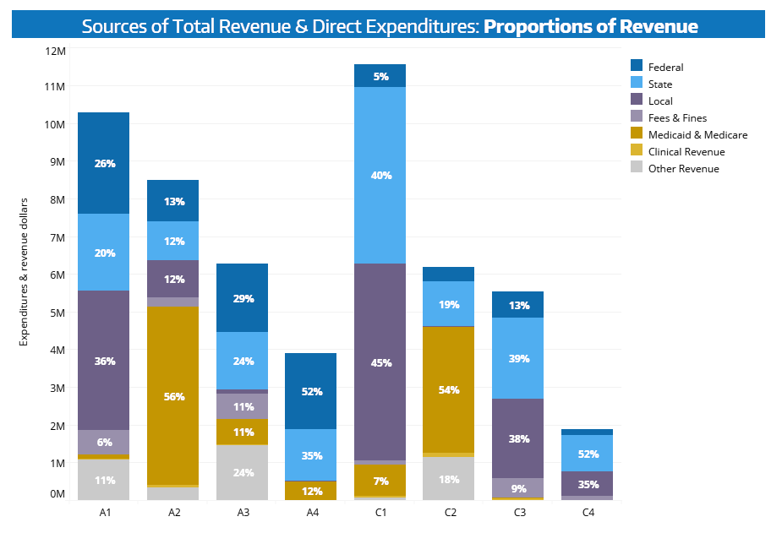
PILOT DATA
Notes:
SIMONE
This shows where an LHD’s total, PH agency-wide revenue comes from, out of 7 different categories

Slide 12
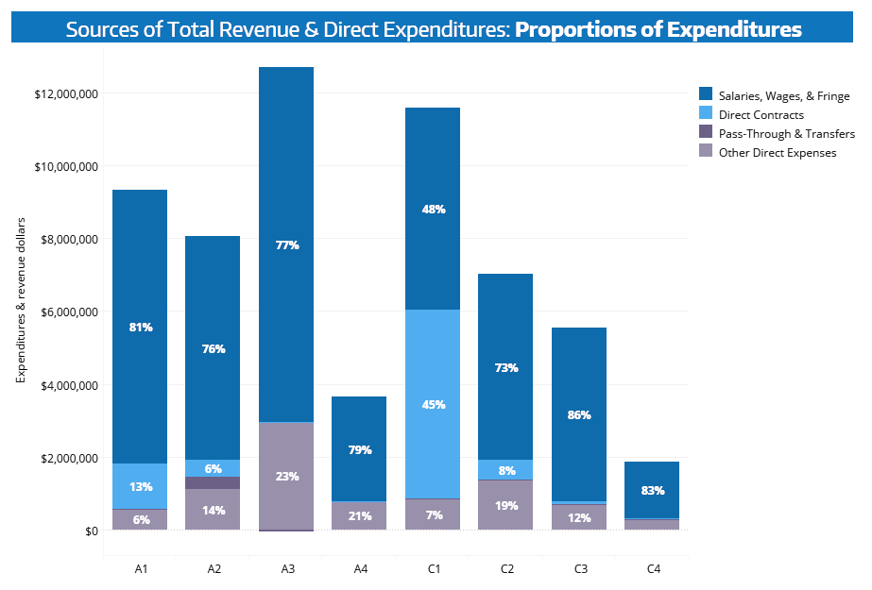
PILOT DATA
Notes:
SIMONE
This shows where a PH agency’s total, agency-wide expenditure are going. There are 4 main categories of expenditures.

Slide 13
FAQs
Does the Uniform COA distinguish between foundational and non-foundational public health services?
  Uniform COA is based upon FPHS, but does not distinguish between foundational and non-foundational public health services
How can a SACCHO get involved?
  Help recruit LHDs
  Assist with training/peer learning
What does the future of the uniform COA look like?
  Project aims to explore how the Uniform COA can be implemented across LHDs
  PHAST team is exploring ways to make the Uniform COA sustainable with help of national organizations
Which LHDs can participate?
  Any interested LHD in the U.S.
What are the costs to LHDs?
    There are no costs besides the time LHDs need to spend to crosswalk their data to the uniform COA.
How many/which years of data do participating LHDs submit to PHAST?
  The most recently closed fiscal year
Are state health departments involved?
  Not at this time
Notes:
GREG

Slide 14
NEXT STEPS
Local Health Departments
SACCHOs
Contact us: phast@uw.edu
Review & sign MOU
Complete online training & crosswalking beginning in July 2018
Share our materials with your LHDs
Learn more about assisting PHAST with TA and administration
  Incentive payments available to SACCHOs
Learn more at our website: phastdata.org/research/chart-of-accounts
View public visualizations: phastdata.org/viz/coa-dashboard
Notes:
GREG
Our materials include a sample e-mail, newsletter text, an e-mail brochure, and a “social media kit” with sample graphics and text to distribute via Twitter and Facebook, etc.
Send email to phast@uw.edu and we will send you and MOU – you can review, ask questions, and once signed you’re part of the project

