Slide 1
Public Health Modernization Interim Evaluation Results
Translating Early Evaluation Results into Future Opportunities

Slide 2
Questions to ask as we walk through evaluation findings
What resonates with your own experience?
What are opportunities that could be expanded upon?
What are the implications for future work?

Slide 3
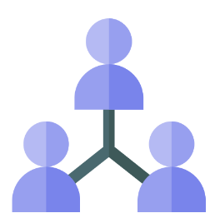

Early evaluation results – key findings
During the first six months of public health modernization implementation:
New and expanded inter-governmental partnerships are resulting in increased surge capacity for outbreak investigations and better preparation for public health emergencies.
Local public health authorities are working with tribes, Regional Health Equity Coalitions and other partners on regional health equity assessments to ensure that health equity and community engagement principles are embedded in communicable disease prevention strategies.
Notes:
Notes:
New and expanded inter-governmental partnerships are resulting in increased surge capacity for outbreak investigations and better preparation for public health emergencies.
Additional thoughts:
LPHAs have created or expanded upon inter-governmental partnerships through formal policies, like memoranda of understanding and cross-jurisdictional sharing agreements.
These formal policies ensure sustainability of joint coordination and resource sharing and could be applied future foundational programs and capabilities.
Strong inter-governmental partnerships are a requirement of new systems for local public health service delivery (referencing primary objectives from previous slide)
Increased surge capacity has largely come from newly-hired regional epidemiologists, infection prevention specialists, and communicable disease investigators.
Surge capacity ensures LPHAs can lead field investigations of outbreaks and epidemics, and is directly supporting counties with fewer resources to conduct routine investigations. (referencing primary objectives from previous slide)
The new Communicable Disease Investigator for the Eastern Oregon Modernization Collaborative has already logged ~60 hours of regional case investigation after four months.
Regions are better prepared for public health emergencies because of new and expanded regional coordination and resource-sharing.
LPHAs are working with tribes, RHECs and other partners on regional health equity assessments to ensure that health equity and community engagement principles are embedded in communicable disease prevention strategies.
Additional thoughts:
Meaningful engagement with tribes and Regional Health Equity Coalitions is essential to implementing strategies to eliminate health disparities (referencing the primary objective)
Some regions have included tribes and RHECs in their regional governance structures and others have paid partners for participating in steering and work plan committees to implement regional work.
Information from the health equity assessments will be used to develop and implement regional action plans.
This is a critical step toward identifying and addressing root causes for health disparities

Slide 4
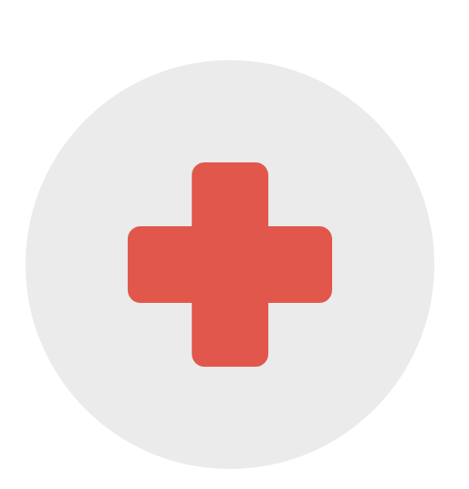
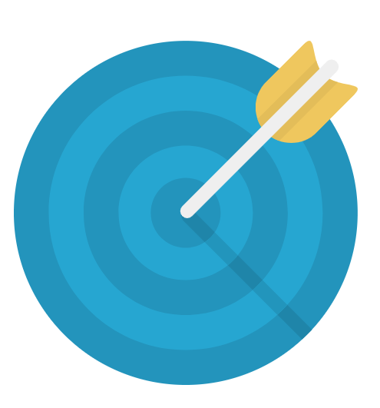
Early evaluation results – key findings
Local public health authorities are partnering with CCOs and working with health care providers to implement new systems for public health service delivery, including providing pneumococcal disease vaccinations in hospital settings.
Several local public health authorities are aligning communicable disease prevention projects with Public Health Accountability Metrics, including improvements to two-year-old immunization rates and gonorrhea rates.
Notes:
Notes:
LPHAs are partnering with CCOs and working with health care providers to implement new systems for public health service delivery, including providing pneumococcal disease vaccinations in hospital settings.
Additional thoughts:
Public health modernization has allowed LPHAs with new opportunities to work with CCOs and health care providers to prevent avoidable flu outbreaks and pneumococcal infections, through new systems for public health services delivery.
I’ll describe some specific examples in the following slides.
Several LPHAs are aligning funded communicable disease prevention strategies with Public Health Accountability Metrics, including improvements to two-year-old immunization rates and gonorrhea rates.
Additional thoughts:
Aligning communicable disease strategies with these metrics demonstrates regions’ strong commitment to accountability for health outcomes (referencing primary objectives from previous slide)
Two examples:
The Coast-to-Valley Regional Partnership (comprised of Lane, Benton, Lincoln, and Linn Counties) has implemented a CDC immunizations quality improvement program, called AFIX, with 18 clinics to improve clinical practices and increase immunization rates.
The Eastern Oregon Modernization Collaborative (comprised of 13 counties) established a regional policy for gonorrhea interventions, and Polk County adopted many of Marion County’s procedures for tracking adequate treatment for gonorrhea to standardize the process across the region.
We look forward to reporting on changes in the next Public Health Accountability Metrics Report, which will be released in early 2019.

Slide 5
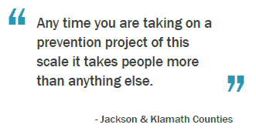
Local use of grant funds
Local public health authorities are using the $3.9 million awarded in 2017-19 to strengthen local systems for communicable disease control and create structures for ongoing coordination.
A modern public health system requires funding to provide communities with the information to identify, respond to and prevent leading causes of death and disability and to eliminate health disparities.

Slide 6
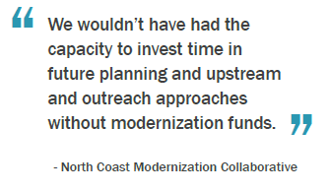
Filling capacity gaps and leveraging funds
Funding has benefited local public health authorities with fewer resources by increasing capacity within the region. Some LPHAs have leveraged modernization funding to secure additional resources.
A modern public health system ensures all local public health authorities have the capacity to pro-vide foundational public health to the community.

Slide 7
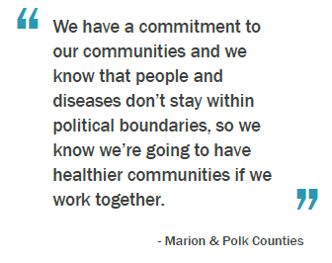
Regional governance structures
Local public health authorities are establishing and expanding on formal governance structures for decision-making and responsibilities for meeting shared goals.
A modern public health system looks for effective ways to use resources within and between counties for common goals.

Slide 8
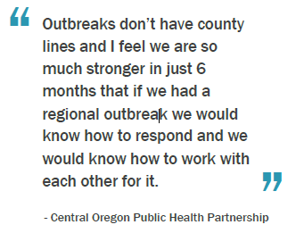
Addressing communicable disease risks
Local public health authorities are using the $3.9 million awarded in 2017-19 to address specific communicable disease risks within their communities.
A modern public health system is prepared to ad-dress communicable disease threats by using comprehensive strategies for identifying, responding to, and preventing the spread of communicable disease.

Slide 9
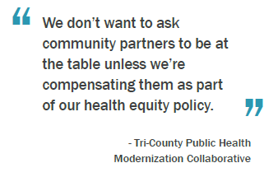
Partnerships development and maintenance
Local public health authorities are using the $3.9 million investment awarded in 2017-19 to establish and enhance local relationships for communicable disease control and health equity.
A modern public health system recognizes that vibrant partnerships are essential for achieving common goals.

Slide 10
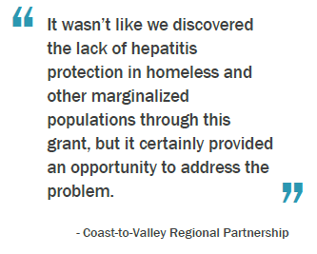
Identifying and addressing health disparities
Local public health authorities are using the $3.9 million awarded in 2017-19 to identify and address community-level differences in communicable disease outcomes.
A modern public health system provides communities with the information they need to under-stand where disparities exist and supports local strategies to eliminate disparities.

Slide 11
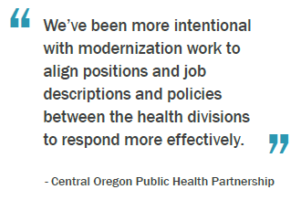
Work on other programs and capabilities
Local public health authorities have leveraged the $3.9 million awarded in 2017-19 to support other foundational programs and capabilities.

Slide 12
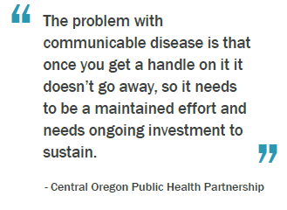
Sustainability of funded work
Sustainability describes aspects of the work that can be continued/built upon in future years.
A modern public health system leverages the gains achieved through any one project or intervention for future work.

Slide 13
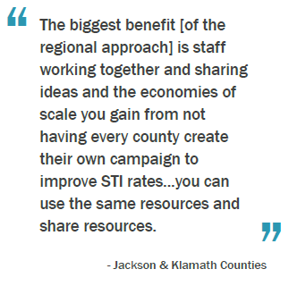
Generalizability of regional model
Local public health authorities can expand the work begun with the $3.9 million awarded in 2017-19 into other areas of the public health system.
A modern public health system uses a common set of skills and knowledge to address most public health priorities.

Slide 14
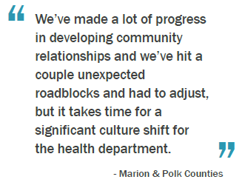
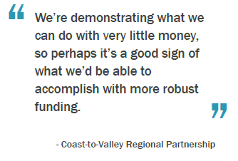
Future work and additional funding
This section describes the focus of communicable disease projects for the remainder of the grant period and how LPHAs would expand upon current projects with additional funding.

Slide 15
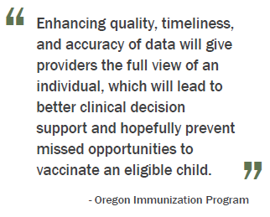
State public health role
The Oregon Health Authority, Public Health Division has used the $1.1 million investment in 2017-19 to improve on the state’s ability to collect and report on population health data.
A modern public health system requires the state to operate statewide public health data systems, and ensure access to local data.

