Slide 1

CLHO March 15, 2018
Jenne McKibben, ALERT IIS Director

Slide 2
ALERT IIS Update Session Goals
Data Review
Opportunity for questions from CLHO members

Slide 5
Notes:
Monthly Snapshot

Slide 6
% Organizations who Submitted Data in Q4 2017 by type

Slide 7
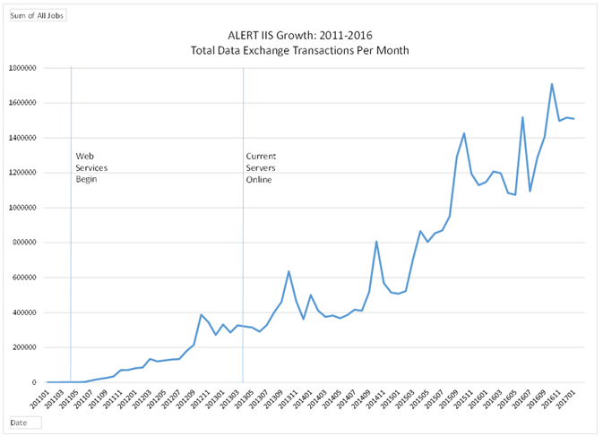
Notes:
The chart demonstrates the growth of immunization reports, and requests for immunization records from 2011-2016:

Slide 8
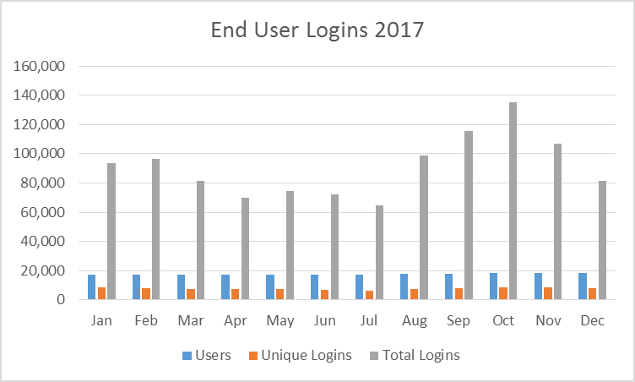
Notes:
Includes clinical and school/childrens facility users

