Slide 1
CCO 2.0 Opportunities for Engagement
Morgan Cowling

Slide 2
Presentation Goals
Provide background as to the timeline for CCO 2.0
Outline the Straw Proposal recommendations with opportunities for public health
Answer questions about next steps

Slide 3
CCO 2.0 Timeline

Slide 4
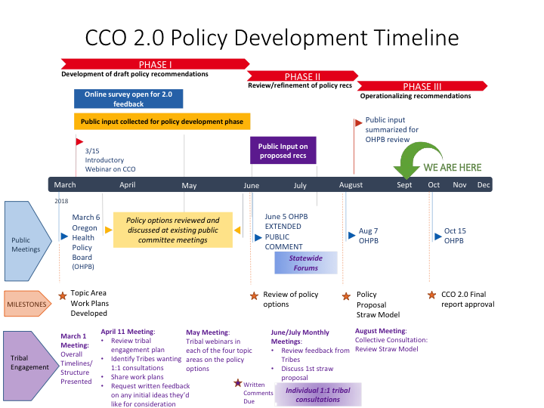

Slide 5
CCO Next Steps
• Receiving substantive public feedback on current draft recommendations by September 21st will allow OHA time to consider the feedback.
• OHA will make changes to the draft report and finalize for OHPB and public review by September 28th.
• OHA will share a proposed final draft by October 8th for the Board’s consideration at the October 15th meeting, the final draft will be publicly available.
• OHPB will vote on the final draft report October 15th.
• After OHPB adopts recommendations, OHA will no longer be able to accept public comment on issues that directly relate to the procurement of the contracts.
• Procurement process & Request for Applications development begins

Slide 6
CCO 2.0 Straw Proposal Overview
Recommended policy Overview:
– Policies that begin implementation in year 1 – 36 recs
– Policies that begin implementation in years 2-5 – 8 recs
– Policies not recommended at this time or for future exploration
CCO 2.0 Report will include an Policy Implementation Expectations Overview and an Equity Impact Assessment

Slide 7
1 -Implement HB 4018
Implement HB 4018: Require CCOs to spend portion of savings on SDOH, population health policy and systems change, and health equity/ health disparities, consistent with the CCO community health improvement plan (CHIP)
Intended impact: Increase strategic spending by CCOs on SDOH and health equity/ disparities. Decision- making is inclusive and consumer –informed.

Slide 8
2- Increase Strategic Spending by CCO in Health Related Services
Encouraging HRS community benefit initiatives to align with community priorities, such as those from CHA & CHIP
Requiring CCOs’ HRS policies to include a role for the CAC in making decisions
Intended Impact: Community resources are used more efficiently. Decision making is inclusive and consumer -informed

Slide 9
3 - Incentive Measures
Encourage CCOs to share financial resources with non-clinical and public health providers
Encourage adoption of SDOH, health equity and population health incentive measures for inclusion in quality pool
Intended impact: Community partners are engaged and receive financial resources for their contribution

Slide 10
4- Strengthen CAC/ CCO partnerships
Require CCOs to report on CAC demographics; year 2 CAC member representation alignment with CHP priorities
Intended impact: CCO have a represented CAC. This builds trust and relationships with members. Systems are designed with the member in mind.

Slide 11
5- Coordinate & support CCO equity activities
Require CCOs to adopt a Health Equity Plan to institutionalize organizational commitment to equity, require single point of accountability for equity; and organization-wide cultural responsiveness and implicit bias fundamentals training plan.
Intended impact:
Standardization of health equity infrastructure present in all CCOs.

Slide 12
7 –Require CCOs to share how CAC connects to CCO Board
Require CCOs to share with OHA (to be shared publicly) a clear organizational structure that shows how the Community Advisory Council connects to the CCO Board.
Intended impact:
Transparency on fulfillment of statutory requirement

Slide 13
8 – Shard CHA/ CHP Priorities & Strategies
Require CCOs to partner with local public health authorities, non-profit hospitals and any CCO that shares a portion of its service area to develop shared CHAs and shared CHP priorities and strategies
Require that CHPs address at least two State Health Improvement Plan (SHIP_ priorities, based on local need
Intended impact:
Improved population health outcomes through CHA CHP collaboration and investments.

Slide 14
Small Group Exercise
1st group– opportunities for collaboration
2nd group – identify potential roadblocks and solutions to colleboaration

Slide 15
For more information check out the draft CCO 2.0 Report
https://www.oregon.gov/oha/OHPB/Pages/CCO-2-0.aspx

