Slide 1


It’s All Bad……….And It’s Getting Worse
Patrick F. Luedtke MD, MPH
Senior Public Health Officer
Chief Medical Officer
Lane County Health and Human Services

Slide 2
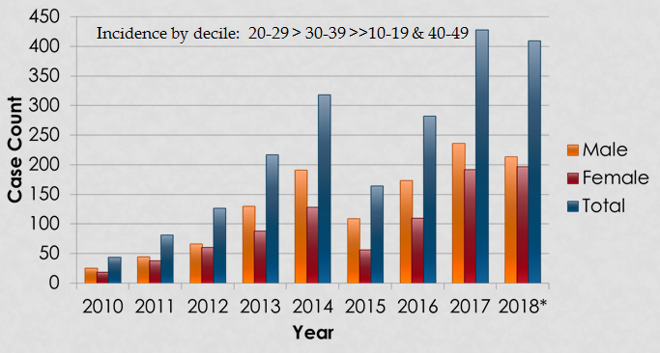
Lane County Syphilis: 2018 Update
*Updated to October 31, 2018

Slide 3
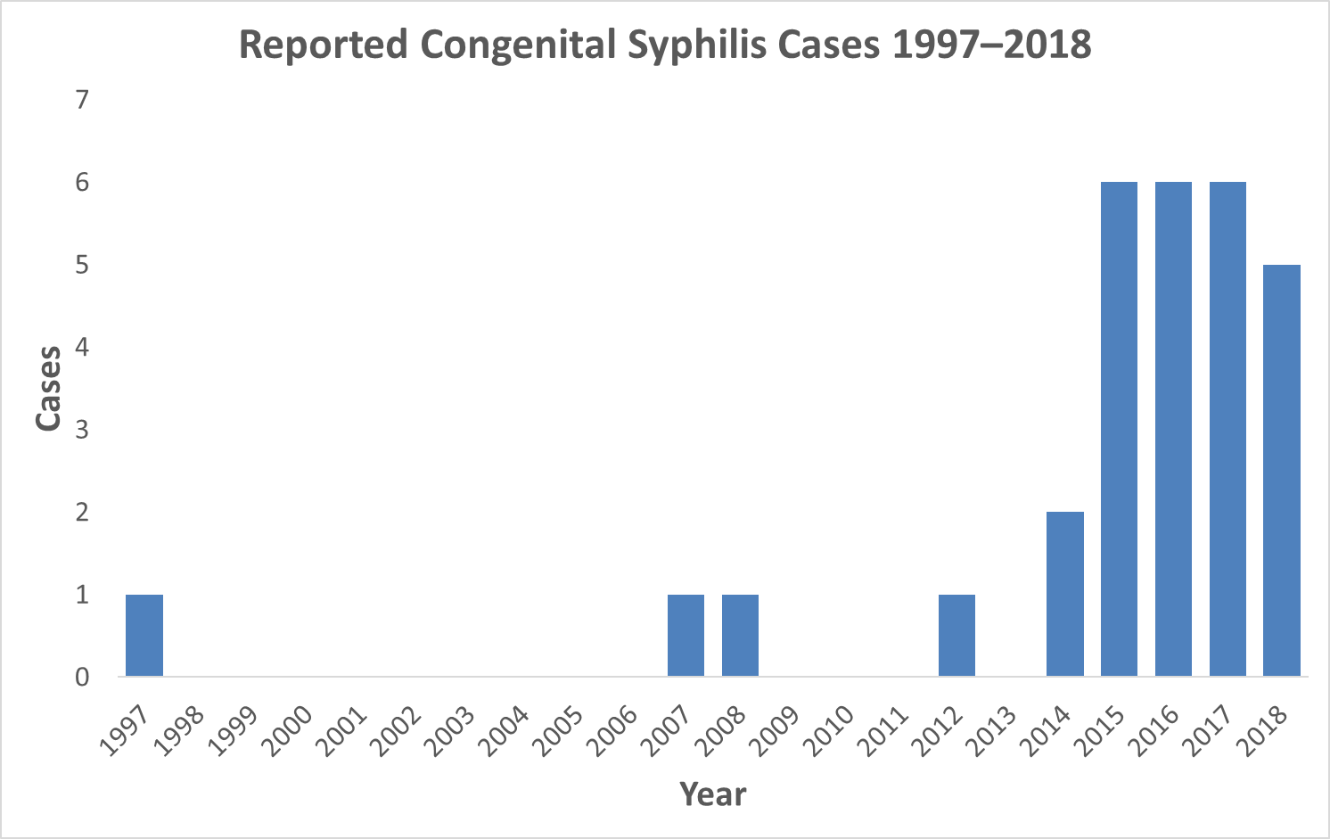
First year cost of congenital syphilis = $67,159 standardized to 2006 dollars

Slide 4
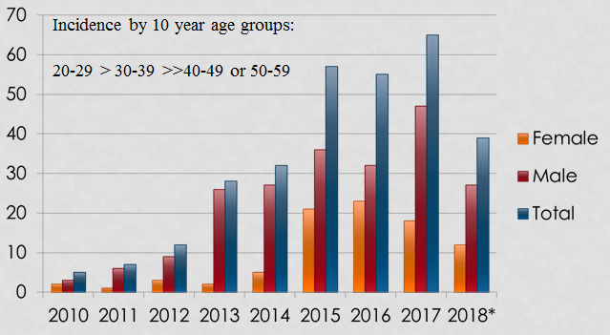

Lane County Gonorrhea: 2018 Update
*Up to October 31, 2018

Slide 5
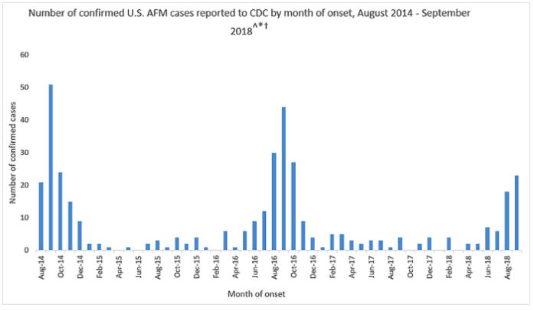
Acute Flaccid Myelitis: 21st Century Polio??

Slide 6


Health Literacy, e-Cigs & Vaccines: Oh My!

Slide 7

Health Literacy
The degree to which an individual has the capacity to obtain, process, communicate, and understand basic health information and services to make appropriate health decisions.
Are residents in your counties health literate?

Slide 8
Healthy Literacy: The War Around Us
Yale University: Rudd Center for Food Policy and Obesity
Fast food industry spends more on advertising in 4 days than our national public health system spends in an entire year
Less than 1% of all kids’ meals meet recommended nutrition standards (33 out of 5,427 meals)

Slide 9
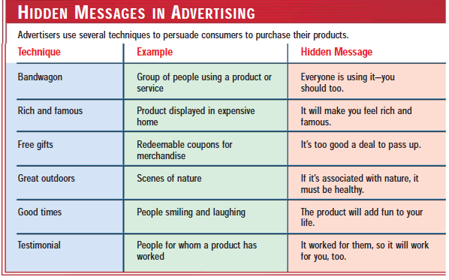

Killing Health: Product Marketing

Slide 10

Health Literacy: Tobacco
Bandwagon
Great outdoors
Good times
Free gifts
What is not shown in this picture?

Slide 11


Health Literacy: E-cigarettes
Rich and famous
Good times
Testimonial
What is not shown?

Slide 12
Common Causes of Death: USA
1. Ebola
2. Commercial aircraft accidents
3. Shark attacks
4. Plague
5. Lightning strikes
6. Tornadoes
7. Flesh eating bacteria
8. Vaccine preventable diseases
1. zero
2. zero
3. <1
4. ˜2
5. ˜55
6. ˜80
100 – 300
50,000+ (including influenza, pertussis, HBV, Strep. pneumoniae, HPV, measles)

Slide 13
Vaccination & Prevention of Disease
Disease | Reported cases before vaccine† | 2006 Reported cases† | Percent Decrease
Smallpox | 29,005 | 0 | 100%
Polio (paralytic) | 16,316 | 0 | 100%
Diphtheria | 21,053 | 0 | 100%
Measles | 530,217 | 55 | > 99%
Rubella | 47,745 | 11 | > 99%
Congenital Rubella Syndrome | 152 | 1 | > 99%
Hemophilus influenzae (Hib) | 20,000 | 208* | 99%
Mumps | 162,344 | 6,584 | 96%
Tetanus | 580 | 41 | 93%
Pertussis (whooping cough) | 200,752 | 15,632 | 92%
†Source: JAMA. 2007;298(18):2155-2163; * 29 type b and 179 unknown (< 5 years of age)

Slide 14
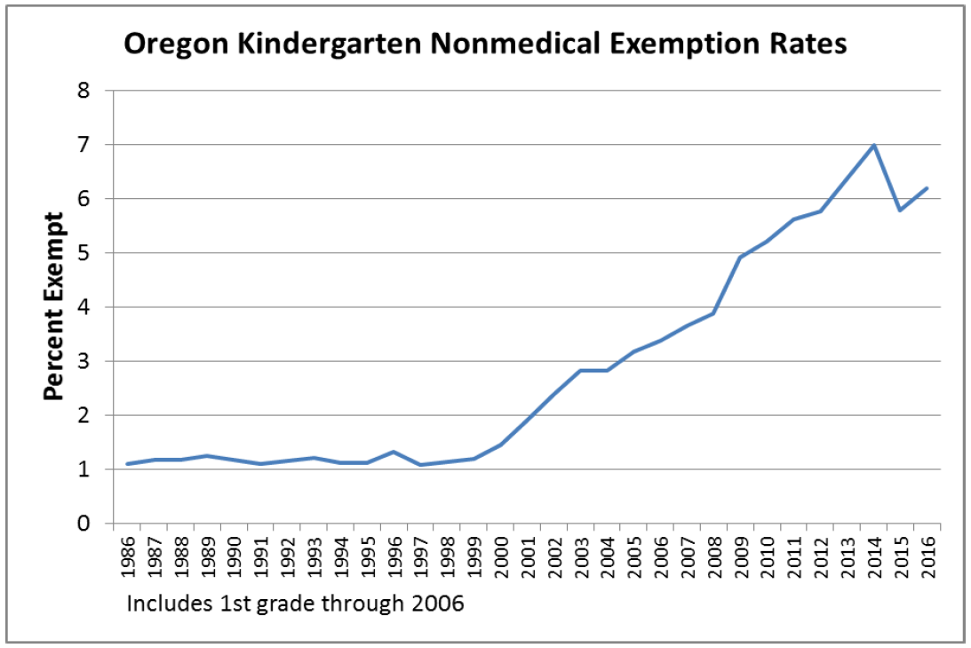

Slide 15
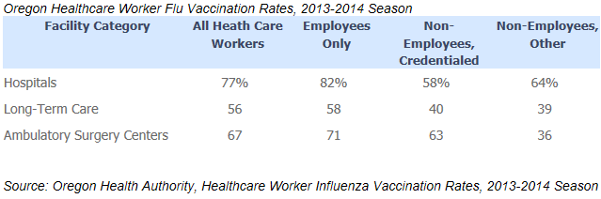
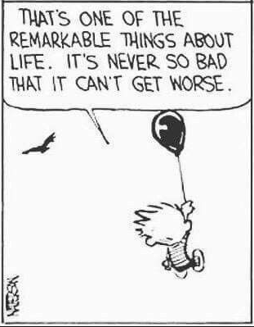
What About Healthcare Worker Vax Rates?

Slide 16
80,000.
People killed by influenza in the 2017-18 season nationally
$11,000,000.
Spent on inpatient influenza care in one year in Lane County
$2,000,000.
Spent on outpatient influenza care in one year in Lane County
Notes:
Last year was a record-breaking flu season with 80,000 deaths attributed to influenza nationally.
Communicable disease costs Lane County millions each year in terms of medical cost.

Slide 17
$15.4 Billion
The annual estimated total cost to employers due to influenza nationally
Cost is disproportionate
Small businesses are hit hardest by the impact of lost employee days and revenue
Notes:
It’s been estimated that the total cost of influenza to employers is $15.4 billion. However, the cost of communicable disease is disproportionate. The burden of cost for lost days and lost revenue is felt most by small businesses who tend to have smaller revenue streams and fewer employees to fill in

Slide 18


17,000,000.
Workdays lost to the flu each year
~300
50+
Cases of whooping cough this year in Lane County
Public schools with reported cases in Lane County
Notes:
Communicable diseases don’t just take your money – they also take your time. An estimated 17 million work days are lost to the flu each year, with millions more school days being missed as well.
Flu is far from the only disease we monitor at Public Health. Last year we experienced a record-breaking outbreak of Pertussis, or whooping cough, with 71 cases in 18 schools in Lane County last year.

Slide 19

It’s All Bad----and It’s Getting Worse
But perhaps it could be even worse

Slide 20
The End
Is Near

