Slide 1


Improving the Health of Moms and Babies
Through Partnership, Collaboration and System Level Work.

Slide 2

The Problem
Oregon women are suffering from significant behavioral health challenges that impact them and their babies.
Our health system is reactive instead of proactive in supporting their psychosocial needs.
Our health system assumes it knows who is at risk for poor outcomes.
Our systems are poorly connected and don’t communicate.

Slide 3

So What Happens?
Women and babies fall through the cracks and we see:
Low birthweight babies
Premature births
Poor mother-infant bonding that can lead to cognitive, emotional and behavioral problems in children
Increased cost of care

Slide 4

In Oregon………………..
10 to 20% of women experience perinatal depression
Those in poverty have rates as high as 40 to 60%
1 in 12 babies are born premature
1 in 12 babies are born with low birth weight

Slide 5




What Can We Do?
Systems Approach
Provide incentives initiatives to change the way we do care
Connect our systems and coordinate care
Assess all women for psychosocial risk factors
Assure understanding of resources and services

Slide 6
What did Yamhill County Do?
Partnered with prenatal providers and CCO to create and implement……………………..
Maternal Medical Homes
A Maternal Medical Home (MMH) provides coordinated care to address the physical, emotional and social needs of women during the prenatal and postpartum period to improve the health outcomes of moms and babies.
Provides an enhanced payment from the CCO to qualifying prenatal practices that meet the established standards.

Slide 7

Goals Healthy Moms, Healthy Babies, Healthy Families!
Increase prenatal care engagement
Supporting pregnant women and new babies
on a continuum of care
Identifying medical and social risk factors early in the pregnancy
Connecting families with appropriate resources
Decrease preterm delivery rates
Decrease low-birth weight rates
Decrease costs

Slide 8
Enhanced Payment
Quarterly payments to prenatal providers made based on which trimesters the women were in care.
First Trimester Care: $300/per patient
Second Trimester: $150/per patient
Third Trimester: $300/per patient
Provider receives payment of $700 per patient, after delivery, when a women enters care in the first trimester and stays in care during the entire pregnancy

Slide 9
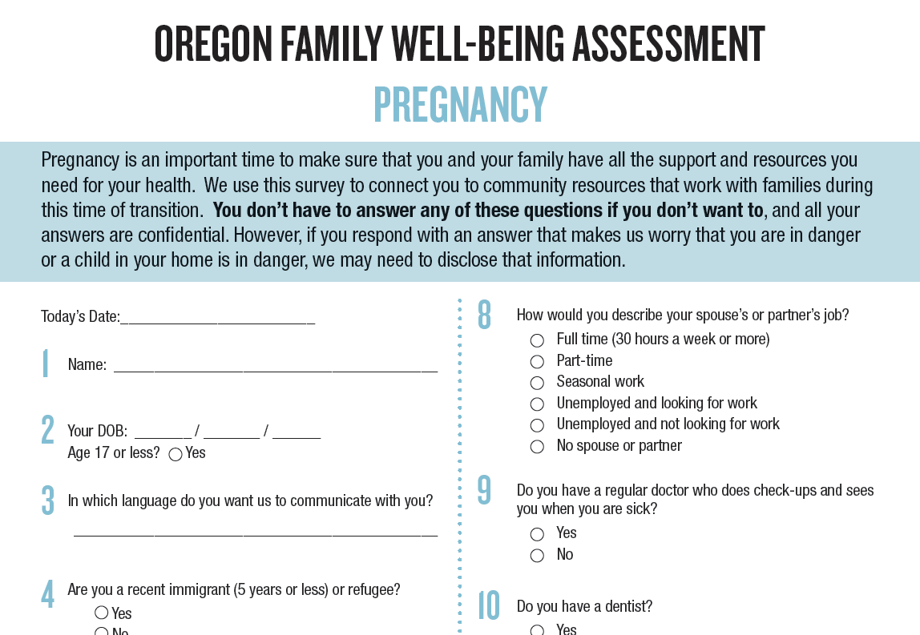
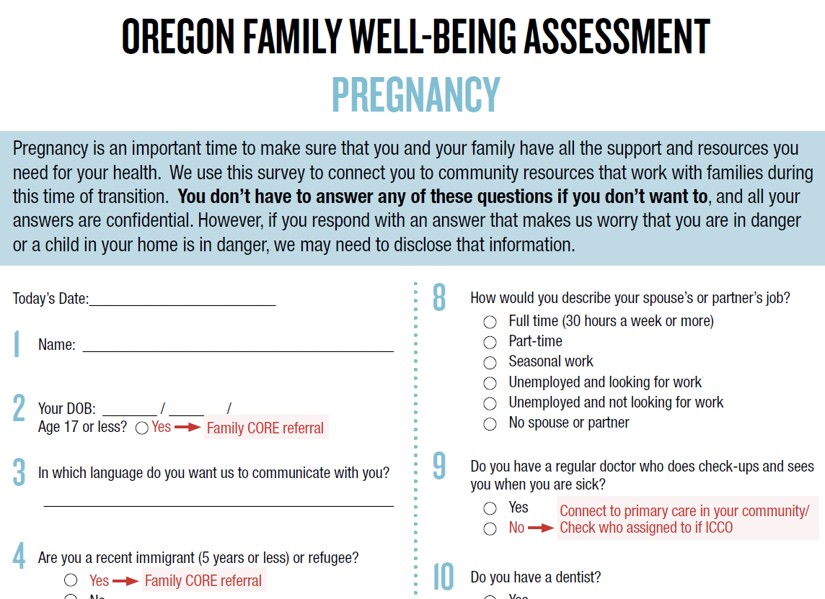
Standardized Screening & Assessment

Slide 10
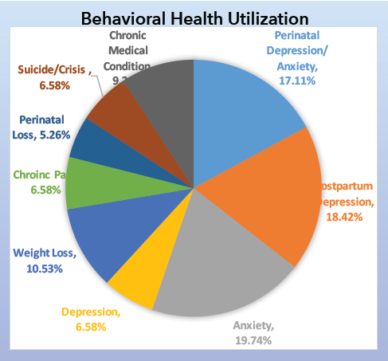
Behaviorist Integration
Provider consultation
Conducts risk assessments
Provides brief behavioral and cognitive behavioral interventions for patients
Triages and facilitated referrals for patients with severe or high-risk behavioral problems to other community resources for specialty mental health services

Slide 11

Case Management
Maternal Child Health Public Health Nurse

Slide 12

Primary Care Provider Linkage
Additional assessment after birth
Assuring knowledge of primary care provider for mom and baby
CCO birth assignment prior to baby being born

Slide 13
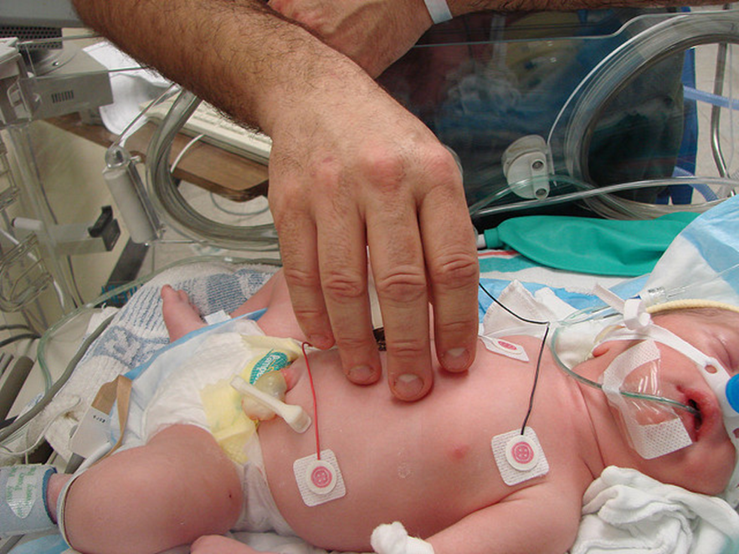
This Work in Action

Slide 14





Slide 15


