Slide 1

Oregon Coalition of Local Health Officials
April 2017

Slide 2
Why Oregon Healthiest State?
Situation
Falling Gallup WBI Rankings
No shared understanding of value of health and well-being
No convening body for cross-sector groups to take action
Launch of Oregon Healthiest State (2013)
Enthusiasm for Solution
Engaged Governor
Private Sector Interest
Iowa Challenge
Leadership from Founding Partners
2
Notes:
Talking Points:
Let’s revisit the history of Oregon Healthiest State. Our health rankings were falling (now at 31st), there was no convening body for cross sector groups to take action and no shared understanding of the value of health and well-being in the business community and in the general public. However, there was an enthusiasm for a solution. There was interest from private sector partners including Cambia, the Oregon Business Council, Nike, and OHSU to do something about this. There was a challenge from Iowa and an engaged Governor. The founding partners launched Oregon Healthiest State in 2013 - inviting more to join in and build a shared strategy to become the healthiest state in the nation.

Slide 3
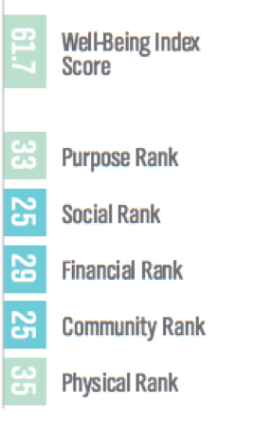
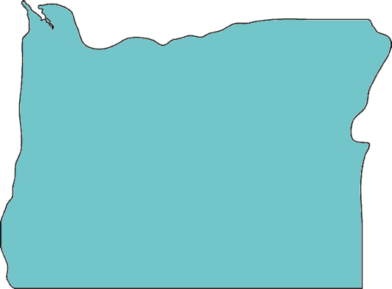
The Well-being Index Guides Our Work
3
Up from #31 in 2015!
Overall Well-Being Score
62.5
Well-Being Category Ranking
Purpose: 41
Social: 11
Financial: 18
Community: 18
Physical: 19
#24
Notes:
Talking Points
The well-being index is a critical measurement tool for Oregon Healthiest State. It takes a broader view of health than typical public health measurement tools, including purpose, social, financial, and community. This broad-based view of health resonated with partners of Oregon Healthiest State and is reflected in the work plan and priority areas of the movement
This 2016 rankings just came out and Oregon is 24th in the national for overall well-being – the 3rd quintile. This is a great improvement over the last few years, where from year to year we were dropping farther in the rankers. Five years ago we were at #X, last year we were #31st.

Slide 4
Health is Driven by our Behaviors and Environment
4
National Health Expenditures
Factors Influencing Health
Prevention 4%
Behavior & Environment
70%
Medical Services
96%
Genetics
20%
Medical Care 10%
Notes:
Talking Points
We also know that most of our health happens outside the healthcare system but our national expenditures do not reflect that – as 96 percent are spent on Medical Services and only 4 percent is spent on prevention. I know that I’m preaching to the chior here, but I’m always surprised when I present this slide to untraditional partners, and they’ve never seen this information before!

Slide 5
Structure and Key Work Streams
5
Oregon Healthiest State
(Housed within the Oregon Business Council Charitable Institute)
Blue Zones Project Statewide Overhead (People, IP, Process)
Financial Peace of Mind
Health and the Outdoors
Employee Wellbeing
Klamath Falls
Life Radius Community Pilot
Other groups TBD (food, early childhood)
3rd Demo
2nd Demo
4th Demo

Slide 6
Oregon Healthiest State Theory of Change
6
Understand the strategic value of health
Individual Behavior Change
____________
Health Improves
Key Sectors Act individually (vertical solutions)
Communicate the value of health through community and partner engagement
Develop Shared Strategy
Understand what works
Key Sectors Act in collaboration with other sectors (cross sector)
Systems Change
____________
Sustained Health Improvements
Aligned strategies and funding to support what works
Early Years
Middle Years
Late Years

Slide 7
The role of Oregon Healthiest State
7
Convening non traditional partners for shared strategy
Communications and strategic engagement for buy-in
Removing barriers to systems change
Ensuring tactical work is sufficiently supported
Aligned funding for scale and sustainability

Slide 8
Oregon Healthiest State Governance
8
Executive Steering Committee
Michael Alexander, Retired CEO, Urban League of Portland
Jorge Casimiro, President and COO, Global Community Impact, Nike
Bobby Cochran, Executive Director, The Willamette Partnership
Mark Ganz, President and CEO, Cambia Health Solutions (Chair)
John Hancock, President, Junior Achievement of Oregon and SW Washington
Scott Parrish, CEO, A-dec Inc.
Joe Robertson, President, Oregon Health & Science University
Lynne Saxton, Director, Oregon Health Authority
Greg Van Pelt, Director, Oregon Health Leadership Council
Duncan Wyse, President, Oregon Business Council
Notes:
Talking Points
Since the launch of Oregon Healthiest State, we’ve worked to broaden our governance structure from just the founding partners to a larger Steering Committee that guides the work.

Slide 9
Alignment to CLHO
9
How are local public health departments involved in OHS?
On the ground implementation in current and future BZP communities
Provides resources to support local health improvement efforts (tobacco, food, built environment)
Provides data and evaluation to understand key community health challenges
Partnerships with health systems for community health improvement plans and tactical implementation
Internal and external policy, system, and environmental changes

Slide 10
Discussion
10
The value of Oregon Healthiest State: Now and in the future
What are we doing well? Where do you see areas of alignment?
What can we do differently to support your work locally and at the state level?

Slide 11
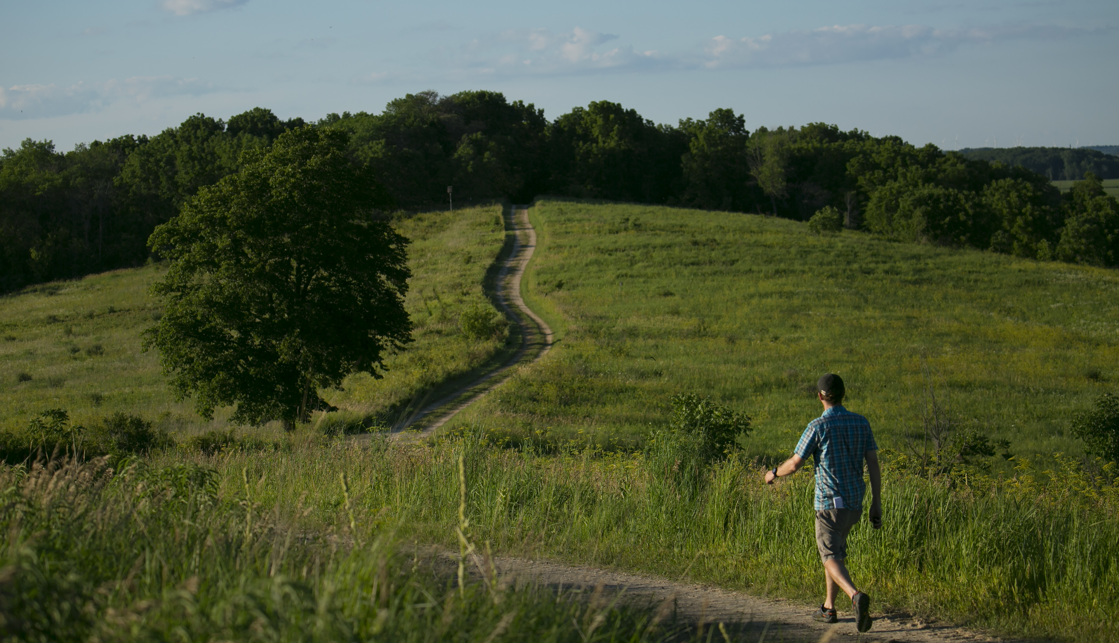
Contact Info:
sfoster@orbusinesscouncil.org

