Slide 1
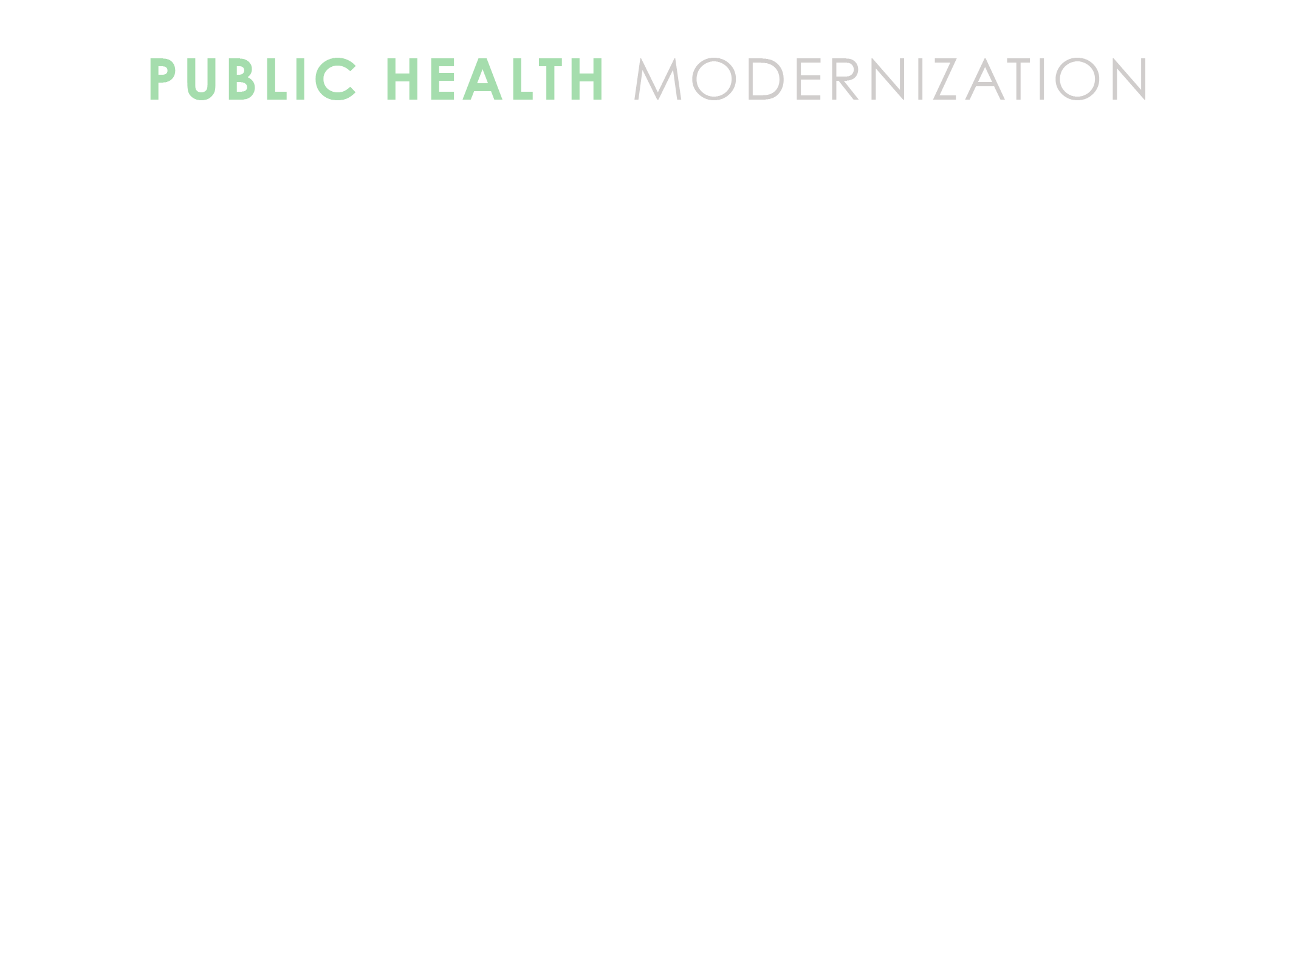
Modernizing Our Public Health System
PRESENTER NAME
DATE
LOCATION
LHD LOGO

Slide 2
Public Health Modernization means everyone in Oregon can expect public
protections critical to their health and the health of future generations— these
include clean air, safe food and water, health promotion and prevention of
diseases, and responding to new health threats.

Slide 3



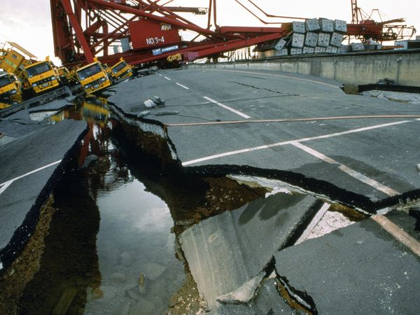


Our Public Health System
Picture Source: 1. Russell Sage Foundation 2. OregonLive 3.medicaldaily.com 4. annarbor.com 5. kidfocused.com. 6.National Geographic,
Notes:
ANIMATED SLIDE- CLICK THROUGH EACH PICTURE
Public Health achievements over the past century have included vaccination campaigns, improvements in motor-vehicle safety, safer workplaces, the control of infectious diseases (like tuberculosis, measles, and HIV/AIDS), a reduction in deaths from heart disease and stroke, more nutritious and safe food, a decline in infant and maternal mortality, an increase in accessibility to family planning services, and the identification of tobacco as a health hazard and the decrease in use over time.
Public health works tirelessly to keep people health and safe, and it is only when something has gone wrong do we usually realize how many aspects of our lives depend on the work of public health.
As a public health workforce we continue to tackle issues such as:
Healthcare accessibility (image 1)
Disease outbreak control, like zika, bacterial meningitis, and ebola (image 2)
Child mortality (Image 3)
Food and water safety (Image 4)
Tobacco use (Image 5)
Preparing for and responding to natural disasters (Image 6)
Include one or two BRIEF examples of work done by your LHD.

Slide 4
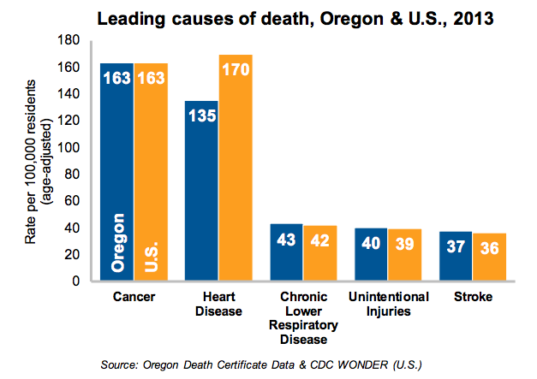
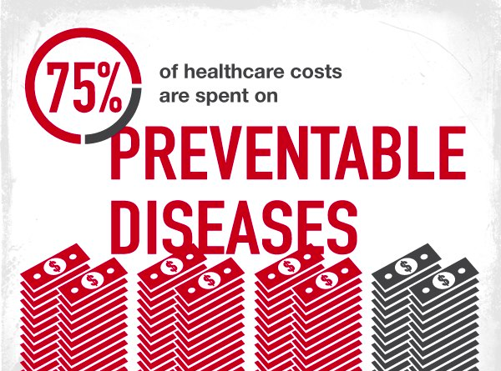
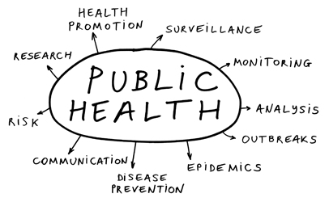
The Challenges We Face
Image Source: 1) CDC Food Safety News 3) Oregon Health Authority
Notes:
ANIMATED SLIDE- CLICK THROUGH IMAGES
Many people in Oregon suffer from preventable illnesses and premature death (image 1) that public health can help prevent (image 2) .
In Oregon our leading causes of death include Cancer, Heart Disease, chronic respiratory disease, and stroke– all preventable diseases
However, the public health system is often public health is often challenged to proactively address preventable diseases and instead, focuses on present and emerging threats like tuberculosis, whooping cough and other communicable diseases (image 3). Include an example here of an outbreak/or mobilizing in prep for potential outbreak and the work that required.
Our public health system should be able to engage in work helping to prevent preventable diseases and death AND respond to emerging threats and outbreaks at the same time.
Oregon’s challenges in maximizing the conditions in which people can be healthy continues to take a growing toll on our economy and on society. As the backbone of the health system, public health possesses the skills and expertise that support communities and other partners to improve the conditions in which we live and work, leading to better health outcomes for all in Oregon.
This requires new strategies that preserve and expand the public health protections and prevention currently enjoyed by everyone in Oregon.

Slide 5


Finishing the Work We Started
To improve the health of everyone in Oregon and reduce deaths from preventable disease while maintaining our health protections, we must:
Image Source: 1.Huffington Post 2. City Funders
Notes:
ANIMATED SLIDE- CLICK THROUGH IMAGES
Shift our perspective to the population from the individual (Image 1)
Prioritize public health funding (image 2)
Chronic diseases that drive the bulk our health spending and loss of workforce productivity are conditions that could be decreased or prevented through the initiatives, services and expertise that public health departments provide. Provide an example of some of the innovative work your health department may be engaging in to address community health (with or without partners).

Slide 6
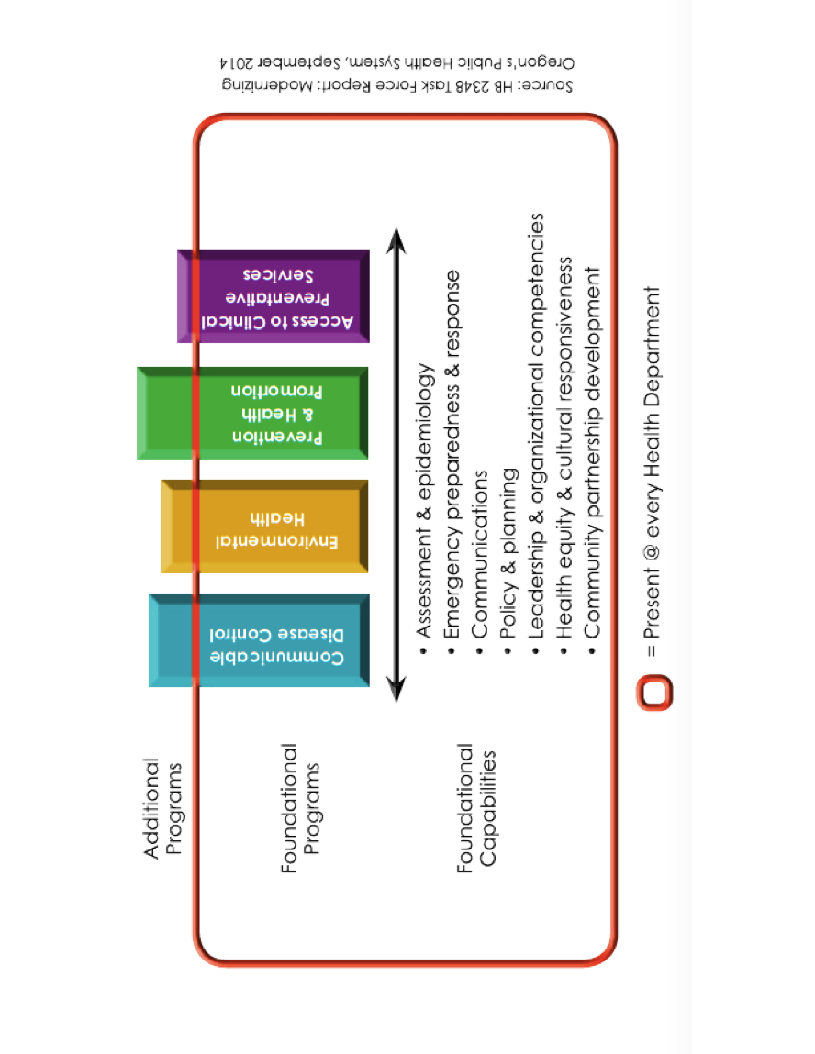
A New Model For Public Health
Notes:
Public Health Modernization is a “minimum, or basic, package of services;” in other words, the suite of skills, programs, and activities that must be available in state and local health departments everywhere for the health system to work anywhere.
A modernized public health system:
protects and promote the health of populations, and
is available and visible in all communities across Oregon
A system-wide assessment conducted in the Spring of 2016 determined that the following public health programs are limited or minimal in over a third of Oregon communities:
• Capacity to investigate and respond to disease outbreaks.
• Ability to identify and prevent environmental health hazards, including air toxics and lead.
• Promote health equity through partnerships and engagement with communities that experience an excess burden of disease and death.
• Access to local, timely and accurate population health data that helps drive community-based decision-making and resource allocation.
The Public Health Advisory Board is recommending investment in these areas as a first step in implementing the Public Health Modernization model.

Slide 7
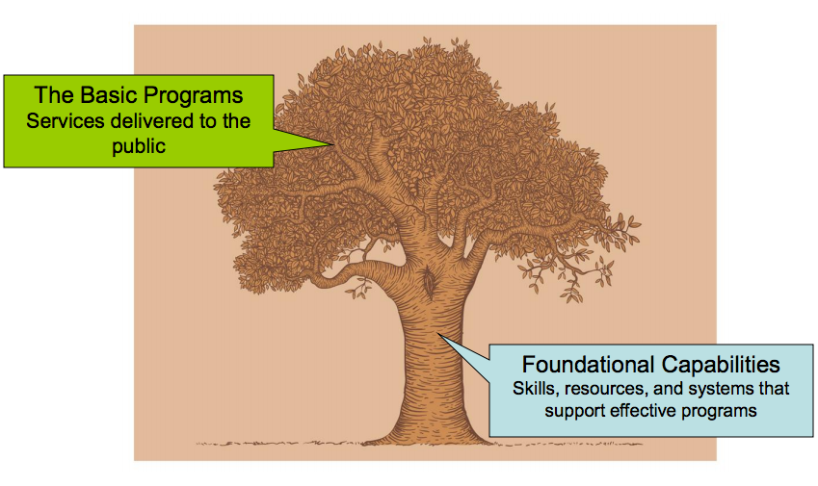
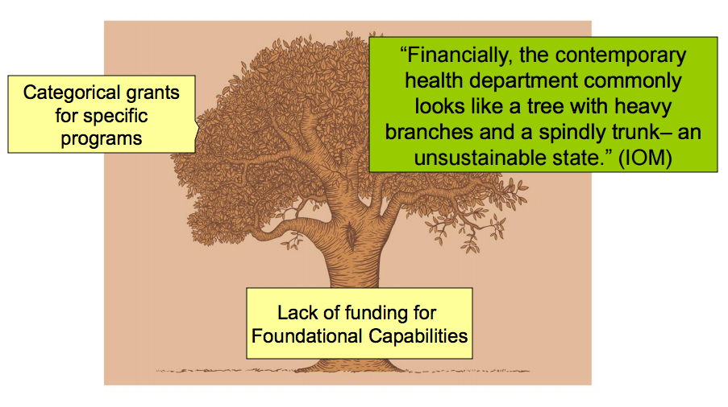
Why We Need a New Model
Image source: Association of Ohio Health Commissioners
Notes:
ANIMATED SLIDE- CLICK THROUGH IMAGES
If we apply the previous model shown to an image of a tree this is what it would look like. The trunk our foundational capabilities, the branches our foundational programs. (IMAGE 1)
What our tree CURRENTLY looks like using this same model is a tree with very heavy branches and spindly trunk – an unsustainable state (IMAGE 2).
The majority of programs are categorically funded
We receive minimal, if any funding, to support foundational capabilities for which most of our programs and services rely upon.

Slide 8
Where Do We Go From Here?
A critical first step investment of $15M of the $105M per year identified need
Focus our initial efforts on responding to emerging communicable diseases and environmental health threats.
Notes:
We need to focus our resources on targeted programs and skills that build upon existing capacity and fill identified gaps. The Public Health Advisory Board is recommending that Oregon’s public health system first focus on:
Capacity to investigate and respond to disease outbreaks.
Ability to identify and prevent environmental health hazards, including air toxics and lead.
Promote health equity through partnerships and engagement with communities that experience an excess burden of disease and death.
Access to local, timely and accurate population health data that helps drive community-based decision-making and resource allocation.

Slide 9
Add Contact Information

