Slide 1
Risk Communication and Message Mapping
CLHO Mentorship Program
12-14

Slide 2
Sources: Risk Communication Message Mapping
Vince Covello
Center for Risk Communication
http://centerforriskcommunication.org/
Peter Sandman
www.psandman.com/

Slide 3
“Communication Regret”

Slide 4
Risk = Hazard + Outrage
High
Level
of
Outrage
Low
Low
High
Level of Hazard

Slide 5
Risk = Hazard + Outrage
High
Stinky
MGP
Level
of
Outrage
Superfund
DuPont
Wells
Meth
Labs
Wind
Farms
H1N1
Fountain
Legionella
MGP
MGP
Cleanup
Crawford
Creek
DuPont
Property
Low
Low
High
Level of Hazard

Slide 6
Risk = Hazard + Outrage
High
Outrage
Management
Risk/Crisis
Communication
Level
of
Outrage
“Precaution
Advocacy”
Public Relations
Low
Low
High
Level of Hazard

Slide 7
Risk Communication and Message Mapping

Slide 8
Risk Communication
Science-based approach for communicating effectively in situations with:
High Concern
High Stress
Emotionally Charged
Controversial

Slide 9
Risk Communication
Accurate and clear information for understanding potential health risks.
Addresses and avoids undue health concerns.
Acknowledges areas of uncertainty.
Reassures public of intentions.
Fosters public support for actions.

Slide 10
Risk Communication Goals
Will result in providing the public with
Knowledge and Understanding
Trust and Credibility
Informed Decisions, Attitudes, Beliefs, and Behaviors.

Slide 11
Risk Communication
Actions, words, and other interactions that incorporate and respect the perceptions of the information recipients, and are intended to help people make more informed decisions about threats to their health and safety.

Slide 12
Evolution of Risk Communication
Ignore the Public
Improve explaining risk data
Dialogue with the community
especially interested and concerned, even fanatic, stakeholders
Treat the Public as a full partner
requires fundamental shifts in an organization’s values and culture

Slide 13
Risk Communication
Is not only a matter of what an organization says, but what it does.
Must account for the affective (emotion) component in people’s perceptions of risk.
dual process of facts and feelings.
shift from presenting facts & data to addressing perceptions
Will be more effective when conducted as dialogue, not an instruction.

Slide 14
Factors Affecting Risk Perception
Lower Perceived Risk
Trustworthy sources
Substantial benefits
Voluntary
Controllable
Fair/equitable
Natural origin
Familiar
Not dreaded
Certain
Children not victims
High Perceived Risk
Untrustworthy sources
Few benefits
Involuntary
Uncontrollable
Unfair/inequitable
Human origin/manmade
Unfamiliar/exotic
Dreaded
Uncertain
Children as victims

Slide 15
Message Mapping
The key for successful Risk Communication is a sound and logical message structure developed with APP:
Anticipation
Preparation
Practice

Slide 16
Key Steps for Message Mapping
Identify stake holders early in the communication process
Anticipate questions and concerns, before they are raised
95% of questions can be predicted in advance.
Organize our thinking and develop prepared messages in response to anticipated questions and concerns.
Develop key messages and supporting information within a clear & concise framework.

Slide 17
Key Steps for Message Mapping
Develop supporting facts & proofs
Conduct systematic message testing
Preferred, but not always possible
Plan for delivery of messages
Provide user-friendly guidance to spokesperson.
Ensure a central repository of consistent messages.
Promote the agency speaking with one voice.
Establish open dialogue about the messages, both within and outside the agency.

Slide 18
Process
Message Mapping Team
Stakeholders and their Concerns
Key Messages and Supporting Facts
Review
Message Preparation
Message Use

Slide 19
Message Mapping Team
Message Teams
Subject Matter Experts
Communication specialists or point-person
Policy/management/legal guidance
Reviewers
Knowledgeable

Slide 20
Identifying Stakeholders
Who is:
Affected?
Interested?
Influential?
Determining Stakeholder’s concerns

Slide 21
Core Message Map
Addresses
What should people know about the issue/event?
What they should know regardless of the questions asked?
What you would put into the opening statement
Be sure these get delivered
Serves as a “harbor in a storm” in case the delivery becomes tense or stressful

Slide 22
Consider When Developing Messages
What’s it all about?
What happened?
What caused it to happen?
What does it mean?
What do you want from stake holders?
What’s in it for stake holders?

Slide 23
Message Construction
3/9/27
3 messages
spoken in 9 seconds
27 words (9/9/9 or 12/6/9)
Order of importance: 1/3/2
Primacy/Rescency
Each message should be able to stand alone
Avoid absolutes and unnecessary negatives

Slide 24
CCO – Compassion, Conviction, Optimism
Shift competence to caring
Listening, caring, & empathy assessed by stake holders in first 30 seconds.
Rule of 3
3 messages
Each message repeated 3 times
Each message supported by 3 supporting messages

Slide 25
1N=3P
In high stress situations, 1 negative message = 3 positive messages
When stating 1 negative, follow-up with 3 positives

Slide 26
IDK
How do you respond if you don’t have an answer?
“I Don’t Know” template
Repeat the question
Say you don’t know, or can’t answer the question, but wish you could
Give reasons why you don’t know or can’t answer the question
Indicate a follow-up with a deadline
Bridge back to what you can say, core messages

Slide 27
Bridging Statements
“The most important thing for people to know is….”
“What this all boils down to is…”
“What needs to be emphasized is…”

Slide 28
Briefings
Presentation: 10 to 15 minutes
Responses to questions: 1 to 2 minutes
Sound bites
27 words, 9 seconds, 3 messages

Slide 29
Health Officer Risk Communication Most Effective When
HOs have strong community partnerships.
HOs have clear public health roles and responsibilities in their communities
HOs have acquired effective risk communication skills.

Slide 30
Message Map Examples
Vapor Intrusion at Monona High School
(May 9, 2012)
Testing inside the school found solvents above acceptable levels.
Breathing these levels is not harmful, but exposures should be stopped.
Mitigation will halt solvents from entering the school.

Slide 31
Message Map Examples
Arsenic in Keyes Lake Wells
(July 16, 2012)
Testing found arsenic a health concern in 27% of wells.
Agencies are helping residents obtain safe drinking water.
All Keyes Lake wells should be tested for arsenic.

Slide 32
In Summary
Risk Communication is a science-based discipline
High stress situations changes communication rules.
The key to success is Anticipation, Preparation, and Practice.

Slide 33
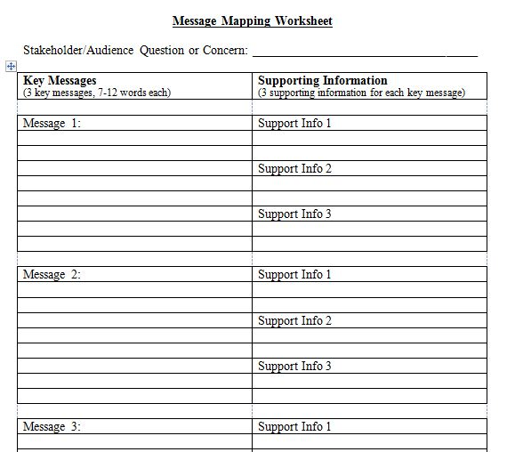

Slide 34
Exercise
Considering the NWS current heat advisories for Monday and Tuesday, develop a message map of the key health messages you think should be provided to the public.
What about
multiple-day heat warnings?
pavement buckling?
people medications (psychotropic)?

Slide 35
Exercise: Heat-related Fatality
A reporter with the local TV station will be arriving in 10 minutes to interview you about the death of a 87 year-old woman who was discovered this afternoon alone in her apartment.
How would you prepare?

Slide 36
Resources
State Public Health – Risk Communications Training
CDC – Risk Communication
http://www.bt.cdc.gov/CERC/

