Slide 1
CLHO Mentorship Program
Cultural Competency
12-14

Slide 2
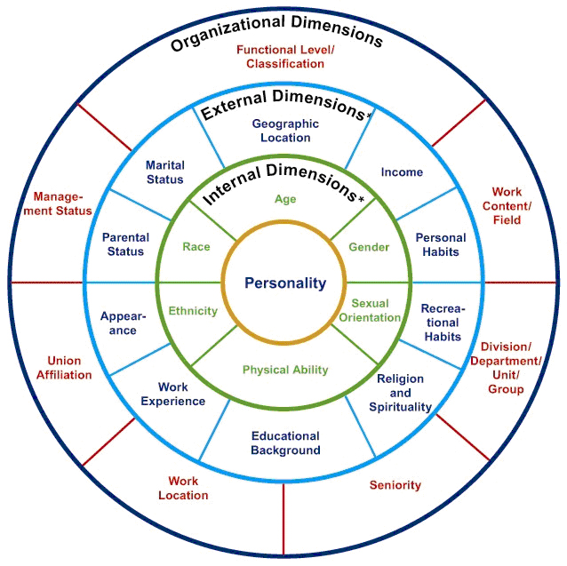
Dimensions of Diversity
Gardenswartz & Rowe

Slide 3

Cultural Competence
Lifelong process to:
  Examine values and beliefs
  Develop and apply an inclusive approach
  Recognize the context and complexities of provider-client interactions
  Preserve the dignity of individuals, families and communities

Slide 4
Why Does Cultural Competence Matter?
Race/Ethnicity | Percentage in Your County County (N= ) Figure out your %’s
White, alone | 89.0
Black or African American, alone | 0.2
American Indian or Alaska Native, alone | 1.3
Asian, alone | 0.3
Native Hawaiian and Other Pacific Islander, alone | 0.0
Two or More Races | 1.6
Some other race, alone | 0.3
Hispanic or Latino (of any race) | 7.3

Slide 5
Why Does Cultural Competence Matter?
Income Distribution of Families (in dollars) | Percentage in County (N= )
Less than 24,999 | 25.9
25,000-49,000 | 29.3
50,000-74,999 | 23.5
75,000-99,999 | 10.1
100,000-149,000 | 8.5
150,000-199,000 | 2.4
200,000 or more | 0.3
Median Family Income | $45,132

Slide 6
Why Does Cultural Competence Matter?
Disabled | Percentage in County Figure Yours
Total (N=20,638) | 20.8
Under 18 years (N=4,322) | 6.3
18-64 years (N=11,802) | 18.0
65 years and over (N=4,514) | 42.1

Slide 7
Why Does Cultural Competence Matter?
Age (in years) | Percentage in County (N=20,978) Example
0-9 | 11.4
10-19 | 12.6
20-29 | 8.8
30-39 | 11.0
40-49 | 12.4
50-59 | 15.7
60-69 | 15.2
70-79 | 8.5
80 and over | 4.6
Median Age | 47.2

Slide 8
Why Does Cultural Competence Matter?
Educational Attainment 25 years and over | Percentage in Counties (N=15,145) Example
Less than 9th grade | 5.3
9th-12th grade, no diploma | 10.1
High school graduate | 38.1
Some college, no degree | 26.2
Associate’s degree | 7.7
Bachelor’s degree | 8.8
Graduate or professional degree | 3.9

Slide 9

What Cultural Competence Training is not……
Easy to do in three short steps
“One size fits all”
A task you can delegate to someone else
Summed up in a 2 page article

Slide 10

Achieving Cultural Competence requires…
Leadership commitment
Organizational buy-in
Continuous learning
Quality Improvement
Self-reflection
Partnership
Evaluation and metrics

Slide 11

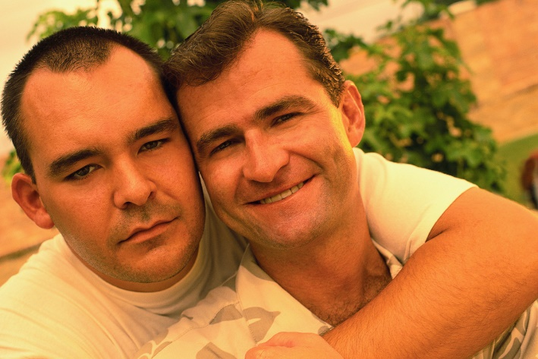
Diversity Assessment

Slide 12
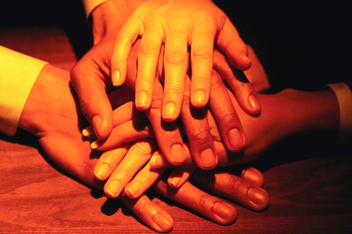
Knowledge of Diverse Communities
  How do you feel about working with other cultures?
  Where are the gaps?
  What do you need?
  Policies – What is there available for staff?
  What social supports are available for clients?

Slide 13
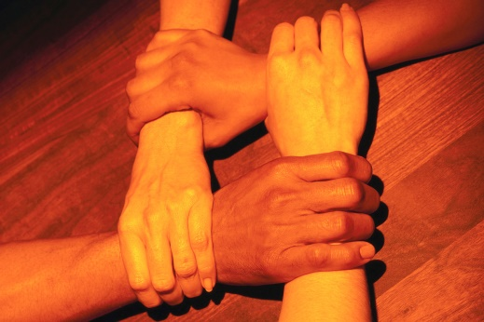
Organizational Philosophy
Mission Statement-incorporates cultural and linguistic competence
Practice Model incorporates Culture
Quality Improvement
Staff felt that we are strong in advocacy for clients of diverse backgrounds

Slide 14
Organizational Philosophy
Review processes for delivery of services and procedures
Community participation in programming through consumer questionnaires
Décor in the building?

Slide 15
Personal Involvement in Diverse Communities
Does your agency identify opportunities for you to be involved in diverse communities?
Does your agency identify opportunities to share with colleagues your experiences and knowledge about diverse communities?
Do policies exist?
Notes:
Examples in the assessment were: attend cultural or ceremonial functions, purchase goods or services from a variety of merchants, subcontracts for services from a variety of vendors, participate in recreation or leisure time activities, participate in career awareness days, or participate in community education activities.

Slide 16

Resources and Linkages
Does your agency
  Collaborate with community based organizations in region?
  Establish formal relationships?
  Use resource materials that are culturally and linguistically appropriate?

Slide 17

Human Resources
How diverse are the staff?
Are there incentives for improvement of cultural competence?
Are there procedures in place to achieve culturally and linguistically competent workforce?
Is there training for cultural diversity?

Slide 18

Clinical Practice
Cultural Diversity in assessment of clients needs?
Interpreters?
  Policy for use of interpreters, etc. for clients?
  Quality of interpreter services?

Slide 19
Demographic Information
Analysis or formation of organizational policy
Cultural groups served?
What groups do you feel the most proficient?
What groups do you feel the least proficient?

