Slide 1
CLHO Mentorship Program: Relationship & Coalition Building to Meet Community Need
August 27th, 2015

Slide 2
Health Equity and Community Engagement
Coalition of Local Health Officials
August 27, 2015

Slide 3

Vision
All people, communities and cultures co-creating and enjoying a healthy Oregon.
Mission
To engage and align diverse community voices and the Oregon Health Authority to assure the elimination of avoidable health gaps and promote optimal health in Oregon.

Slide 4

Equity Unit
Community engagement
Policy development
Fund development
Data improvement
Diversity Unit
Cultural competence
Diversity development
Affirmative Action/EEO
Client Civil Rights

Slide 5
Ladder of Community Engagement
8 | Community Control |  | Degrees of Community Power
7 | Delegated Power
6 | Partnership
5 | Placation |  | Degrees of Tokenism
4 | Consultation
3 | Informing
2 | Therapy |  | Non-Participation
1 | Manipulation
Adapted from Arnstein, S.R., A Ladder of Citizen Participation in the USA in the Journal of Town Planning Institute, Vol 57, No. 4, 1971.
Notes:
The bottom rungs of the ladder are (1) Manipulation and (2) Therapy. These two rungs describe levels of "non-participation" that have been contrived by some to substitute for genuine participation. Their real objective is not to enable people to participate in planning or conducting programs, but to "educate" or "cure" the participants.
Rungs 3 and 4 progress to levels of "tokenism" that allow the community members to hear and to have a voice: (3) Informing and (4) Consultation. When they are proffered by institutions as the total extent of participation, [community members] may indeed hear and be heard. But under these conditions they lack the power to insure that their views will be heeded by the powerful. When participation is restricted to these levels, there is no follow-through, no "muscle," hence no assurance of changing the status quo.
Rung (5): Placation is simply a higher level tokenism because the ground rules allow community to advise, but retain for the institution the continued right to decide what ultimately happens.
Further up the ladder are levels of [community] power with increasing degrees of decision-making clout. [Community members] can enter into a (6) Partnership that enables them to negotiate and engage in trade-offs with traditional power holders. At the topmost rungs, (7) Delegated Power and (8) [Community] Control, [community members] obtain the majority of decision-making seats, or full managerial power.

Slide 6
Building Authentic Relationships
Create shared spaces
Honor community wisdom
Be informed by research/data, but not driven by it
Collaboration within communities
Share resources – build capacity
Community control
Notes:
Shared spaces for leadership/community
Recognition of community wisdom
Getting one parent to engage with public health services is good, but getting a group of parents working together is better. Getting a group of parents is good, but connecting with an organization with roots, resources, and relationships in that community to support those parents is better. Connection with one organization is good, but helping to build a coalition of organizations with a range of resources and relationships with parents and a community constituency is better. - See more at: http://vue.annenberginstitute.org/issues/36/how-can-authentic#sthash.MMgKqQXI.dpuf

Slide 7
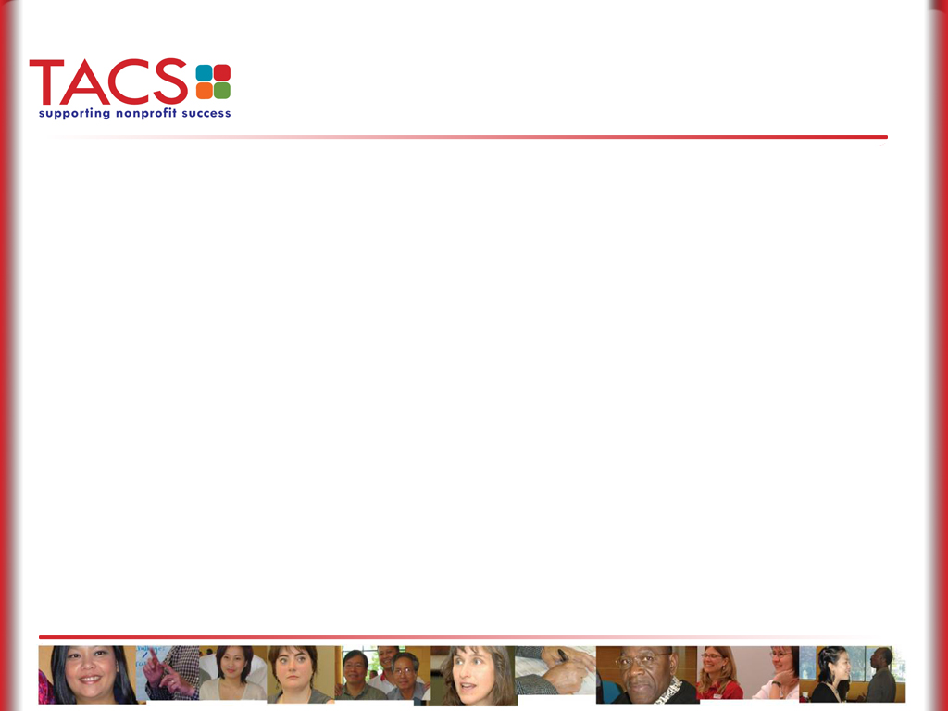
Overcoming Barriers
Embrace community as part of your work
More listening than talking
Transparency: meeting notes, data, decision-making
Accountability
Learning community values
Understanding community histories
Language access
Clarifying roles
Resourcing community efforts
Historic non-participation
Move beyond surveys/focus groups
Lack of trust
Beliefs/ assumptions about each other
Lack of cultural competency
Being “done to”

Slide 8
Guidelines for Community Engagement
Consistent with the community’s cultural framework
Acknowledges and addresses barriers to participation for racially, ethnically, and linguistically diverse populations
Builds upon the strengths of the community
Empowers community through meaningful inclusion and partnerships
Provides feedback to communities regarding how their input was implemented
Builds capacity of communities to engage in future policy and programmatic work
Prioritizes community knowledge and lived experience
Targets resources to support ongoing community engagement
Facilitates mechanisms that encourage mutual learning

Slide 9
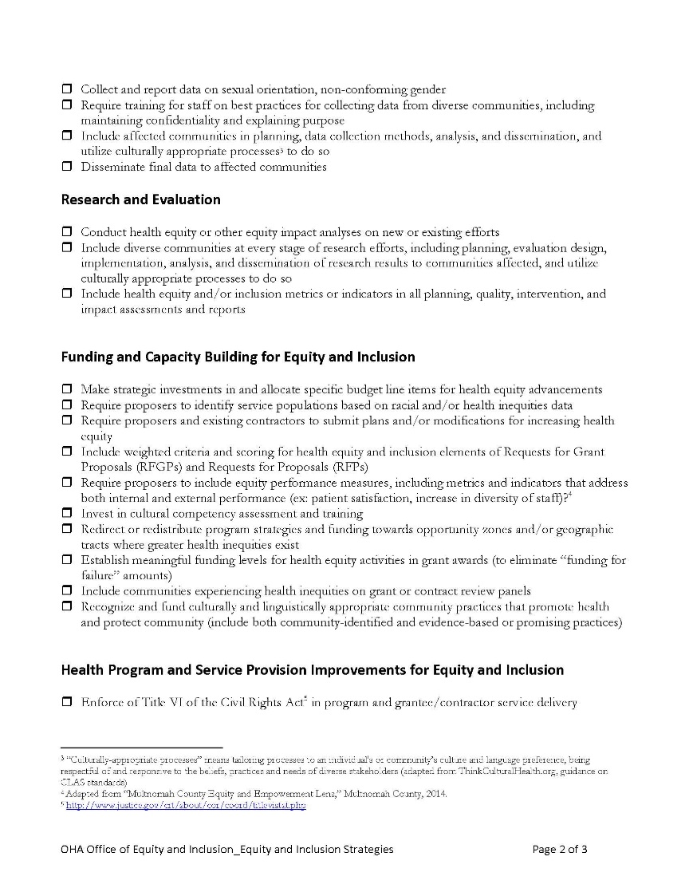
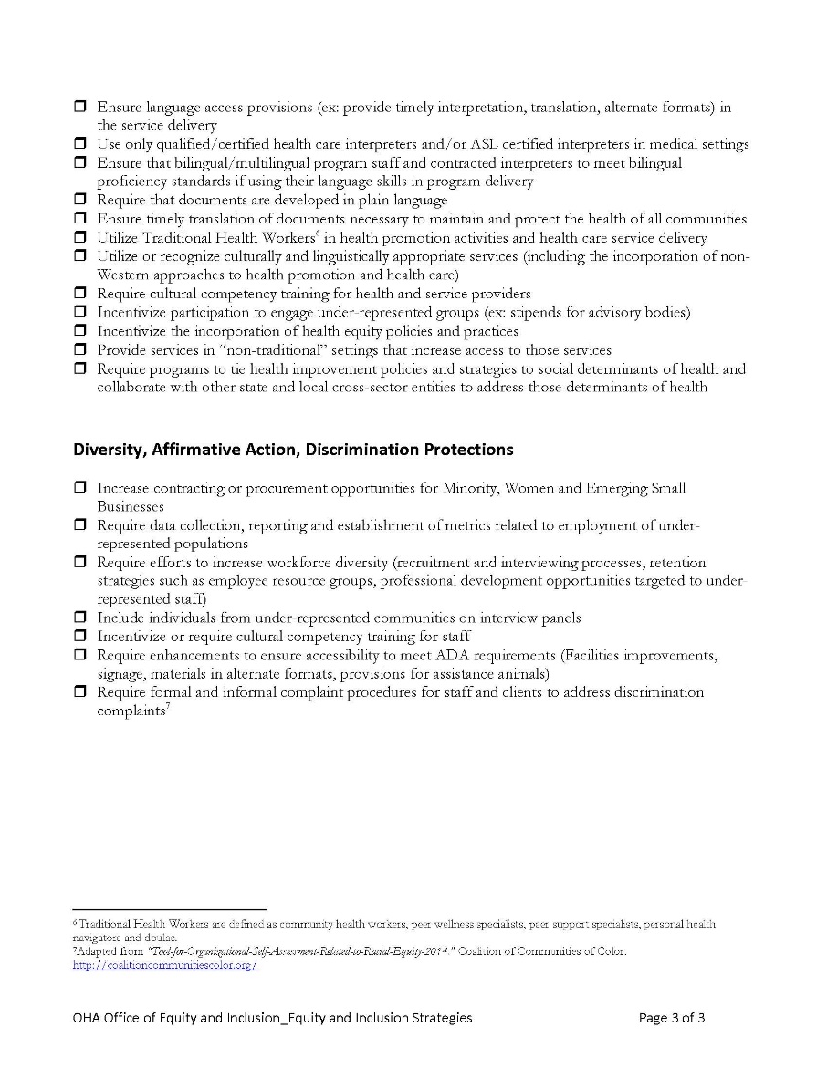
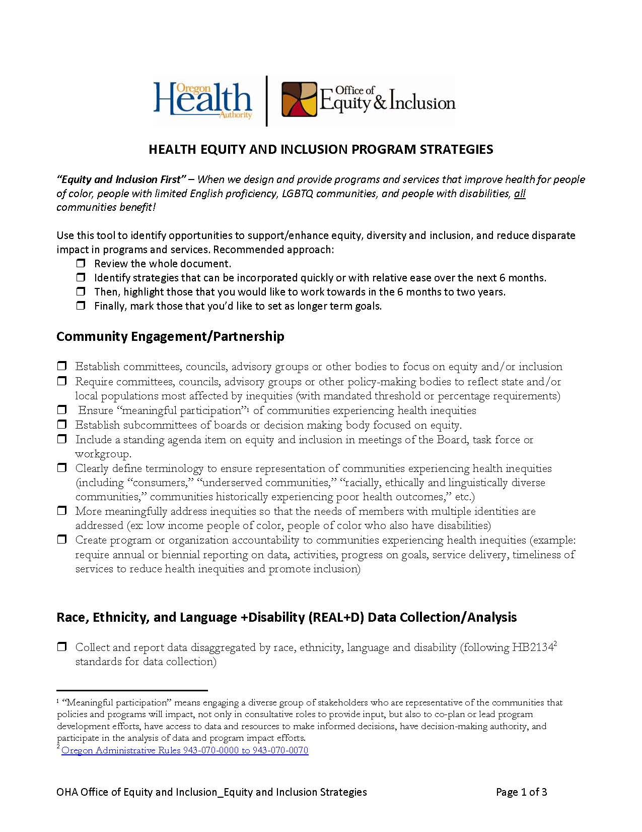
Establish Policies to Advance Equity

Slide 10

Office of Equity and Inclusion
Carol Cheney, Equity, Policy & Community Engagement Manager
carol.i.cheney@state.or.us
www.oregon.gov/oha/oei

Slide 11
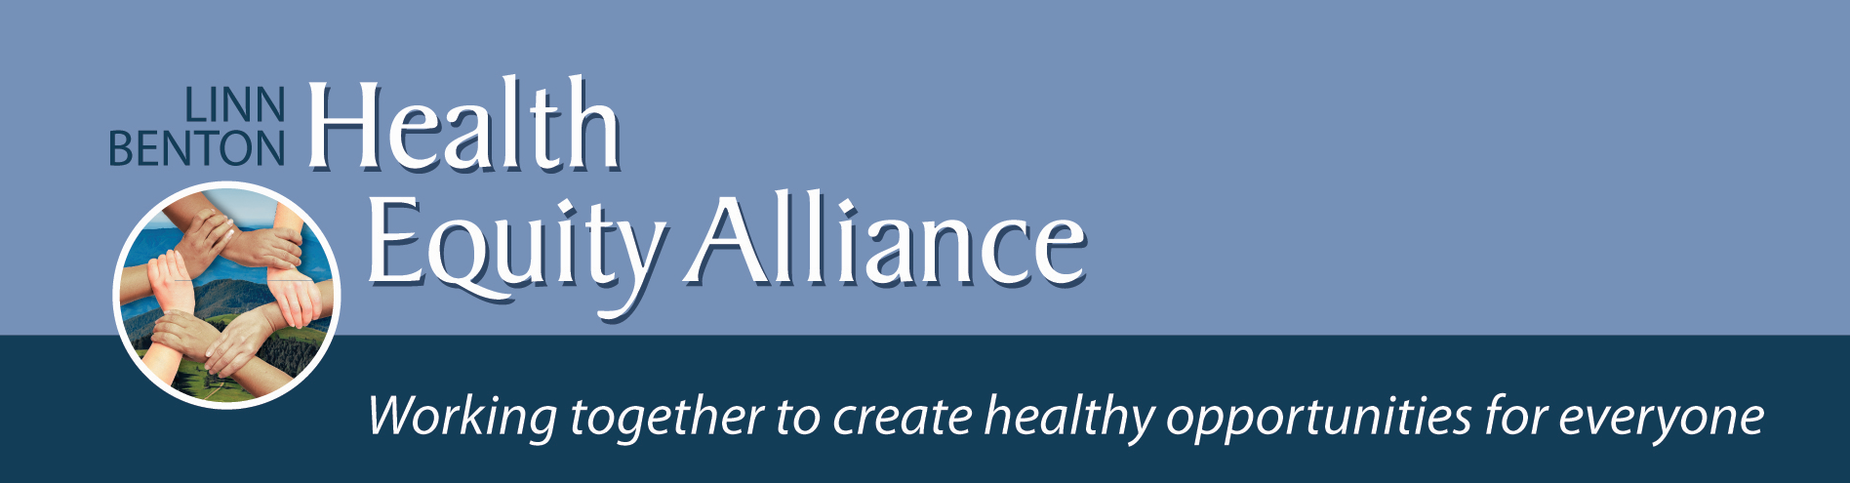
Oregon Coalition of Local Health Officials
August 25, 2015

Slide 12
WNHS’ mission
Committed to improving lives and strengthening communities through quality affordable housing, homeownership, economic opportunity, and community partnerships.

Slide 13
WNHS Services
Affordable housing development
Homeownership promotion
Homeownership preservation
Financial education and coaching
Resident services
Community building and organizing

Slide 14
Home Matters
Everyone should be able to afford decent housing and still have something left for food & basic necessities.
Children thrive in school and in the community when they have a sense of stability.
Healthy habits take root more easily in stable, affordable homes. Children grow strong and adults stay well, and live better.

Slide 15

WNHS’ introduction to the social determinants
of health
Insight - Realizing housing/community development people and public health people have something in common: we both work to address the underlying causes and conditions that impact the well-being of individuals and families.

Slide 16
Healthy Kids Healthy Community (HKHC)
Benton County Health Department Lead Org. Corvallis Parks and Recreation co-managed the HKHC initiative
Multiple organizations worked toward changes in public policies, systems, and built environments that promote; active living; improve access to affordable, nutritious foods; and reduce health disparities among approximately 3,110 children living in South Corvallis

Slide 17
Healthy Communities -- South Town Community Engagement

Slide 18

Real change requires “cross-sector collaborations,” the integration of programs and funding streams to create multifaceted approaches, and is both place-based and people-centered.

Slide 19
What does Linn Benton Health Equity Alliance do?
Start where health begins – in the places we live, learn, work and play
Focus on housing, education, health care, and capacity building

Slide 20
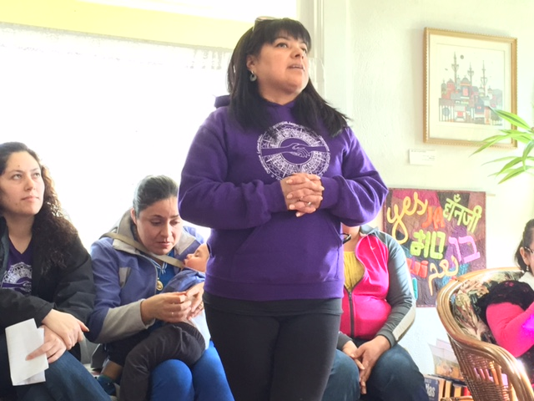
What does Linn Benton Health Equity Alliance do?
Fund local programs and organizations
Focus on policy change
Host monthly educational meetings

Slide 21
Adult Smoking:
Linn: 20%
Benton: 11%
Lincoln: 24%
Oregon: 16%

Slide 22
WNHS’ Smoke Free Housing
Video

Slide 23
WNHS properties would not have gone smoke free without the support from public health staff.
Health dept staff provided a trusted partnership and tools to help make the policy change.
Education was essential and resources for residents to quit are necessary.
Policy change takes time.

Slide 24
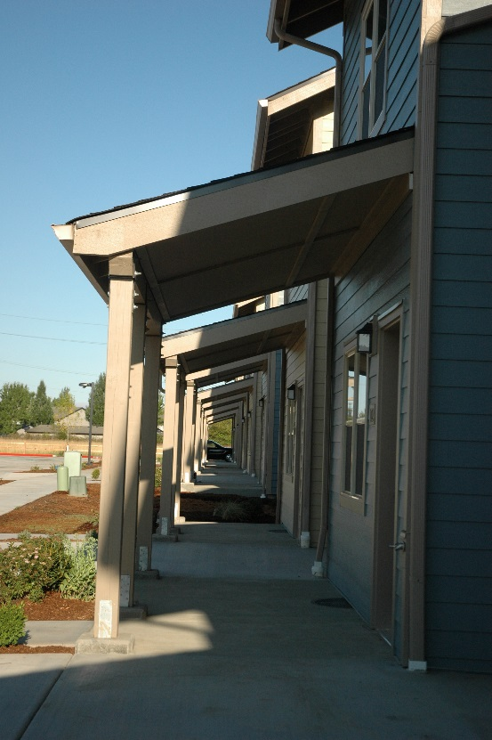
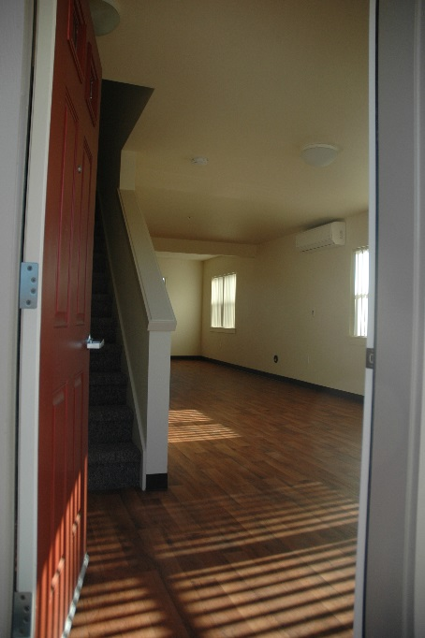
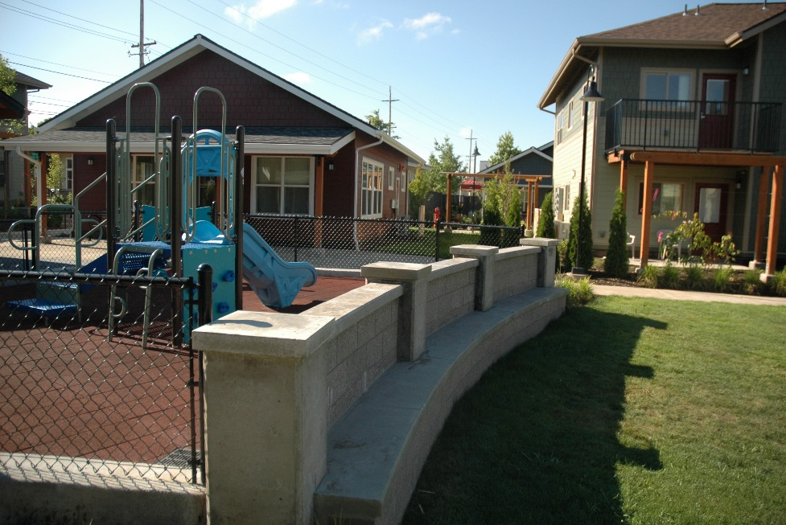
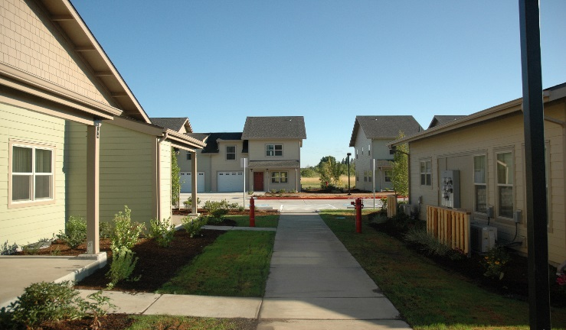
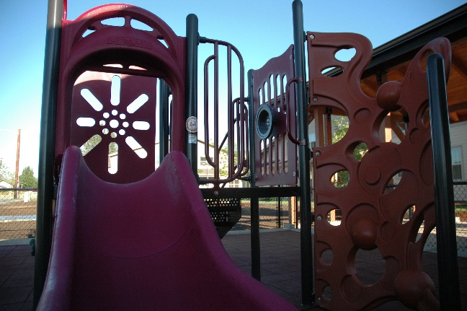
Healthier Communities: Alexander Court and Seavey Meadows

Slide 25
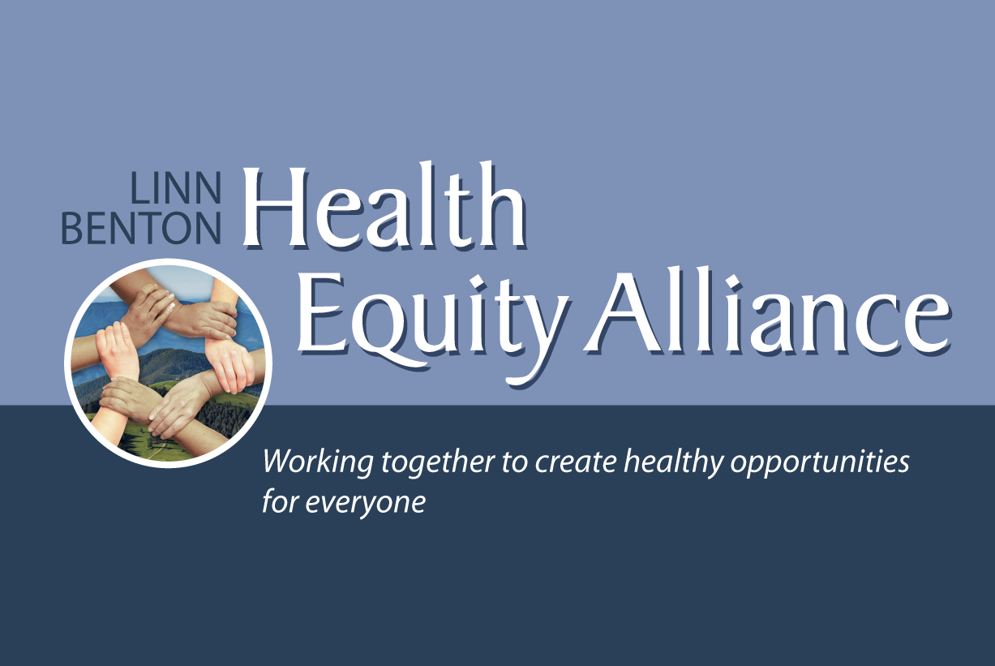

Slide 26

Building Partnerships & Community Engagement in Jackson County
A Regional Health Equity Coalition’s Journey
Notes:
Good morning. I want to thank Kathleen Johnson and the Coalition of Local Health Officials for inviting me to share with you all how SO Health-e formed lasting relationships with community partners and continues to build relationships with communities in southern Oregon in the effort to increase the health and well-being of all Oregonians.
My name is Jennifer Ware and I am the Coalition Coordinator for So Health-E which is one of three programs managed by the Health Care Coalition of Southern Oregon. My position is solely dedicated to the health equity coalition and I love the work that I get to do everyday. Being in a position focused on the coalition is actually an important part of our success. I will get to why later.

Slide 27




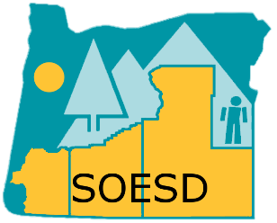










Who We Are: SO HEALTH-E Southern Oregon Health Equity Coalition
Notes:
Before I jump into how the coalition partnerships were formed I want to show you who is involved with SO Health-E.
We have a local nursing school, two federally qualified health centers, two CCOs, the transformation center, Jackson County Health & Human Services, a number of community advocacy networks, and a dental care organization.
What you may also notice is there are not only health related organizations represented in our coalition, but also some that are not traditionally linked to an individual’s health; like law enforcement or a local school district.
We have a steering committee structure within our coalition with smaller work groups focused on specific topics such as data, community engagement, and cultural agility training.

Slide 28
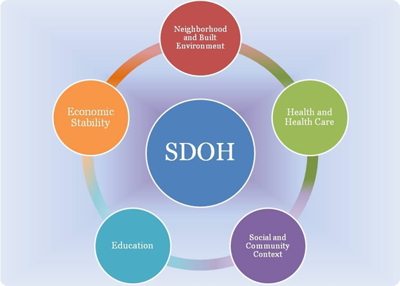


Notes:
Our coalition was created to specifically to address health equity after a Latina Health Coalition working to reduce teen pregnancy rates for Latina females found data highlighting that many factors impacting a teen’s life go beyond talking to parents about sex and can include the health and wellness of the teen and their family, safety of their community, school environment, and so much more. These are what we call the social determinants of health.
It was the social determinants of health that initiated our coalition building process.

Slide 29
Initial Steps
What are the problems?
Who/what is working to fix them?
Notes:
We started with an examination of the issues in our community that we were aware of and listed who or what organizations were working to resolve them.
From the final list, we were able to determine multiple organizations to invite to join the coalition. Fortunately, requesting partnership in a coalition to improve health outcomes was not a difficult task for healthcare agencies. The tricky part was showing non-healthcare organizations how their work played a part in the overall wellness of the county.
Part of our strategy was to use the social determinants of health along with some preliminary data that highlighted the population change in our community and the need for policies and programs to evolve with the growing numbers. By that point organizations wanted to be a part of this change.

Slide 30
Clear charter outlining coalition work
Rotating facilitation of all meetings
Team building activity at every meeting
Discuss difficult topics together
Notes:
When our group reached about 12 partners discussion on strategies to address health equity began. We meet monthly and not only work on specific projects, but also spend time getting to know one another on a personal level to better understand beliefs and ethics. This was an important step for us to help build trust. We knew that without trust, a group could not be fully committed or willing to tackle difficult work and also could not rely on other members completely. I have found that much of this work is personal and without a personal connection to the partners you are working with, it’s not authentic. Every one of our meetings begins with a team building activity or check in question.
Other ways that we were able to build a strong coalition was ….
Drafting a charter as the first order of business to outline the structure of our coalition and how decisions are to be made. This was created collaboratively of course.
We rotate facilitation of all meetings to not only keep members engaged, but to also mirror equity in our own group
We talk about racism, current events happening nationally, some solutions to the problems, challenges within our organizations, and offer one another support as needed.
Additionally, letters of agreement were created for each partner agency that outlined the minimal amount of time each representative is asked to complete. Many of our coalition members spend more than the minimum advocating for health equity.

Slide 31
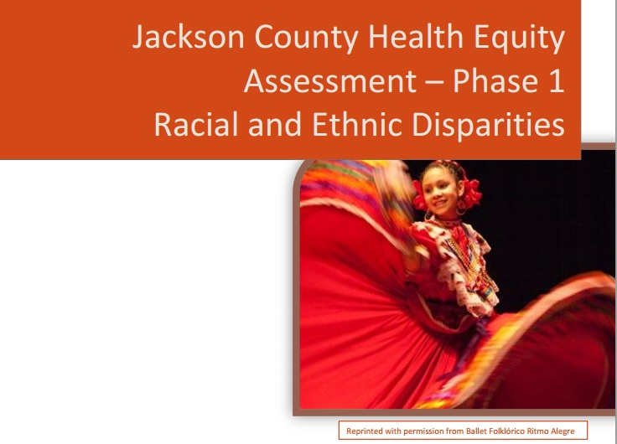
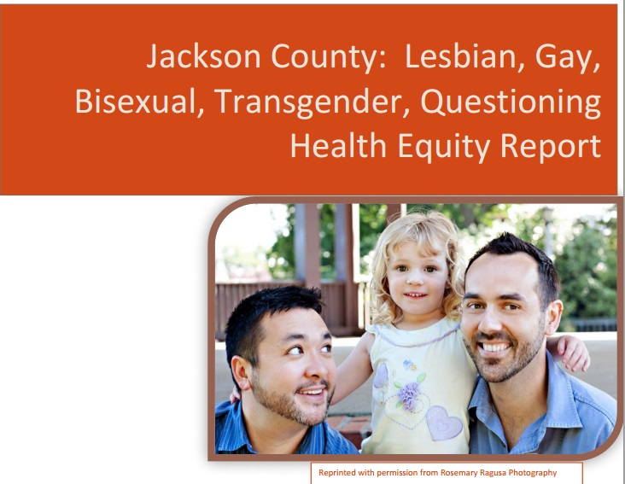
Coalition Work
Notes:
At the start of our work together community data was assessed and disaggregated to understand the disparities present in Jackson County. In the Winter of 2015 we released two disparity reports one based on race and ethnicity, and another focused on the LGBTQ community.
After the reports were released the coalition believed it was important to know whether the communities living these disparities agreed with the quantitative data. So we decided to ask. This summer we have been holding multicultural storytelling sessions asking residents who identify with demographic groups represented in the reports what health means to them and what might be the most strategic step to address their needs.
We modeled our sessions after the 2006 Minnesota Department of Health Multicultural Storytelling tour.
The input that we receive will guide our strategic plan for reducing health disparities. We’ve heard many times from residents that organizations will ask for their input and either do nothing with it or do the opposite of what was recommended. We refuse to do that and make all efforts to make that clear to the groups we work with.
At every session or event we host, coalition members facilitate a space that is health literate and culturally appropriate, fully disclose our goals, and explain how the information shared will be used. We maintain transparency with the community just as we do in our coalition.
In my opinion, our manner of engagement not only shows residents that we truly want what is best for every one but also builds trust and empowers each person that participates in our sessions to use their voice to impact change. Through authentic engagement, we are able to make connections with residents and know that they support the changes that we advocate for.

Slide 32

Leverage Coalition Champions
Notes:
As mentioned a moment ago our coalition members play a role in engaging the community. These roles can include bridging the coalition with groups they work with in their respective fields or as models for how equity can be achieved.
The Jackson County Sheriff’s office is a model organization. Having the Sheriff on our coalition steering committee opened the door for us to work with other law enforcement agencies as well as policy makers. The Sheriff has also been a great champion when talking with the community and always linking his work to being a member of the coalition. The Southern Oregon Education service district has also been a champion helping to bridge the coalition with a local school district by providing resources to improve equity and the success of all students.
It is with the full support of our steering committee and their leadership in the community that we have success. Our Coalition is made up of many champions.

Slide 33
My Top 10 Recommendations
Hire staff
Assess community needs
Determine the organizations working to answer those needs
Create a working group with cross sectoral champions
Mirror the demographics of your community in your work group
Create a shared agenda, mission, and vision
Agree on a charter
Build trust via team building or group trainings
Leverage your champions
Maintain transparency in everything
Notes:
The moral of my story are these 10 recommendations:
Hire staff specifically focused on the coalition work (As I mentioned at the beginning, my job is solely to move this work forward. This is a very important step as the work can be time consuming and may not move without dedicated staff to do much of the leg work.)
Assess community needs (what are the issues/concerns of people living in the community)
Determine the organizations working to answer those needs
Create a working group of cross sectoral champions to advocate for health equity
Ensure that the demographics of your community are represented in the work group
Create a shared agenda, mission and vision (this will be your roadmap)
Collaboratively agree on a group structure and charter for how work will occur
Take part in team building or group trainings as this will help build trust (this will also help group members be more comfortable around topics such as racism that are sure to come up as you approach other organizations and advocate for change)
Use group champions to bridge professional sectors and connect you to communities
Be transparent with all players in the coalition and report back to them with the progress of the work (this includes the community members)

Slide 34
Jennifer Ware Coalition Coordinator jennifer.ware@hccso.org www.hccso.org 541-774-8235
Notes:
We’ve had great success following these steps and are looking forward to great changes in our community with regards to hiring practices of various organizations, policing of minority residents, and watching the health of people living in this state improve.
Should you have any questions or want to discuss our journey in more detail, you can find us at OPHA on October12th or contact me via email or phone.
Thank you all for listening.

