Slide 1
Prescription Drug Overdose Prevention Grant
Lisa Millet and Matt Laidler
Public Health Division
Injury and Violence Prevention Program
CLHO meeting
December 17, 2015

Slide 2
Topics covered
The burden of prescription drug overdose
Overview of the CDC Prevention Grant for States
Plan and selection process for regional funding
Program element and next steps

Slide 3
Prescription Opioids: The Problem
In Oregon, over 2,400 people have died from overdoses associated with prescription opioids since 1999
Results from the 2012-2013 National Survey on Drug Use and Health tie Oregon for 2nd place among all US states in non-medical use of prescription pain relievers
In 2013, 3.6 million prescriptions for opioid painkillers were dispensed in Oregon, enough for 925 opioid prescriptions for every 1,000 residents in that year alone

Slide 4
CDC Prevention Grant
Oregon is one of 16 states selected for CDC Prescription Drug Overdose: Prevention for States funding for 2015-2019, to advance prevention in four key areas:
Enhancing and Maximizing State Prescription Drug Monitoring Programs (PDMPs)
Implementing Community or Insurer/Health Systems Interventions
Conducting Policy Evaluations
Developing and Implementing Rapid Response Projects

Slide 5
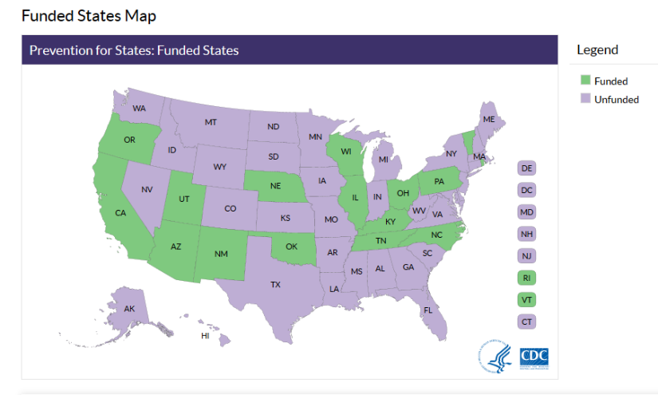

Slide 6
Driver Diagram: PDO Prevention, 2015 - 2019
Aim
Primary Drivers
Secondary Drivers
1. Implement opioid prescribing guidelines for pain management
Engage CCOs, Emergency Departments, health systems, pharmacies, and insurers to expand uptake and use of evidence-based opioid prescribing and management guidelines
Fund five high- burden county regions to form and convene regional pain guidance groups (PGGs) and interdisciplinary action teams (IATs) to expand uptake of model opioid prescribing guidelines
Reduce problematic prescribing practices
2. Enhance and maximize the Oregon Prescription Drug Monitoring Program (PDMP)
Reduce barriers and increase PDMP registration and use
Reduce data reporting interval
Increase PDMP reporting, surveillance, and data sharing
Establish messaging to PDMP users
Authorize PDMP to share identified data with researchers, public health, and health systems
Increase access to and reimbursement for non-opioid treatments for chronic non-cancer pain
Reduce deaths, hospitalizations, and emergency department visits related to drug overdose
Provide Medication Assisted Treatment (MAT) for opioid use disorder
3. Provide reimbursement for non-opioid pain treatment therapies
Require insurers to pay for non-opioid care for chronic non-cancer pain treatment
Encourage CCOs and other prescribers to increase the use of non-opioid pain management
Increase and improve the infrastructure of naloxone rescue
4. Increase the number and geographic distribution of primary care physicians certified to provide MAT for chronic opioid dependency
Use data to target interventions to populations at highest risk
5. Increase access to naloxone
Establish a standing order for Naloxone distribution at pharmacies
Increase access to Naloxone through community-based programs
Include co-prescribing of naloxone in model guidelines when prescribing opioids for at-risk patients
Staff
Katrina Hedberg, State Health Officer Lisa Millet, Principal Investigator Lisa Shields, Program Coordinator Matt Laidler, Research Analyst Josh van Otterloo, Research Analyst
6. Evaluations of policy and programs
Evaluate the public health impact of removing methadone as a preferred pain treatment drug from the state Medicaid drug formulary
Evaluate the impact of 72-hour or “real time” PDMP reporting

Slide 7
State “hot spots”
Aim: fund five high- burden county regions to form and convene regional pain guidance groups (PGGs) and interdisciplinary action teams (IATs) to expand uptake of model opioid prescribing guidelines
Jim Shames and Laura Heesacker (Jackson County) are consultants for this effort

Slide 8
Funding for 5 regions
Years 1-2
Multnomah, Clackamas, Washington
Lane, Douglas
Coos, Curry, Josephine
Years 3-4
Clatsop, Tillamook
Lincoln, Linn, Benton

Slide 9
Selection
Index measure/composite score of 5 factors: 1) county rate of opioid overdose death, 2) county rate of opioid overdose hospitalization, 3) rate (per 1,000 residents) of prescribing for all opioids, 4) average # patients per month with > 100 MED prescriptions, 5) county population
Factors weighted according to importance for reducing aggregate overdose rates and problematic prescribing rates
Counties were assigned points by their rank of these factors (e.g. the county that had the highest overdose death rate received 25 points, the next highest, 24, etc.)
Composite score = averaged county factor scores across five factors [no single factor alone disproportionately contributed to composite score].
Selected counties are a mix of large and small (population), but each with sizable overdose and/or problematic prescribing rates

Slide 10
Program Element highlights
$95,500 annually for a PDO coordinator in each region who will:
Complete remote (web-based) training on using the Oregon Prescription Drug Monitoring Program (PDMP) and PDMP guidelines.
Promote prescriber enrollment and adoption of the PDMP
Accomplish movement toward building or strengthening a community network within the region
Convene or strengthen an existing Interdisciplinary Action Team (IAT), a Pain Guidance Group (PGG), and a regional summit
Disseminate local data or stories to local media outlets to promote public awareness of the burden and preventability of PDO

Slide 11
Next steps
December 18 – The approved PE will be sent to OHA Contracts for processing.
OHA will develop templates for budget and work plan
PE included in the January amendment
OHA will host phone calls in January with each region and the project team to discuss next steps

Slide 12
Contact Information
Lisa Shields
Lisa.m.shields@state.or.us
Matt Laidler
Matthew.laidler@state.or.us
Lisa Millet
Lisa.m.millet@state.or.us

