Slide 1

Working to Improve Public Health Outcomes with CCOs
CLHO Retreat
Thursday, September 18th
Ambridge Event Center

Slide 2
Presenters
Jackson Baures, Jackson County Public Health
Carrie Brogoitti, Union County Center for Human Development
Charlie Fautin, Benton County Public Health
Loreen Nichols, Multnomah County Public Health
Pat Luedtke, Lane County Public Health
Tom Machala, Jeffferson County Public Health
Michael Tynan, OHA Public Health Division

Slide 3

Southern Oregon Perinatal Task Force
Community Prevention Grant Strategies
CCO Metrics Addressed by Project
Clinical Intervention: Pregnancy Intention Screening – using One Key Question ® : Would you like to become pregnant in the next year? (Asked in primary care and public health settings of all reproductive age women)
Community Intervention: Community Preconception Health Campaign – (Social marketing, thru school-based health centers, special outreach thru Health Equity Coalition)
Early Entry into Pre-natal Care
Daily Multivitamin Use (w/ Folic acid)
Teen Pregnancy Rate
Teen Birth Rate
Unintended Pregnancy Rate
Contraceptive Use Rate
Percentage of contraceptors using LARCs

Slide 4
Preconception Health Project
Community Consortiums & Steering Committees Formed & Fully Engaged:
  Steering Committees formed in Jackson & Josephine County. CCO and Public Health involvement. Meeting monthly
  Larger Community Consortiums in each county – meeting quarterly
Presentations on One Key Question Initiative – buy-in from partners
  5 presentations of OKQ initiative by founder, Michelle Stranger Hunter –
  200 key stakeholders reached. Buy-in and support from CCOs, Public Health, FQHCs. .
Reproductive Health Update Training – Nov 13th
  Focus on Primary Care - CMEs, CNEs – for clinical & community staff
  IUD & Implant training
Implementation Toolkit Ready:
  Patient Education materials in English & Spanish (One Key Question, Preconception Health, Folic Acid, Contraceptive Methods)
  Family Planning Referral Grid – local resources
  Clinic Flow sheets & Data Collection Forms
  Multi-Vitamins to reinforce message
Early Implementers of One Key Question Receive Training & support:
  Jackson & Josephine Co Public Health ( WIC, Family Planning)
  Jackson & Josephine Co Early Head Start,
  La Clinica FQHC - Down-town Clinic,
  Allied Health Service Methadone Treatment Clinic
  Women’s Health Center -

Slide 5
Healthy Eastern Oregon Consortium
Developmental screening in the first 36 months of life
  EOCCO Baseline: 6.7%
  EOCCO 2013 Final Rate: 30%
    Individual counties ranged from 0% to 75.7%
  EOCCO 2014 Target: 32%
  EOCCO 2014 Quarter 2 Preliminary Results: 26%
    Individual counties range from 0% to 50.7%
Timeliness of prenatal care
  EOCCO Baseline: 68.3%
  EOCCO 2013 Final Rate: 78.3%
    Individual counties ranged from 60.5% to 100%
  EOCCO 2014 Target: 79.5%
  EOCCO 2014 Quarter 2 Preliminary Results: 79.5%
    Individual counties range from 64.1% to 100%

Slide 6
Regional Healthy Communities Steering Committee
History of Partnership Building
Regional planning discussions since 2010
Collaborative application in 2013 for an AmeriCorps*VISTA worker
VISTA worker co-placed at IHN-CCO and Benton County Health Department (20 hours a week @ each location)
Modeled after successful 5-year co-staffing between BCHD & Corvallis Parks & Recreation dept in a RWJF Healthy Kids, Healthy Communities grant
Recently awarded a 2-year CDC Public Health Associate to assist with regional CHA work

Slide 7
$ 897,000 Grants Awarded
(so far!)
Community Prevention Program (CPP) $130,000 / yr for 3 yrs ($390,000 total)
Mental Health Promotion and Prevention $200,000 for 18 months
Strategies for Policy and Environmental Change (SPArC) $227,000 for 14 months
School Based Health Center Innovation Grant $80,000 for 11 months

Slide 8
Public Health / Tobacco
Community Prevention Program (CPP) Grant
SPArC
Tobacco-Free
Clinical
Samaritan Health Services
County FQHCs
Clinics
Public Health
Objectives:
Systematic Screening & Referral
Tobacco Retail Environment
Smoke-Free Workplace (Sunset)
Tobacco-Free Social Service Agencies
Linn County
Benton County
Lincoln County
Tobacco Prevention Education Program
WNHS
OCWCOG
CAC
Linn Together
Health Equity Alliance
Tobacco Prevention Education Program
WNHS
OCWCOG
CAC
Health Equity Alliance
Tobacco Prevention Education Program (Lincoln Co. & Siletz)

Slide 9
Mental Health
Mental Health Promotion & Prevention Grant
Objectives:
Conduct Needs Assessment
Build Regional Capacity and Readiness
Youth Engagement
Awareness/Social Media Campaign
Community Education and Training
Linn County
Benton County
Lincoln County
Linn Together
Boys & Girls Club of Albany
Linn Co. STAND
Local Alcohol and Drug Planning Committee
Mental Health Advisory Board
Community Advisory Council
Linn County Schools
LBL-ESD
Linn County Health Services
Faith Community
Mental Health, Addiction and Developmental Disabilities Advisory Committee
Community Advisory Council
Centro de Ayuda
Oregon Central Coast PFFLG
Local Local Alcohol and Drug Planning Committee
Community Advisory Council

Slide 10
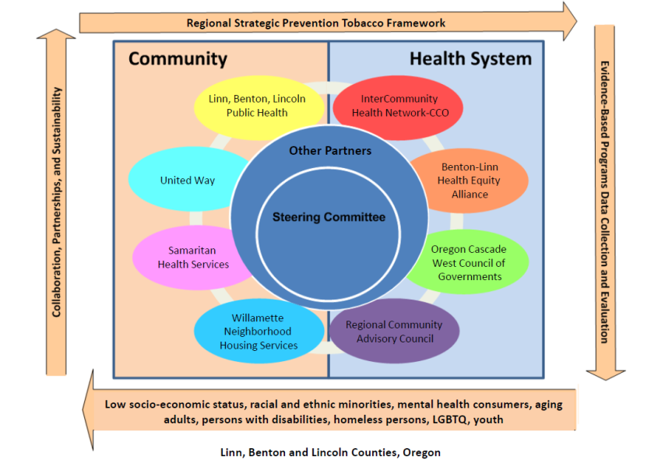
Regional Healthy Communities
Steering Committee (CPP Model)
Notes:
The Steering Committee is made up of the following key partners. Confederated Tribes of the Siletz Indians has also been added to the list of project partners. We did outreach during the grant writing process and they did not have the capacity to participate at that time. We continue to invite them to the table and have left a place holder for them in year 2 & 3 budgets.
IHN-CCO is also the fiscal agent for a regional mental health promotion grant with funding allocated for Linn, Benton, and Lincoln County Health Departments. This model only reflects the CPP portion of the Steering Committee Members.

Slide 11
Portland Metro Tri-County Consortium:
Opiate Safety and Overdose Prevention
Naloxone Distribution: Increase community capacity to reverse opiate overdose through training 2100 needle exchange users and 150 agency staff to administer naloxone.
Community Engagement: With HOPE Coalition (Urban League PDX as lead agency), support overdose prevention and substance abuse training for CHWs and identify opiate overdose education plan engaging communities of color.
Safe prescribing: Health Share Oregon/Healthy Columbia Willamette adopt safe opiate prescribing practices (including prescription monitoring, patient/provider/public education).

Slide 12








How the New World Order Works
Vital statistics birth data review.
Federally qualified health centers pregnant patient chart review.
Public Health (PH)
“We have too many preemies and pre-term labor cases.”
Obstetrics/Gynecology (OB/GYN)
Claims data review for preemie/pre-term labor costs. (CCO)
PH-PCP-OB/GYN steering committee
“All my pregnant patients smoke!”
Primary Care Physicians (PCP)
Nicotine testing & incentive $$ for pregnant smokers

Slide 13
Lane County Public Health &
Trillium Community Health Plan
Tobacco Cessation
  % of prenatal care providers sending fax referrals to the Quitline
  % of pregnant consumers who are using tobacco access cessation services
  % of all women on OHP in Lane County who smoke at any time during their pregnancy
  % of full term births with normal birth weights born to Trillium consumers
Good Behavior Game
  Number of elementary school teachers trained
  % of kids in classrooms with trained teachers

Slide 14
Central Oregon
Quality Indicator:
Inter-organizational relationships, interactions, and practice
Baseline/Target:
Qualitative Interviews with provider/staff
Baseline and Year 1
Measures:
# served (pregnant women, receiving NFP, MCM, CaCoon
# clients screened for depression using EPDS.
# clients screened for substance use
# families referred to medical home
% of women receiving 1st trimester care
% of postpartum OB/GYN check-ups (21-56 days postpartum)
# of pregnant women receiving oral health exam during pregnancy
# of special needs children with dental home

Slide 15
OHA Public Health Division
Currently there are 17 incentive metrics for CCOs
Metrics and Scoring Committee indicated that there was interest in adding one or two measures to the list of metrics for 2015
Public Health measures proposed:
Tobacco use
Obesity
HPV vaccination
Flu vaccination
HIV screening
Teen pregnancy
Committee voted in August to add Tobacco

Slide 16
Working to Improve Public Health Outcomes
Discussion Questions:
  How can local public health strive for better accountability through outcomes?
  How can local public health leverage innovative partnerships for greater public health outcomes?

