Slide 1



Developing the data & evidence for public health services research
& decision-making
Betty Bekemeier
University of Washington School of Nursing
December 18, 2014
OR’s CLHO and partners
Funded by RWJF: Nurse Faculty Scholars Program (RWJF #68042), Public Health
Practice-Based Research Networks (RWJF #69688), and RWJF (#71472)

Slide 2
Outline
What is PHAST?
Highlights of PHAST Findings
MCH & LBW
Food Safety & Enteric Disease
CD Control
Dealing with data
Data harmonization
Standardizing public health services data

Slide 3
PHAST
A data repository
A resource (harmonization, standardization)
A diverse research team
What works?
For what populations?
Under what conditions?
PBRN PHAST Study | A project first funded by The RWJF –Nurse Faculty Scholars Program
Notes:
A) Intro
PHAST: WHAT
A data repository and database available as a resource for a multidisciplinary research team involving practitioners, all aimed at answering the questions,
What works?
For what populations?
Under what conditions?
Increasingly being used by other researchers
It’s development so far has been DEPENDENT on and INTEGRAL to/with PBRNs

Slide 4

Practice-Based Research
PH practice leaders
Academic researchers
Notes:
These were uniquely detailed data we used to be able to get to these findings
Working with these data was possible because of our practice-based research approach
Our studies are conducted through & with PH PBRNs
These PBRNs are sort of a marriage between PH practice leaders & academic researchers
As a researcher, then, I’m committed to answering questions of interest to practice & policy-makers
The question we tackled here really came out of the need for local PH practice partners to have some research evidence regarding the potential impact of major cuts underway to their MCH programs
IMPLICATIONS
So the IMPLICATIONS of our study really supported their sense that these MCH cuts to local PH programs would likely create real burdens for families, communities, & systems
it may not be enough, for example, to transfer these services to some other organization
There’s something in the way that LHDs provide these services that we HAVE to assure does not get lost
…whether it’s LHDs providing them in the long run or not
Because the consequences are potentially very costly—on many levels

Slide 5
A data repository
A Collaborative Process
Practice
Data “owners”
Interested state-wide workgroups
Local knowledge
Priorities for decision-making
Specific data needs
Academia
PHAST database
Data management resources
Analytic expertise
Links to research resources
Facilitating data standardization
Engagement
Notes:
Collaborative Process
Practitioner – had the data; has the workgroups that might be interested in the project
Researcher – has the data compilation and analyses ability; expertise in data display; has the links to other academic resources and national efforts.
Together - iterative analysis and display
Long term engagement
Mutual participation regarding state-wide LHD data collection
Experience with LHD data
Previous studies conducted together
Practitioners reached out to researchers with desire for
data compilation, validation, further analyses
Increasing data “accessibility”
Iterative analysis & display activities

Slide 6

PHAST Finance: Variation in LHD investments relative to need & economic change
A diverse research team

Slide 7

MCH
LHD targeted expenditures: Health outcomes for women and children

Slide 8

MCH
Research Question
Are LHD expenditures on MCH services impacting health outcomes for populations at risk?
Notes:
Are LHD expenditures on MCH services impacting health outcomes for populations at risk?

Slide 9

MCH
MCH Findings/Discussion
LHD MCH expenditures have an independent impact on birth outcomes…especially in areas of high poverty
Despite limited variation & change in the outcome, an effect was detected
Targeted expenditures “impact” more proximal outcomes
Implications
Findings of interest to policy & practice!
Listen to NPR Story!
http://news.wgcu.org/post/study-found-cuts-health-programs-increased-low-birth-weight-rates-florida
Bekemeier, B., Yang, Y., Dunbar, M., Pantazis, A., & Grembowski, D. (2014).
Notes:
LHD expenditures appear to have an independent impact on birth outcomes
This effect varies by population served and appears especially true for those in poverty
Strongest effect was seen in our sample’s poor WA jurisdictions
While significant findings were not seen as consistently in other segments of our sample, we consider it quite noteworthy that we detected significant effects when the variation and change over time in these outcomes was as small and flat as it was
Suggesting that the signal or significance is there, but that it is blocked out to some degree by other “noise” in the model…and particularly in some parts of our sample.
But it seems that the more concentrated the community of need is the better we can pick up the effect (in Rural areas)…this is more diluted in the other counties.
The finding that more Focused expenditures were associated more proximal outcomes really fit too, with what we’d hoped to find
Previous studies have had to look at higher level outcomes such as mortality and use a more blunt level of TOTAL expenditures
Since we had these more detailed, service-specific expenditure data we could look at other, more proximal outcomes to the specific service that LHDs were likely providing
As a result, For example, we found that the more focused the expenditure (e.g. on WIC or FP versus total MCH or on total MCH versus total expenditure) the stronger were our coefficients for the signficant findings
It also follows that we’d see this w/ %LBW, in particular…LBW is a more proximal outcome than IMR…For example, with WIC directly providing good prenatal nutrition and FP services helping promote birth spacing and avert some of the more direct factors that cause LBW
IMPLICATIONS
Reductions in MCH spending by LHDs appears likely to impact birth outcomes
This is of particular importance given our recent previous study that indicated that some of these service expenditures were inversely proportionate with “need”....suggesting that cuts to particularly high-need communities, where these services may prove to provide the greatest good, might be the hardest hit
PBRNs and detailed (often existing!) data are key to advancing PHSSR
Even with 102 LHDs and 6 years of data, the 2 states and their LHDs that we examined only represent a small segment of the range of types of PH systems, funding strategies, and policy approaches to funding and service allocation that exist among our nation’s public health systems
However, with the support of PBRN partners we have studied important, detailed data not previously used for research.
Opportunities exist for expanding this and related research to understand the distribution and contributions of local public health services and to provide effective direction to practice leaders, policy makers, and the public.
Our use of annual, local data available from state level sources also has implications for examining important practice-based research questions.
This type of detailed annual data, being assembled through public health PBRNs and into the PHAST database has the potential to make key contributions to an insufficient evidence base for public health practice leaders and to support difficult programmatic decisions related to how best to reach marginalized populations in need

Slide 10
EH
Environmental
Health

Slide 11



EH
Research Question
Are LHD expenditures on food safety & sanitation impacting enteric disease morbidity?

Slide 12

EH
EH Findings/Discussion
EH expenditures by LHDs consistently in expected, beneficial directions with enteric disease
Significant beneficial relationships between Food Safety & Sanitation expenditures & enteric diseases
Higher LHD Food & Sanitation spending associated with lower incidence of:
Salmonellosis (WA, NY + WA)
Cryptosporidiosis (NY)
Bekemeier, B., Yip, M. P., Dunbar, M., Whitman, G., & Kwan-Gett, T. (2014, under review).
Notes:
With other factors controlled for, enteric disease rates were consistently in expected, beneficial directions across the sample of LHDs in both states.
Preliminary findings from our models suggest a significant beneficial inverse relationship between Food Safety and Sanitation expenditures and rates of selected enteric diseases.
In particular, higher LHD Food and Sanitation spending was significantly associated with a lower incidence of Salmonellosis in WA and NY + WA a lower incidence of Cryptosporidiosis in NY

Slide 13

CD
Communicable Disease

Slide 14
CD
Mean Per Capita CD Control Expenditures by Rural, “Micro,” Metro/Urban
– state 1 – state 2 – state 3 – state 4 --- 4-states combined
Notes:
BETTY
this graph is one of many great examples we have of the staggering diversity among states and LHDs.
Notice
Red state is consistently WAY less than others
Yellow state—tending to have MORE pc spending on CD in rural areas than urban
Green state—the opposite, tending to have MORE pc spending on CD in rural areas than urban
This SHOULD provide lots to look at in terms of how these differences and changes over time impact outcomes

Slide 15

CD Analyses…
CD
Immunizations
Imms Spending & Imms rates for children 0-36 months…
Imms Spending & Pertussis…
MORE data needed
Strong relationships
TB Spending & TB rates…
Very complicated methodologically
CD Control Spending & Enteric Disease…
CD Control Spending & STIs…

Slide 16
PHAST Finance: Implications
Proof of concept
Research-quality data can identify beneficial links between LHD services related health outcomes.
PBRNs add tremendous value to the research
Research like this is critical for practice
Notes:
MARGUERITE
While these individual study findings are really interesting, the take-away for this session that we want to get across today is:
We can inform practice & policy-making w/ this type of PBRN research
This suite of PHAST-Finance studies basically provides a sort of “Proof of concept” that
Research-quality data can identify beneficial links between LHD services related health outcomes.
Important findings for planning & advocacy
Beneficial relationships can be identified between an LHDs’ service-specific expenditures and certain related health outcomes.
This is not easy work and requires a partnership to provide the data, understand it together, and interpret the findings, but we found here that, in this case,
Detailed administrative data can help answer important research questions for practice
All of this is particularly critical in an era where investment is increasingly tied to evidence-based practices and policies
PBRNs also added tremendous value to the research
Assuring that the questions addressed were relevant to practice
It's a partnership whose research can inform the overarching foundational services work being conducted out of the state's public health improvement partnership's agenda for change.
The variation that we see across states also exists locally.
Research like this is critical for practice because…..
We desperately need evidence that what we do matters (and/or that we are doing the things that DO matter)
And when resources become tight, and policymakers and practitioners need to prioritize, having data about what makes a difference is critical.
From our experience in King County, we are continually being asked to justify how taxpayer dollars are being used and what impact do our services make.

Slide 17

PHAST Finance: Implications
Data potential
Detailed administrative data can help answer important research questions for practice.
Data limitations
Inhibit capacity to measure cost, performance, & more outcomes of prevention efforts
Standardized data are needed!!!
Notes:
BARRY
Other implications of this study were mentioned by Betty in terms of the DATA….
She and her team and our PBRN partners reinforced the important POTENTIAL that data like these can hold….
that detailed administrative data that represent changes and variation in service delivery can be used to examine important research questions for practice.
But this was an uphill climb to answer these questions and the data limited them/us to very specific services.
Data Limitations
While this study highlights the potential, it also drove home the NEED to address data limitations for PH practice
The same data that limited what we could have Betty & her team study, also limits what we can use directly in practice for detailed, program-specific PH service-related data to measure the cost, performance, & outcomes of prevention efforts to inform practice and policy-making.
This work underscores the fact that
Standardized data are needed!!!
…data that could then be used to conduct the research we need for practice-evidence
As well as to give us what we need for examining our own output, performance, peer comparisons…..
This need for standardized data has been recognized nationally & described at length in this Institute of Medicine report, saying that this lack of good data has resulted in a very poor understanding of PH services
This leads us to the where we’ve been and are headed w/ regard to developing good data
…data that can help us have some common ground w/ each other…..

Slide 18
A resource (harmonization, standardization)
Public Health
Services Data Standardization

Slide 19
“Big Buckets” of Service Expenditures
Domain/ Sub-domain | FL 2000-10 | WA 1998-2011 | MN 2005-10 | OH 2000-11 | NY 2000-10
EH total | x | x |  | x | x
EH food & sanitation | ? | x |  |  | x
CD total | x | x | x |  | x
CD immunization | x | x |  |  | x
MCH total | x | x |  |  | x
“3 MCH” (WIC, FP, & MICA) | x | x |  |  | x

Slide 20
Data Harmonization of EH Services
FL (Service Code) | NY (Service Code) | WA (Service Code) | MH | OH
limited use public water(57) public water system(58) private water system(59) coastal beach monitoring(47) SUPER Act Services(56) pools/bathing places(60) storage tank compliance service(55) | pub wtr sup prot (19) indiv wtr(37) nyc watershed(57) | drinking water quality(562.52) environmental water quality(562.60) chemical & physical (562.57) | tot_eh | Local eh State eh Federal eh
solid waste disposal service(63) individual sewage(61) public sewage(62) biomedical waste services(64) water pollution(70) | indiv wtr sewage(23) indiv sewage(38) reality subdiv(22) DEC programs (56) | solid & hazard waste(562.53) OSS & land development(562.54)
rabies surveillance(66) arbovirus surveillance(67) rodent/arthropod control(68) | cd_rabies(11.1) emergency vector(50) vector sc gphw(28) cd_vector sc(11.2) cd_arthropod vector(11.3) cha vector sc(17.1) he vector sc(16.1) mosq vect cont(46) | vector(562.55)
occupational health services/ tattoo facility services(44) community EH project(45) lead monitoring service(50) sanitary nuisance(65) tanning facility service(69) air pollution(71) radiological health(72) toxic substances(73) | EH hlth assess(25) kead poisoning(4) nuisances(24) env radiation prot(20) radioactive matter(33) radiation equip(34) | environmental health-other(562.59)
body art(49) group care facilities(51) housing & pub bldg(53) mobile home & park(54) | comm sanit food (21) housing hygiene(35) | living environment(562.58)
food hygiene(48) | comm sanit food(21) | food(562.56)
general EH services(75) gen enviro. engineering service: water, sewage & pollution(76) EH surcharge(115) | other env serv(36)
Notes:
WHAT it takes to get to harmonizing these existing administrative data!

Slide 21
WA
Notes:
Total_EH
4.55E+07(2000)
4.85E+07(2001)
4.91E+07(2002)
5.00E+07(2003)
5.36E+07(2004)
5.68E+07(2005)
6.22E+07(2006)
6.73E+07(2007)
6.97E+07(2008)
6.72E+07(2009)
6.32E+07 (2010)

Slide 22
Share of Local, State, and Federal Funding for LHJs: Comparing Seattle-King County to the Other 34 LHDs in Washington State (inflation-adjusted 2010 dollars)
Seattle King-County
The Other 34 LHJs

Slide 23
Public Health Service Data
No standardized data collection or reporting
Resulting in poor understanding of PH services
Tremendous need for systems to measure contributions of public health agencies
Notes:
There are "Flaws in Current System"

Slide 24
PHAST “1.0” | PHAST “2.0”
existing data | prospective data
harmonization | standardization
compare few states | compare many states
compare few measures | compare many measures
Notes:
Facilitating Standardization of PH Service Data Collection
Working from original MPROVE measures
Support states interested in service data collection
Refine measures, as needed
Assure relevance for
Accreditation,
Advocacy,
Data-driven decision-making,
Demonstrating use of resources
Other??

Slide 25
Multi-Network Practice and Outcome
Variation Examination Study (MPROVE)
A 6-state RWJF study managed by U. KY.
Betty and Barry co-PIs for WA.
Identified service delivery measures for selected, high-value PH services
Created a registry of measures collected consistently across local communities
Profiling geographic variation in the delivery of selected PH services across communities
Examining associations among services & outcomes
Prove the concept of a multi-state (eventually national) activities & services data system.
(Glen P. Mays,6-27-2012).
Notes:
BARRY
Our work w/ that A&S Inventory has been actually rather unique nationally
But there’s been a growing need nationally and among other states for something just like this
...this need resulted in the MPROVE study led by Glen Mays out of the Univ of KY
MPROVE involved 6 state PBRNs (WA, CO, NJ, FL, MN, TN), of which WA was one
The work we did together over 2012-13 was a rather laborious process in which practice and research partners came up w/ a mutually agreed upon set of measures in 3 domains (CD Control, EH, and Chronic Disease) that fit an agreed-upon set of high value criteria
This slide outlines the process, but this is still ongoing in many ways
1) The work we did in 2012/13…
Identified service delivery measures for selected, high-value PH services
2) Then we all collected these measures across our states in 2013 to
Create a data set that we can use here in WA and across these 6 states now
The idea was (and is) to create a registry of measures collected consistently across local communities
THIS is still evolving
3) Ultimately this registry for states can
Profile geographic variation in the delivery of selected PH services across communities
Help us all to see variation relative to components such as:
– need-sensitive or preference-sensitive factors
– supply-sensitive factors
Examine associations between services & outcomes
In the case of our A&S Inventory, we already have collected SOME of these items for a few years now

Slide 26
MRPOVE Measures
Incorporating MPROVE measures
Created by rigorous expert process
PH practitioners & researchers
Measure core/foundational PH services
EH, CD Control, Chronic Disease
Intended to detect practice variation
1st round of data collected in 6 states in 2013

Slide 27
Notes:
BARRY

Slide 28
Food service establishments inspected in 2012
per Food Safety FTE in State X
Local Health Departments

Slide 29
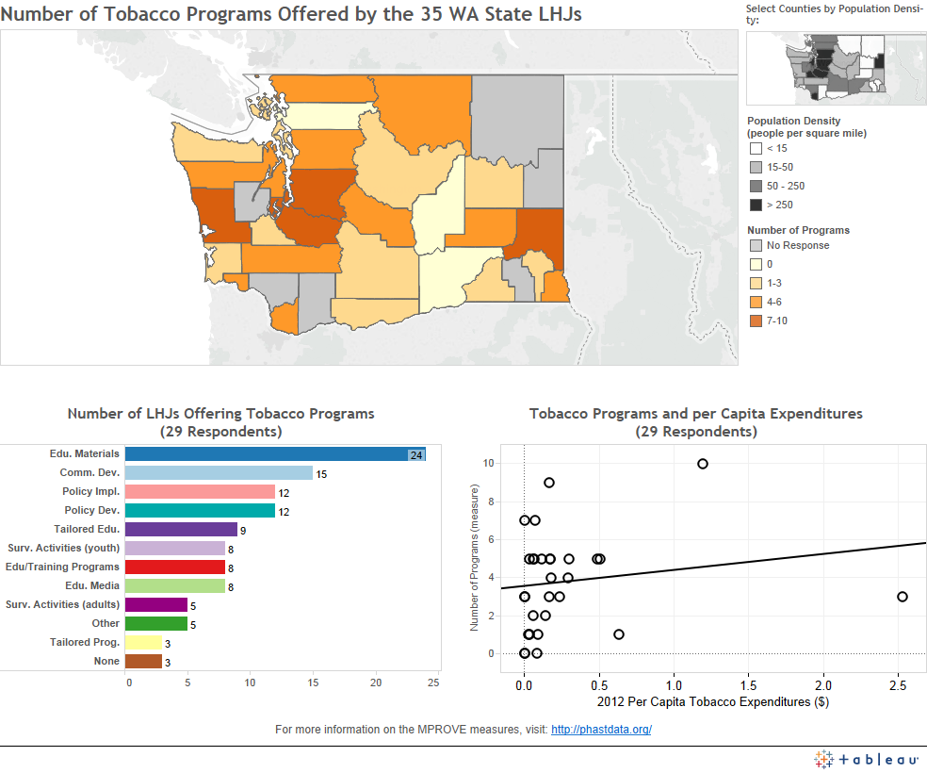
WA MPROVE Visualizations
Notes:
BETTY
Refining the MPROVE measures
Working from original MPROVE measures
Determine what worked & what didn’t…& WHY
Identify adaptations to be made
How?
Examination of 6-state dataset for completeness, face validity
Interviews with MPROVE PBRN investigators
Ongoing review by Data Governance Board
Preliminary results
Not enough time/resources built in to original MPROVE grants to assure completeness, examine data
Too many measures, not enough rationale for effort required
Lots of interest in refining measures and improving process
Link for the gallery is https://public.tableausoftware.com/profile/jyoung#!/

Slide 30
Example: Summary of MPROVE Measures for CD Control
% of children fully vaccinated upon entering kindergarten (outcome)
# of immunizations administered by LHD to children age 0-5, and age 6-18
# of confirmed cases, with vaccine status, for vaccine-preventable diseases
# of reported & confirmed cases of selected enteric diseases
# of investigations of reported foodborne/enteric disease cases conducted by LHD (service delivery)
Ave. time from receipt of reported case of enteric disease to completion of case investigation (quality)
# confirmed cases of and contacts followed for STIs
For TB:
# of reported cases
# of unduplicated clients that were provided active contact screening services by the LHD
% of cases that were placed on directly observed therapy
% of contacts with newly-diagnosed latent infection who started treatment
% of contacts with newly-diagnosed latent infection who completed treatment
Staffing level -- # of current LHD FTEs for disease intervention
Notes:
this is a concise summary for one of the domains of PHAST 2.0 measures
NOTE: the TIME INTERVAL for many of these measures is "for the past 12 months"

Slide 31
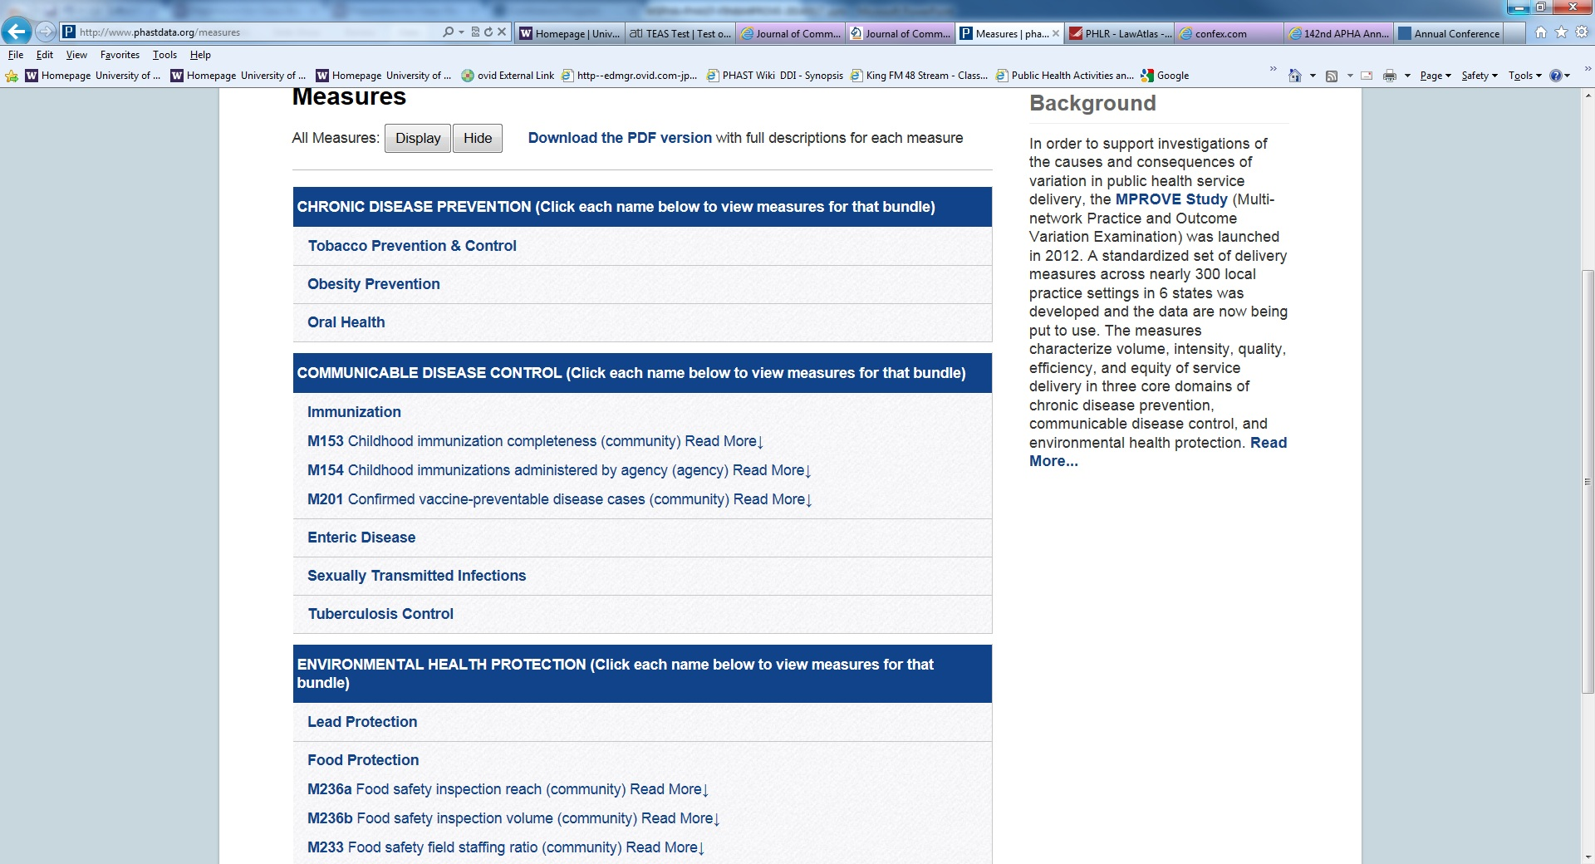
www.phastdata.org
Notes:
BETTY

Slide 32
More to come…..
Cross-Jurisdictional Sharing
Does it influence volume, intensity, & unit cost of services?
If so, under what conditions?
MCH
Learning from LHDs with better-than-expected MCH outcomes (“positive deviants”)
Pending…LHDs & disparities
The influence of LHDs & related partners on reducing disparities in STIs, birth outcomes

Slide 33
PHAST Papers
Bekemeier, B., Yip, M. P., Dunbar, M., Whitman, G., & Kwan-Gett, T. (2014, under review). Local Health Department Food Safety and Sanitation Expenditures and Reductions in Enteric Disease.
Bekemeier, B., Pantazis, A., Dunbar, M., & Herting, J. R. (2014, in press). Using available data to classify local health department approaches to service.
Bekemeier, B., Yang, Y., Dunbar, M., Pantazis, A., & Grembowski, D. (2014). Targeted Health Department Expenditures Benefit Birth Outcomes at the County Level, American Journal of Preventive Medicine, 44(6), 569-577.
Klaiman, T., Pantazis, A., & Bekemeier, B. (2014). A Method for Identifying Positive Deviant Local Health Departments in Maternal and Child Health. Frontiers in Public Health Services and Systems Research, 3(2), Article 5. http://uknowledge.uky.edu/frontiersinphssr/vol3/iss2/5
Bekemeier, B. (2012). Tracking local public health services to inform decision making. Northwest Public Health, Spring/Summer 29(1),14-16. http://www.nwpublichealth.org/archives/s2012/tracking-local-public-health-services-to-inform-decision-making.
Bekemeier, B., Bryan, M., Dunbar, M., & Fowler, C. (2012). Local health department provision of WIC Services relative to local “need”— examining 3 states and 5 years. Frontiers in Public Health Services and Systems Research, 1(1), Article 2. http://uknowledge.uky.edu/frontiersinphssr/vol1/iss1/2
Bekemeier, B., Dunbar, M., Bryan, M., & Morris, M. (2012). Local health departments and specific Maternal and Child Health expenditures: Relationships between spending and need. Journal of Public Health Management and Practice, 18(6), 615-622.
www.PHASTdata.org

Slide 34

THANK YOU!
Thank You
The Robert Wood Johnson Foundation
…and PBRN Colleagues!!
Great teams have the
“right people on the bus.”
(Jim Collins, Good to Great, 2001)

