Slide 1



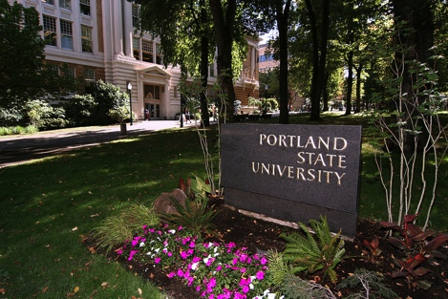

Update on the
OHSU-PSU School of Public Health (SPH) Initiative
CLHO Presentation
12/18/2014

Slide 2
Why a School of Public Health (SPH) in the metro area & why now?
The collaboration between OHSU and PSU
Steps & timeline
Interim leadership of the SPH Initiative
Questions?

Slide 3
Oregon MPH Program (OMPH):
Brief Overview of a Long History
1994 - Oregon MPH Program began accepting students
    A unique 3 university collaboration (Oregon State, OHSU & Portland State) since no single institution composed the “whole” for accreditation
    A strong 21-year history, resulting in 3 successful accreditations.
2010 - OSU began development of a School of Public Health
2011 - OHSU & PSU Presidents shared vision for a metro area SPH
2014 – OSU accreditation for SPH
- OHSU/PSU accreditation for the Oregon MPH program
*******************
1,075 MPH degrees granted across PSU & OHSU
  About 50 full time faculty involved at both institutions
  Affiliated faculty greatly enhance student, research, & practice opportunities

Slide 4
What Value Does a School of Public Health in the Metro area add?
Adds capacity to workforce development in the Southern Washington & Oregon metro area (BA, MPH, PhD)
Expands academic-research partnerships with Governmental Public Health, and with other community partners
Addresses the diversity of population & public health needs in the state’s largest urban/rural area
Provides unique university partnerships leveraging the experience & strength of a clinically focused & a community focused academic systems

Slide 5
What Value Does a School of Public Health in the Metro area add?
Builds capacity for broad funding portfolios in public health with regional, state & national partners
Sustains & build our governmental & community relationships allowing for broad & varied student opportunities and employment
Reinforces the national reputation for innovative progressive models that Portland enjoys across government, academic, industry, public & private sectors

Slide 6
Why NOW?
OHSU & PSU Presidents’ Initiatives investing in training & research capacity
  The Collaborative Life Sciences Building (CLSB) on waterfront
  SPHs attract additional revenue nationally, e.g., workforce development, training, & research center funding
  Encourage population & public health units to collaborate
  The OMPH program & its collective research environment
  is larger than the typical MPH program
  is equal to a mid-size school of public health
Recent strong & successful accreditation from CEPH (Council on Education in Public Health):
  full 7 years accreditation, 2014 through 2021

Slide 7
The OHSU/PSU Programs in
The SPH Initiative
6 MPH Programs
Primary Health Care & Health Disparities
(Online)
Health Management & Policy
Health Promotion
Epidemiology
Biostatistics
Environmental Systems & Human Health
Certificate in Public Health
(Online)
3 PhD Programs
Epidemiology
Community Health
Health Systems & Policy

Slide 8
Additional Features of our Education Programs
Undergraduate medical students
Dual degrees, not offered at any other Oregon university or partnership:
  MD/MPH (OHSU)
  MPH/MSW (PSU)
  MPH/MURP (PSU)
  MD/PhD (OHSU & PSU)

Slide 9
OHSU-PSU School of Public Health Timeline & Hallmarks
OUS Approves Epidemiology, Health Systems & Policy, & Community Health PhD programs
Submit draft
self-study
December 2015
September 2013
CEPH
Accreditation Decision
Develop collaborative SPH based on OMPH
Develop initial 3 PhD programs for
OHSU-PSU SPH
Interim SPH
Dean appointed
November 2016
May 2010
December 2012
May 2014
2010
2011
2012
2013
2014
2015
2016
2016
May 2011
May 2013
April 2015
Brainstorming & workgroups
OMPH accreditation self-study submitted to CEPH
Application to CEPH for SPH accreditation
June 2012
July 2015
Planning Meetings
Steering Committee launched
Applicant status OHSU-PSU SPH Opens
June 2014
March 2016
National search for
SPH Founding Dean
OHSU-PSU combined 6 MPH degree programs offered through OMPH
Funding Efforts

Slide 10
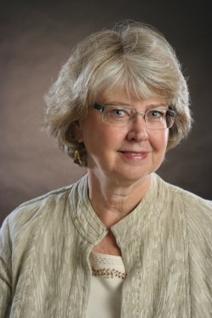
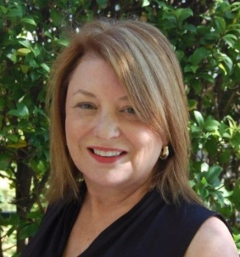

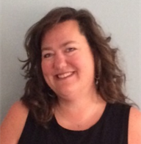
Interim Leadership
Elena
Andresen, PhD Interim Dean
Katherine
Bradley, PhD, RN, Assoc. Dean for Practice
Nancy
Goldschmidt
PhD, Asst. Dean Accreditation
Leslie
McBride, PhD, Assoc. Dean Academic Affairs
Alison Schneiger, BS, Program Coordinator
Notes:
Four people who are critical to the success of our program, the members of the Deans Oversight Council (the ultimate governing body of our program)
Gail Houck – OHSU SoN
Ed Keenan – OHSU SoM
Craig Wollner – PSU College of Urban and Public Affairs
Jeff McCubbin – OSU College of Health and Human Sciences

Slide 11

Questions
For additional information:
Elena Andresen
503-494-8078
andresee@ohsu.edu
Katherine Bradley
503-494-1137
bradleyk@ohsu.edu
Dean’s Office
Gaines Hall @ OHSU
840 SW Gaines St., Room 227
Our website: www.ohsu.edu/psu-psu-publichealth

