Slide 1
public health in oregon
Presentation by
Morgan D. Cowling, CLHO Executive Director
Muriel DeLaVergne-Brown, CLHO Chair
September 17th, 2014

Slide 2
Highlights:
Oregon State-Local System of Public Health
About the Conference of Local Health Officials
About the Coalition of Local Health Officials
Moving Forward –
Public Health Issues,
Opportunities and Challenges

Slide 3
State-Local System of Public Health
Public Health systems are primarily governmental
Public Health in Oregon is decentralized
Centers for Disease Control and Prevention is the lead federal agency
Oregon Health Authority – state agency
34 local health departments across Oregon (one district – North Central Public Health District)

Slide 4
Oregon Health Authority – Org Chart

Slide 5
Conference of Local Health Officials
Shared governance between the local health officials and the state public health division
ORS 431.330 Conference of Local Health Officials is created. (1) The Conference shall consist of all local health officers and public health administrators, appointed pursuant to ORS 431.418 and such other local health personnel as may be included by the rules of the conference.

Slide 6
Conference of Local Health Officials Scope and Duties
Make Recommendations on funding distribution formulas
Make recommendations on program elements
Set minimum standards for local public health
Minimum standards including education requirements for public health administrators, registered environmental health specialists, health officers, and public health nursing supervisors

Slide 7
CLHO Funding Formula
ORS 431.380 –
From funds available to the Oregon Health Authority for local public health purposes, regardless of the source, the Authority shall provide payments to the local public health authority on a per capita or other equitable formula basis to be used for public health services. Funding formulas shall be determined by the department with the concurrence of the Conference of Local Health Officials.

Slide 8
Conference Structure
The Conference functions through committees:
CLHO Communicable Disease
CLHO Healthy Families
CLHO Healthy Communities
CLHO Information Management
CLHO Healthy Structure (internal public health structure)
CLHO Health System Transformation
Recommendations from Committees on policy or budget issues must go to the full CLHO Board for discussion and approval.

Slide 9
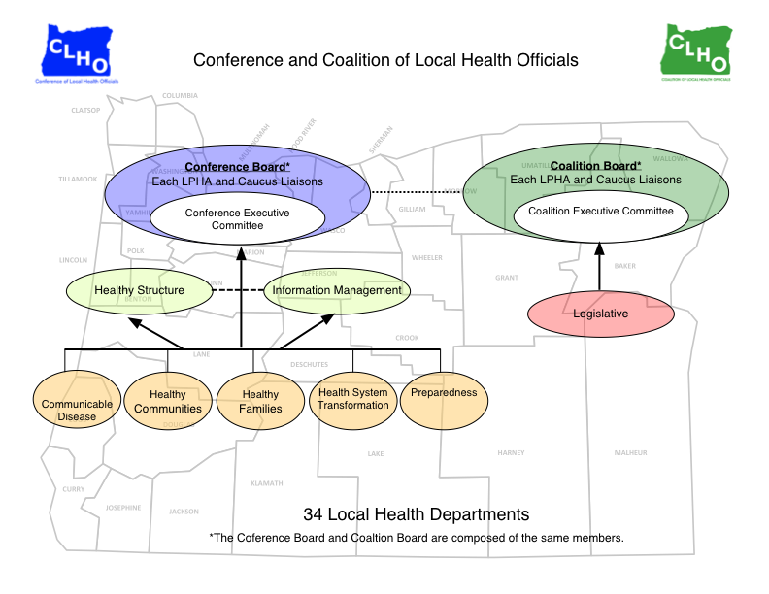

Slide 10
Coalition of Local Health Officials (the other CLHO)
Workforce development and technical assistance and training
Advocacy and representation before boards, commissions and the legislature
Support for public health administrators
Work to generate funding opportunities for the whole system of public health through the legislature and private funding sources

Slide 11
Coalition’s 2015 Legislative Agenda
Local Public Health Authority/Future of Public Health Taskforce
E-cigarettes
Public Health impacts of recreational-use marijuana legalization

Slide 12
Emerging Public Health Issues, Opportunities and Challenges
Future of Public Health Taskforce: Recommendations and Legislation
National movement toward the accreditation of local health departments
State Health System Transformation

Slide 13
Accreditation of Local Health Departments in Oregon

Slide 14

Future of Public Health Taskforce
The Conceptual Framework
The Implementation Proposal
Operationalizing the Framework
Next Steps

Slide 15
Health System Transformation
HB 3650 (2011) and SB 1580 (2012) created Oregon’s system of Health System Transformation – Coordinated Care Organizations (CCOs)
Local Health Departments are working with CCO’s throughout the state in different capacities.
HB 3650 requires agreements between local public health and CCOs for “point of contact” services including immunizations, communicable disease, sexually transmitted infections etc
SB 1580 defines the duties of the Community Advisory Committee to advocate for preventative care and oversee a Community Health Assessment and Community Health Improvement Plan
This is a great place for collaboration between local public health and CCOs
Health Department staff throughout the state are working with CAC’s
SB 1580 also allows for the sharing of protected public health information with public health entities for public health oversight purposes

Slide 16
Health System Transformation cont.
Public health interventions can help CCOs meet their metrics and outcomes
Public health and CCO partnerships are continuing to develop. Here are a few examples:
Community Advisory Council staff support by LHD
New models of care for maternal and child health for CCO patients
Joint Community Health Assessments focused on larger population health
Tobacco prevention expertise to Medicaid population – SIM grants
Coordination of Quality Metrics

Slide 17
Conclusions – Questions?
Oregon’s Public Health landscape is changing and we have to be ready to step up to the challenge to improve Public Health in Oregon.

